Slide 1
Foundations in Biology
Block 1A – 2.5 Biological membranes
Fluid mosaic model

Slide 2
Spec

Slide 3
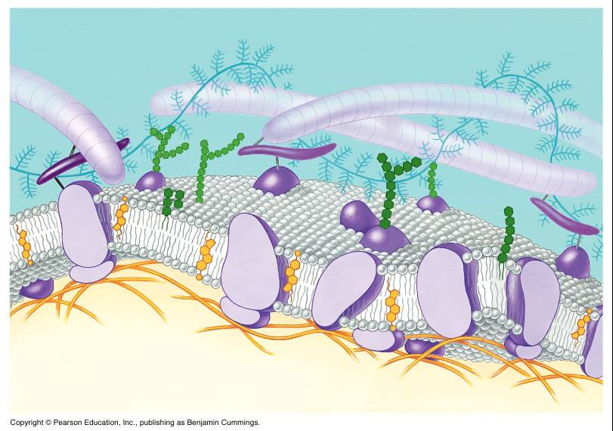
The Fluid Mosaic model
Learning Objectives
Success Criteria
Describe the structure and function of the cell membrane
Label the fluid mosaic model (Grade E)
Describe the functions of the following components of the plasma membrane (Grade C)
Explain the roles of the components in the plasma membrane (Grade A)

Slide 4
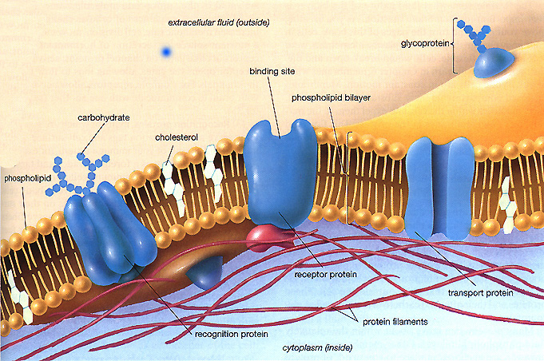
Memory Game – try and draw this in as much detail as possible

Slide 5
Cells have many membranes:
plasma membrane
tonoplast
outer mitochondrial membrane
inner mitochondrial membrane
outer chloroplast membrane
nuclear envelope

Slide 6
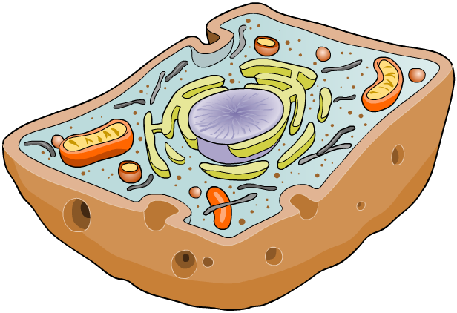

What are membranes?
Membranes cover the surface of every cell, and also surround most organelles within cells. They have a number of
functions, such as: (In pairs answers on a post it)
Divides the cell into different compartments. Making different functions more efficient
allowing selected molecules to move in and out of the cell - partially permeable (lets some molecules through but not others)
isolating organelles from the rest of the cytoplasm, allowing cellular processes to occur separately.
a site for biochemical reactions – may hold enzymes or ribosomes
Cell recognition and cell signalling
allowing a cell to change shape.

Slide 7
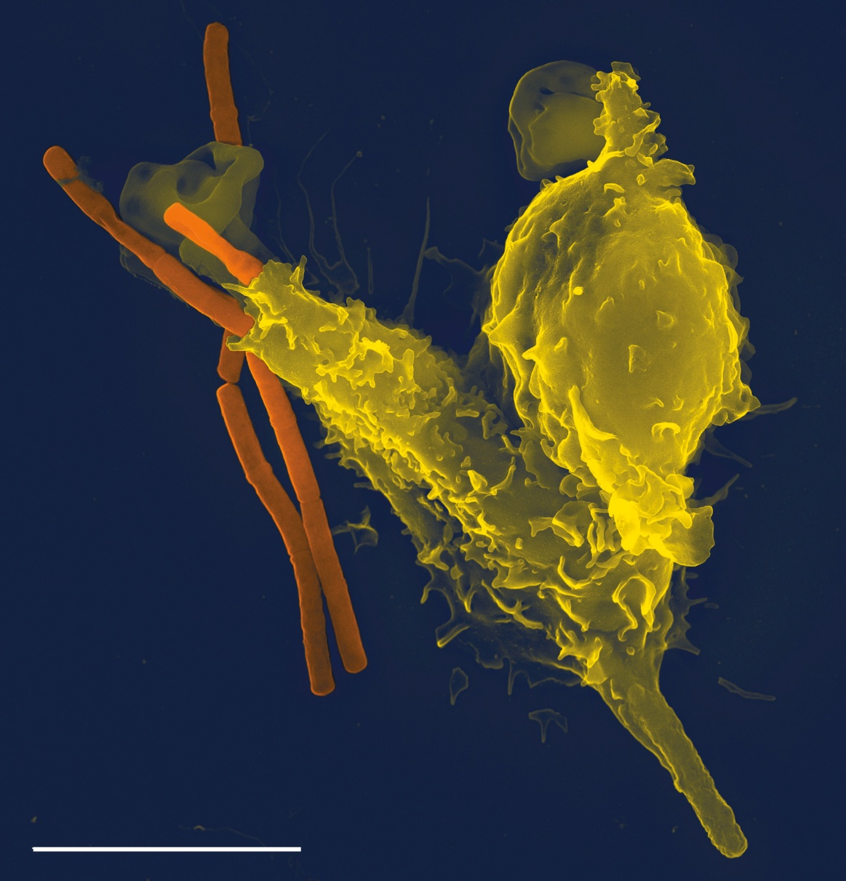
Membranes are flexible and able to break and fuse easily
Neutrophil engulfing anthrax bacteria.
Cover credit:
Micrograph by Volker Brinkmann, PLoS Pathogens Vol. 1(3) Nov. 2005.
5 μm

Slide 8
Membranes allow cellular compartments to have different conditions
pH 4.8
Contains digestive enzymes, optimum pH 4.5 - 4.8
lysosome
Membrane acts as
a barrier
pH 7.2
cytosol

Slide 9
Membranes are mainly made of phospholipids
phosphate group
hydrophilic
head
phosphoester bond
glycerol
ester bond
fatty acid
hydrophobic
tail

Slide 10
The polar hydrophilic heads are water soluble and the hydrophobic heads are water insoluble
Hydrophobic (water-hating) tail
air
aqueous solution
Hydrophilic (water-loving) head
Phospholipids form micelles when submerged in water

Slide 11
Question: Explain why phospholipids form a bilayer in plasma membranes (4).
Click to reveal answers
Phospholipids have a polar phosphate group which are hydrophilic and will face the aqueous solutions
The fatty acid tails are non-polar and will move away from an aqueous environment
As both tissue fluid and cytoplasm is aqueous
phospholipids form two layers with the hydrophobic tails facing inward
and phosphate groups outwards interacting with the aqueous environment
Click here to hide answers

Slide 12
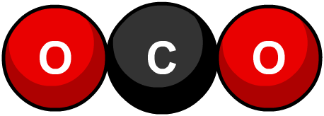
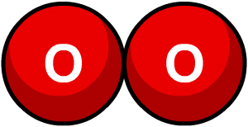
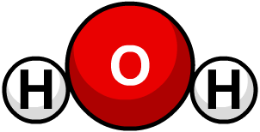
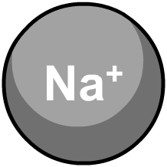
Phospholipids in membranes
The role of phospholipids in membranes is to act as a barrier to most substances, helping control what enters/exits the cell.
Generally, the smaller and less polar a molecule, the easier and faster it will diffuse across a cell membrane.
Small, non-polar molecules such as oxygen and carbon dioxide rapidly diffuse across a membrane.
Small, polar molecules, such as water and urea, also diffuse across, but much more slowly.
Charged particles (ions) are unlikely to diffuse across a membrane, even if they are very small.
Notes:
Teacher notes
See the ‘Transport Across Membranes’ presentation for more information about diffusion.

Slide 13
The fluid mosaic model of the plasma membrane:
Lipid molecules give fluidity and proteins give the membrane a mosaic (patchwork ) appearance. The molecules can move about.
The proteins can move freely through the lipid bilayer.
The ease with which they do this is dependent on the number of phospholipids with unsaturated fatty acids in the phospholipids.

Slide 14



Plasma membrane
TASK – Using page 129 label the cell

Slide 15
The membrane contains many types of protein:
carbohydrate chain
Glycocalyx: For cell recognition so cells group together to form tissues
Receptor: for recognition by hormones
glycoprotein
Enzyme or signalling protein
integral protein
carrier protein
extrinsic protein
hydrophilic channel

Slide 16
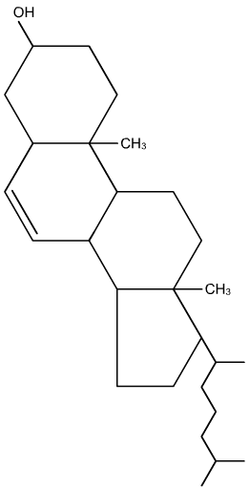
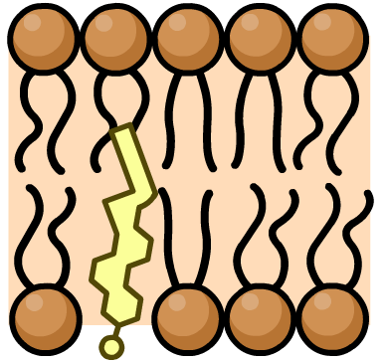
Cholesterol in cell membranes
Cholesterol is a type of lipid with the molecular formula C₂₇H₄₆O.
Cholesterol is very important in controlling membrane fluidity. It binds to hydrophobic tails of the phospholipids, packing them more closely together. The more cholesterol, the less fluid (more stable) – and the less permeable – the membrane.
Cholesterol is also important in keeping membranes stable at normal body temperature – without it, cells would burst open.

Slide 17

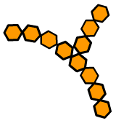
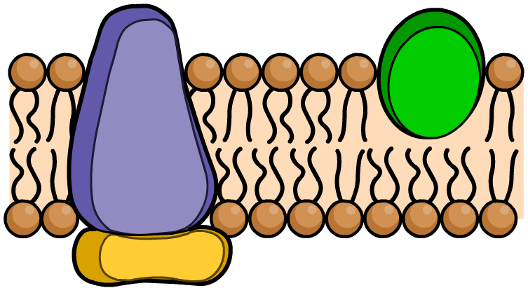
Proteins in membranes
Proteins typically make up 45% by mass of a cell membrane, but this can vary from 25% to 75% depending on the cell type.
Integral (or intrinsic, or transmembrane) proteins span the whole width of the membrane.
carbohydrate chain
integral protein
Peripheral (or extrinsic) proteins are confined to the inner or outer surface of the membrane.
peripheral protein
Many proteins are glycoproteins –
proteins with attached carbohydrate chains.
Notes:
Teacher notes
See the ‘Biological Molecules: Proteins and Lipids’ presentation for more information about proteins.
See the ‘Transport Across Membranes’ presentation for more information about carrier molecules and channels.
Proteins typically make up around 45% by mass of a cell membrane, but this can vary widely depending on the cell type. Students could be asked to discuss the nature of cell membrane proteins in terms of regions of polarity and non-polarity. For example, would the part of an integral protein embedded in the membrane be polar or non-polar?

Slide 18
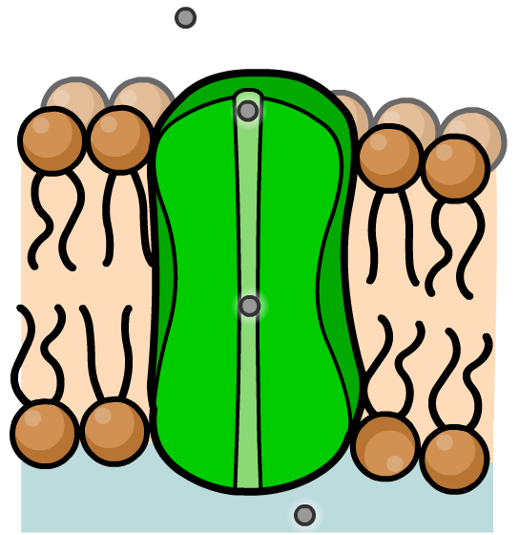
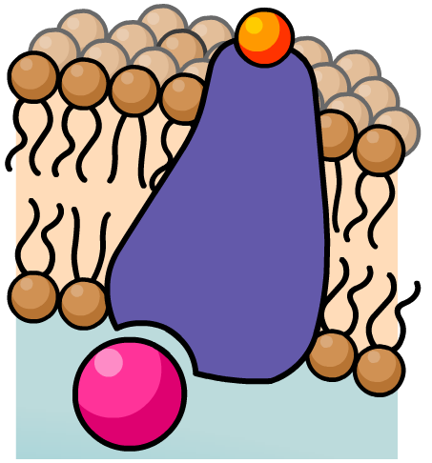
Integral proteins
Many integral proteins are carrier proteins or channels.
These help transport substances, such as ions, sugars and amino acids, that cannot diffuse across the membrane but are still vital to a cell’s functioning.
Other integral proteins are receptors for hormones and neurotransmitters, or enzymes for catalyzing reactions.

Slide 19
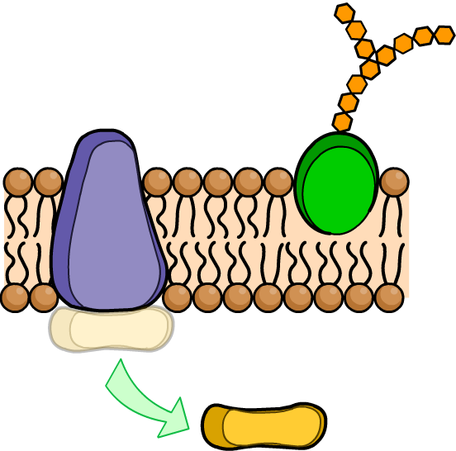
Extrinsic proteins
Extrinsic (or Peripheral) proteins may be free on the membrane surface or bound to an intrinsic (or integral) protein.
Extrinsic proteins on the extracellular side of the membrane act as receptors for hormones or neurotransmitters, or are involved in cell recognition. Many are glycoproteins. (carbohydrates attached to lipids)
Extrinsic proteins on the cytosolic side of the membrane are involved in cell signalling or chemical reactions. They can dissociate from the membrane and move into the cytoplasm.

Slide 20
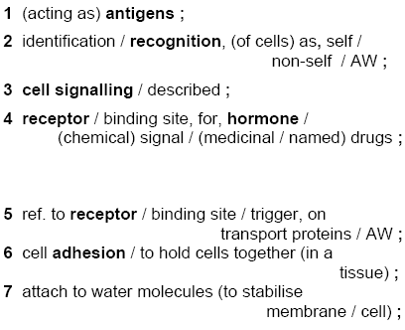
Functions of glycoproteins

Slide 21
Complete the worksheet
Ensure you are aware of all the functions of the membrane components
Highlight any structure-function relationships
Give at least 3 examples of cells that have a membrane that doesn’t follow the normal membrane composition (page 129-130 – help)
Notes:
P59-60 Biozone

Slide 22

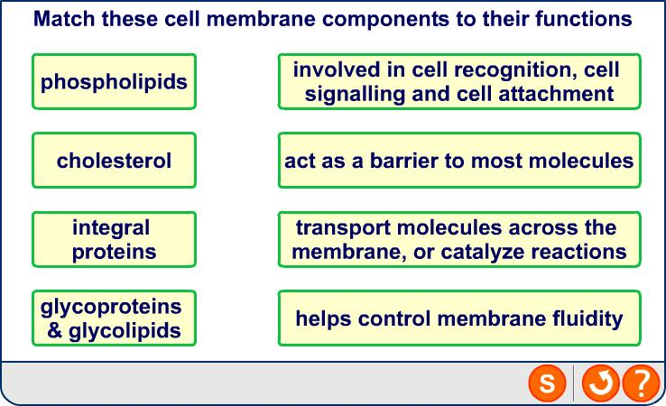
Functions of membrane components

Slide 23
Question: Label the diagram (11marks)
1
4
Note: label the proteins based on location or structure, e.g. you do not need to identify receptors and enzymes.
5
6
3
2
7
10
9
11
8
1) carbohydrate; 2) glycoprotein; 3)integral protein; 4) extrinsic protein; 5) carrier protein 6) hydrophilic channel; 7) phosphate group; 8) fatty acid; 9) phospholipid;
10) glycocalyx; 11) phospholipid bilayer click to cover answers
Click to reveal answers

Slide 24
Quick questions
What is meant by ‘partially permeable’, with regard to membranes?
Explain the meaning of hydrophilic and hydrophobic
Explain why the membrane is an effective barrier against water soluble molecules.
Allows certain molecules through
but not others
‘attracts water’ and ’repels water’
The centre of the membrane is hydrophobic.

Slide 25
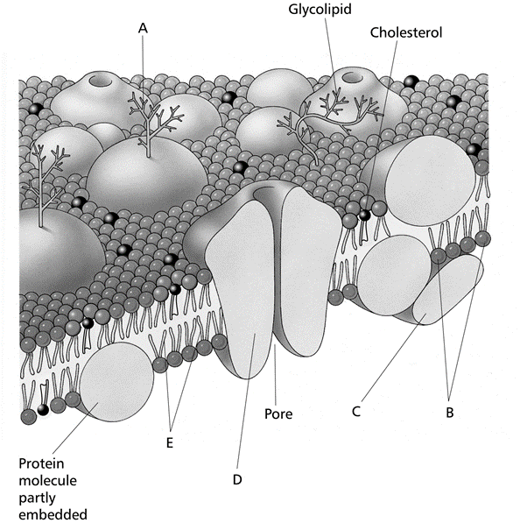
Label each cell membrane component A - E
Plenary

