Slide 1
Module 5 Communication, homeostasis & energy
Block 2C – 5.5 Animal responses
5.5.7 The reflex

Slide 2
Spec

Slide 3
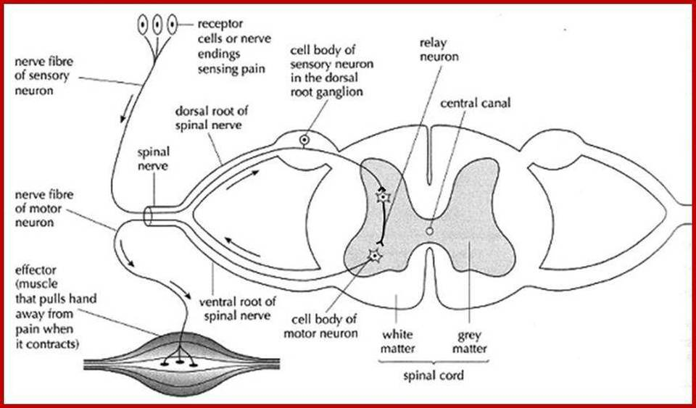
Describe what is happening where…..

Slide 4
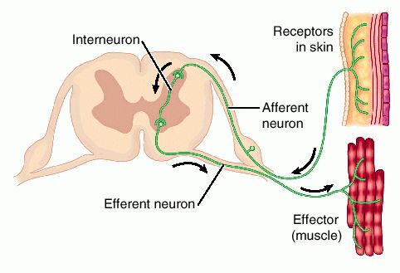

Slide 5
Learning Outcomes
To know what a reflex action is (Grade E)
To describe reflex actions include knee jerk reflex and blinking reflex
(Grade C)
Explain why and how reflex actions are associated with survival (Grade A)

Slide 6
Reflex actions
A response that doe not involve any processing by the brain, this makes it a rapid response
It involves 3 neurones - sensory, relay and motor neurone
The brain may be informed that the reflex has happened
Automatic and rapid responses such as these have a survival value

Slide 7
What is the sequence of 5 events that occur in any reflex action (3 marks)
Stimulus → receptor → coordinator → effector → response

Slide 8
Categorising reflexes
Knee jerk reflex is a spinal reflex.
Important in coordinated movement and balance
The pathway consists of only two neurones: sensory and motor neurone.
There is no relay or interneurone.
This means that there is only ONE synapse – therefore it is a very fast response.
This also means that because there is no relay neurone – the brain cannot inhibit the reflex - (the inhibition would have to be provided by inhibitory synapses before the motor neurone is depolarised).
The pain withdrawal reflex is a multisynaptic spinal reflex
Notes:
Spinal reflex – passes through the spinal cord and not the brain

Slide 9
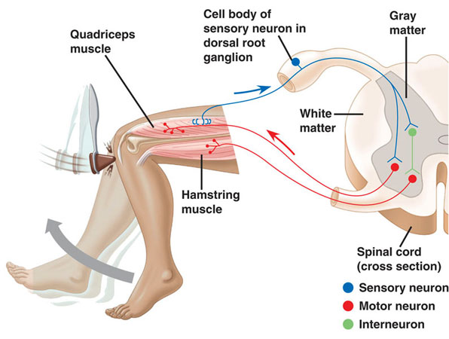
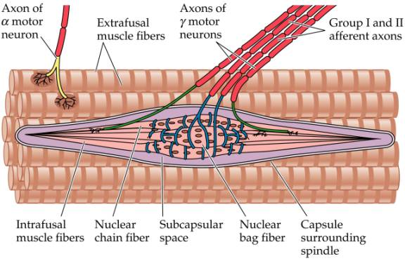
The knee jerk Reflex
Simplest spinal reflex
The quadriceps muscle contracts to straighten the leg, its attached to the lower leg bones at the front of the knee by the patella tendons
Muscle spindles lie parallel to the muscle fibre. They are sensitive to changes in muscle length.
Responds to changes in length by sending a message to the spinal cord

Slide 10
Describe the processes occurring in a knee jerk action (3 marks)
1. Stimulus — stretching of quadriceps muscle tendon.
2. Stretch receptor in quadriceps generates an nerve impulse
3. impulse is sent down sensory neurones in the upper leg towards the spinal cord
4. connect directly with motor neurone in spinal cord
5. motor neurone carries nerve impulse to the effector, thigh muscle causing contraction.

Slide 11
Proprioceptors and the Control of Movement
Proprioceptors – specialized receptors found in tendons, muscles, and joints
Provide sensory information about the state of muscle contraction, the position of limbs, and body posture and balance
This feedback is provided primarily by afferent (sensory) input from two sensory receptors:
tendon organs and muscle spindles

Slide 12
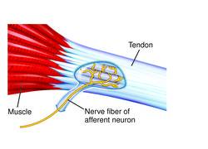
Golgi Tendon Organs (Tension Reflex)‏
Sensory receptors that terminate where tendons joint to muscle fibres
Since they are aligned with muscle, any stretching of the muscle also stretches the GTO
The job of GTO is to detect increased tension exerted on the tendon
When a change in tension is detected an impulse is sent along afferent (sensory) neurons to the CNS
The efferent (motor) neurons transmit an impulse causing the muscle to relax
This prevents injury

Slide 13
Describe the processes occurring in a knee jerk action (3 marks)
1. Stimulus — stretching of quadriceps muscle tendon.
2. Stretch receptor in quadriceps generates an nerve impulse
3. impulse is sent down sensory (afferent)neurones in the upper leg towards the spinal cord
4. connect directly with motor (efferent) neurone in spinal cord
5. motor neurone carries nerve impulse to the effector, thigh muscle causing contraction.

Slide 14
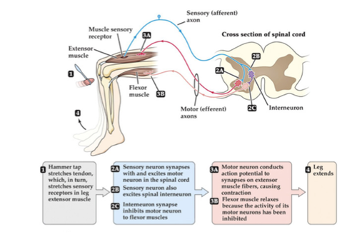

Slide 16
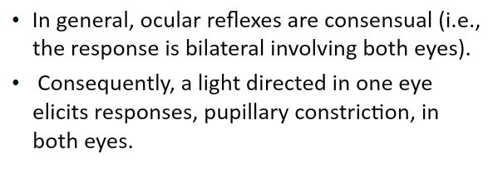
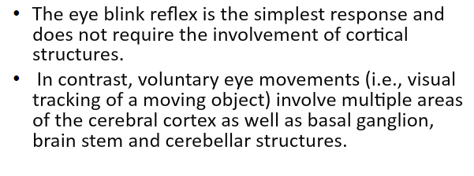

Slide 18
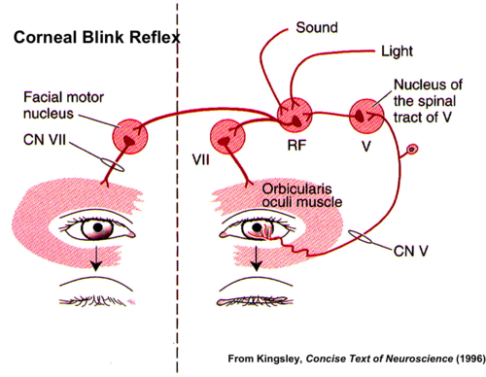
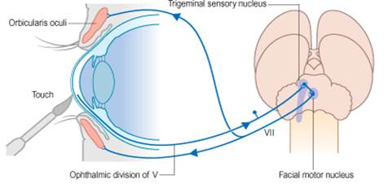
Categorising reflexes
The blink reflex is a cranial reflex. It is a reflex arc because the receptor and effector are in the same place.
The corneal reflex – stimulated by touching the cornea – has two synapses and so can be overridden by inhibitory signals from the cerebral cortex.
Notes:
Blink = temp closure of eyelids to protect eyes from damage. Cranial – passes through the brain, but does not involve any thought processes
Corneal = sensory neurone from cornea enters the pons. Sensory-rely-motor (passes to the facial muscle= blink) RAPID RESPONSE
Sensory Aps along myelinated neurones in the pons to the cerebral cortex, so it can be overiden by conscious control.

Slide 19
Task
Use page 96 and 97 complete a simple flow diagram to help you recall the sequence of events in a blinking and corneal reflex

Slide 20
Questions
Explain why higher reasoning or conscious thought are not necessary for reflex behaviours.
Distinguish between a spinal reflex and a cranial reflex and give an example of each.
Describe the survival value of the following reflexes:
Knee-jerk
Corneal blink reflex
Grasp reflex
Pupillary light reflex
It would slow down response time
The neurones involved in a spinal reflex are located in the spinal cord eg knee jerk, pain withdrawal and the neurones in a cranial reflex interact in the brain, eg pupil reflex
Maintain posture and balance when walking
Protects eye from damage by foreign bodies
Ensures the infant remains attached to its mother
Ensures thatbright lights do not damage the retina
Notes:
Blinking reflex = Protects eye from damage; any irritation will trigger the reflex, e.g. objects coming towards it at speed, drying of the eye, an object in the eye, contact with an irritant.

