Slide 1
Genetic Engineering
6.3 – Manipulating genomes

Slide 2
Specification Reference

Slide 3
Learning Objective
Success Criteria
Understand the principles of genetic engineering.
Understand the techniques used in genetic engineering.
Describes the steps involved in isolating and then transferring a gene into a vector.
State the enzymes used in genetic engineering.
Explain the importance of ‘sticky ends’.

Slide 4
Intro to Genetic Engineering
Genetic engineering involves combining the DNA of different organisms.
The gene of interest has to be isolated.
A copy of it is then placed into a vector.
The vector carries the gene into the recipient cell.
The recipient then expresses the gene.
Organism 1
Organism 2
gene
vector

Slide 5
Techniques
The stages mentioned on the previous slide all have a variety of techniques that can be used to carry them out.
Task:
Use the blue box at the top of page 228 to find out the definitions of the following:
Plasmid
Restriction Enzymes
Vector
Recombinant DNA
DNA ligase

Slide 6
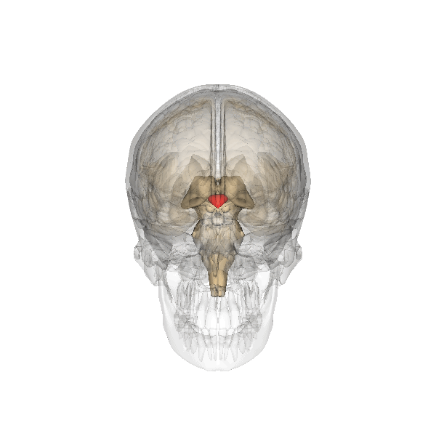
Stage 1: Obtaining the required gene
A common way is to obtain mRNA from cells where the required gene is being transcribed.
Although there will only be one copy of each gene in the nucleus of a cell, there will be large quantities of the mRNA version of that gene in the cytoplasm.
An enzyme called reverse transcriptase works ‘backwards’ to synthesise cDNA from strands of mRNA.
Eg:
A
U
G
C
U
The Hypothalamus produces a hormone called vasopressin
T
A
C
G
A
mRNA template for the hormone, vasopressin
A
T
G
C
T

Slide 7
Stage 1: Obtaining the required gene
Another way is to use restriction enzymes, which are enzymes that can cut DNA at specific base sequences.
Cutting DNA with restriction enzymes can have two outcomes at either end of the gene.
Some restriction endonuclease produce ‘blunt ends’
Some restriction endonuclease produce ‘sticky ends’

Slide 8
This gene (from a human) can be cut with a restriction enzymesuch as EcoRI
KEY:
Gene from Human
Gene from E.coli
Sticky End
This is a section of DNA from E.coli.
If this section of DNA from E.coli is also cut with EcoRI, a complimentary sticky end is produced.
Sticky End
If these two ‘cut’ pieces of DNA are mixed, recombinant DNA has been produced.

Slide 9
Stage 2: Placing the gene into a vector
Once the gene of interest has been isolated, it is ready for placement in a vector.
Plasmids are small loops of DNA found in prokaryotes.
They can be cut open using the same restriction enzyme so they have complementary sticky ends to the gene of interest.
Restriction Endonuclease
Restriction Endonuclease
A plasmid
DNA coding for a desired protein
As the DNA fragment was cut out using the same restriction endonuclease as used to cut the plasmid open, they have complimentary sticky ends.

Slide 10
Once the bases have paired, they form their usual weak hydrogen bonds between each other.
The only thing left to do, is form the link between the sugar-phosphate backbones, and this is done by the enzyme, DNA Ligase.

Slide 11
Stage 3: Getting Vector into Recipient Cell
Heat Shock
Subjecting bacteria to temperature fluctuations (0ºC – 42ºC) in the presence of calcium chloride ions causes the cell membrane and wall to become porous. This allows the recombinant plasmid in.
Electroportation/Electrofusion
A high voltage is applied to the cells which disrupts the membranes, causing the recombinant plasmids to enter.
Transfection
Bacteriophages are viruses that infect bacteria. The relevant gene can be packgaged in a bacteriophage, which can then transfect the host cell.
Direct Introduction into Host Cell
Recombinant plasmids can be placed in bacteria which infect some plants, inserting DNA into host cell genomes. Gold or tungsten can even be coated with recombinant DNA and shot into plant cells.

Slide 12
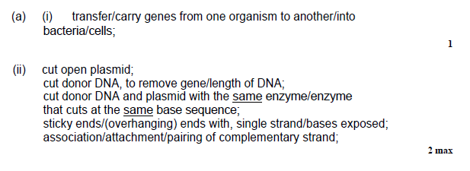
Exam Question
Have a go at the practice exam question.
Answers:

Slide 13
Genetic Engineering Toolbox…

Slide 14
Genetic Engineering Toolbox
Genetic engineering techniques are successful because scientists use naturally occurring enzymes to their advantage.
They must have the following enzymes in their ‘toolbox’.
You have already encountered them this lesson:
Reverse Transcriptase
Present in viruses such as HIV, these have the ability to synthesise cDNA from an RNA template.
Ligase Enzymes
These join DNA fragments. They catalyse condensation reactions in the sugar-phosphate backbone.
Restriction Enzymes
Many prokaryotes use these as a defence against bacteriophages. They cut up invading viral DNA, rendering the virus harmless.

Slide 15
Plenary
Answer the following questions:
mRNA from the beta cells of the pancreas can be obtained to make the insulin gene.
What type of enzyme will be required to synthesise the gene from the mRNA?
Explain why the gene made in this way will not contain any introns.
The gene will be spliced into a bacterial plasmid. When genes are cut from host DNA, why are they cut out with the same restriction enzymes as the ones used to cut open the vector plasmid?

Slide 16
Learning Objective
Success Criteria
Understand the principles of genetic engineering.
Understand the techniques used in genetic engineering.
Describes the steps involved in isolating and then transferring a gene into a vector.
State the enzymes used in genetic engineering.
Explain the importance of ‘sticky ends’.

