Slide 1
Issues With Genetic Manipulation
6.3 – Manipulating genomes

Slide 2
Specification Reference

Slide 3
Learning Objective
Success Criteria
Learn about the potential benefits and risks of genetically modification.
State examples of genetically modified organisms.
Be able to justify the genetic manipulation of an organism for a specific purpose.
Explore the reasons why some people may be against the genetic manipulation of certain organisms.

Slide 4
An Example of Genetic Engineering
A classic genetic engineering example is using bacteria to synthesise insulin.
Insulin mRNA is obtained from beta cells in the pancreas.
Reverse transcriptase is used to synthesise cDNA.
The gene is inserted into plasmids from E. coli.
The recombinant plasmids are placed back into E. coli.
Quick Recap Questions:
What is reverse transcriptase?
What is ligase?
What are restriction endonucleases?
What are sticky ends?

Slide 5
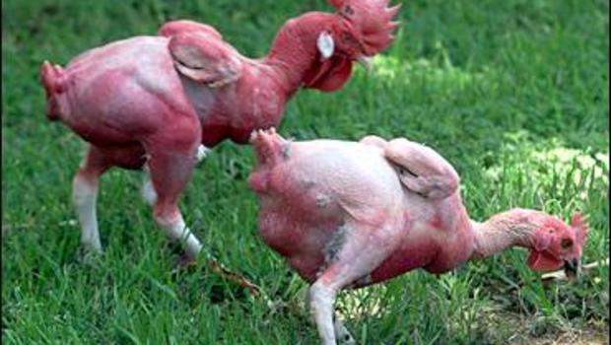
Ethical Issues
Genetic engineering has replaced the ‘hit or miss’ approach of selective breeding.
It is now possible to transform crops, animals or bacteria in a single generation.
However, there are concerns about the potential hazards and risks associated with genetic modification.
It is important to weigh up the potential benefits against the potential hazards of genetically modifying an organism.
Genetically engineered, featherless chickens
The next few slides will explore specific examples of GMOs and their potential benefits and hazards.

Slide 6
SPEC CHECK
The course specification outlines the following examples as important examples:
Soya
Pathogens
Pharmaceuticals from animals.
However:
Other examples can always pop up in the exam, so it is important that you go over the table that starts on page 231 of the textbook.

Slide 7
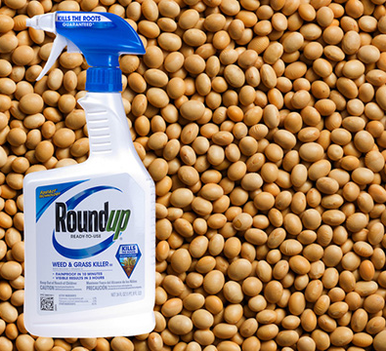
1. Genetically Modified Soya
Soya beans have been genetically modified to make them produce herbicides.
Benefit(s)
GM soya beans are resistant to a herbicide (Round-Up).
Weeds competing with the soya will be killed off by the herbicide, but the soya plants will survive.
Hazard(s)
There is a risk that the gene for resistance to the herbicide could pass into weeds, creating ‘superweeds’.
This has not happened to date.

Slide 8
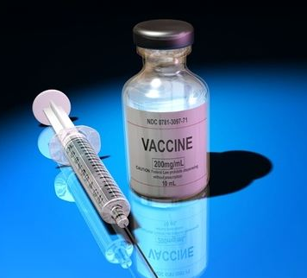
2. Pathogens
GM viruses can be used in vaccines to prevent infection with certain diseases.
Benefit(s)
Viruses can be made to be harmless and then injected into patients, reducing the chance of illness.
Viruses can also be used as vectors in gene therapy.
Hazard(s)
There is some evidence of increased risk of cancer when using viral vectors to carry alleles into human cells.
The alleles may interfere with gene regulation.

Slide 9
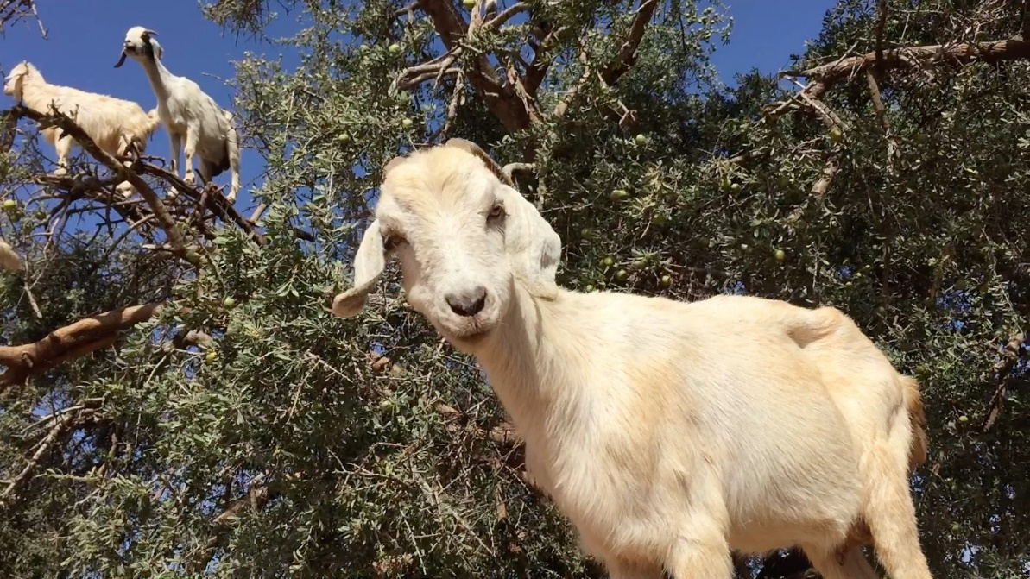
3. ‘Pharming’
Using GM animals to produce pharmaceutical products.
Benefit(s)
Goats and sheep are regularly genetically modified by introducing human genes.
Proteins such as antitrypsin are produced in their milk, which helps treat emphysema.
Hazard(s)
There are concerns about the welfare of the animals and possible side-effects.
However, the animals are valuable and likely to be looked-after.

Slide 10
Task: Exam Question
Have a go at the exam question.
This is a good example of a question that tests your reasoning skills. The answers need to be longer and show that you have thought about more than just one argument.
Answers are in a separate file.

Slide 11
Genetic Engineering Quiz

Slide 12
Question 1
What name is given to enzymes obtained from bacteria that can cleave DNA at a specific recognition site?
Ligases
Reverse transcriptases
Restriction endonucleases
DNA polymerases
Notes:
Answer: Restriction endonucleases

Slide 13
Question 2
Who developed the first method for genetic fingerprinting?
Alec Jeffrys
James Watson
Kary Mullis
Fred Sanger
Notes:
Answer: Alec Jeffrys

Slide 14
Question 3
Five molecules of DNA were amplified using the PCR. After 11 cycles, there are about 10,000 molecules of DNA. How many more cycles are needed to produce 80,000 molecules?
3
7
14
15
Notes:
Answer: 3

Slide 15
Question 4
What is meant by the term ‘recombinant DNA’?
Notes:
Answer: Modified DNA

Slide 16
Question 5
In addition to the original DNA, free nucleotides and DNA polymerase, what else needs to be added to the thermocycler for the PCR to occur?
Notes:
Answer: Primers

Slide 17
Learning Objective
Success Criteria
Learn about the potential benefits and risks of genetically modification.
State examples of genetically modified organisms.
Be able to justify the genetic manipulation of an organism for a specific purpose.
Explore the reasons why some people may be against the genetic manipulation of certain organisms.

