Slide 1
Gene Therapy
6.3 – Manipulating genomes

Slide 2
Starter: Comparing DNA processes
Process | What does it do? | How does it work?
PCR (Polymerase Chain Reaction)
DNA Sequencing
DNA Profiling
Gel Electrophoresis

Slide 3
Process | What does it do? | How does it work?
PCR | Copy DNA | Separate DNA strands with heat Attach primer Complementary base pairing by DNA polymerase Repeat
DNA Sequencing | Work out base sequence of DNA | Pyrosequencing Starts off the same as PCR But when the complementary base pairing happens different amounts of light are given off when a different base is added Sanger Sequencing Starts off same as PCR But when complementary base pairing happens some of the free nucleotides have been radioactively tagged When they are added enzyme stops This is then run through gel electrophoresis you can see the base sequence
DNA Profiling | Create DNA fingerprint | Cut DNA into pieces with restriction enzyme Run through gel electrophoresis Compare pattern
Gel Electrophoresis | Sort DNA fragments by size | Cut DNA into pieces with restriction enzyme DNA put into gel with current running through it, DNA moves to positive end Shorter DNA moves further

Slide 4
Specification Reference

Slide 5
Learning Objective
Success Criteria
Understand the principles of gene therapy.
Learn about the techniques used in gene therapy and which cells are targeted.
State the difference between somatic cell and germ line gene therapy.
Describe how liposomes and viruses can be used to insert healthy alleles into patients’ cells.
Explain how cystic fibrosis can be treated using gene therapy.

Slide 6
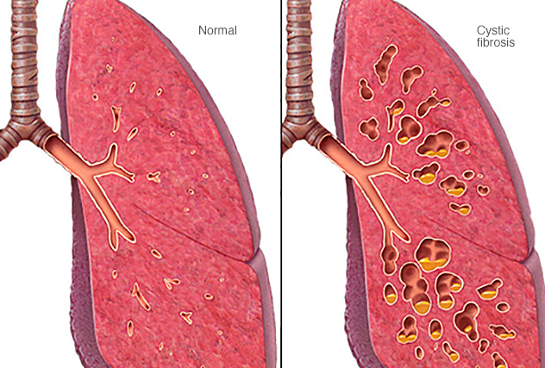
Starter
Cystic Fibrosis (CF) is a severely debilitating, genetic disorder that affects mostly the lungs, but also the pancreas, liver, kidneys and intestine.
Long-term issues include breathing difficulties and coughing up mucus as a result of frequent lung infections.
Watch the video and answer the questions on your sheet.
Teacher – only need to watch until 2:10s. Rest is optional.
Link: https://www.youtube.com/watch?v=BhFpFiZumS0

Slide 7
Starter
The name “cystic fibrosis” refers to damage to which organ?
In genetic terms, what kind of disorder is CF?
Which gene does CF affect?
What are you referred to as, if you only have one mutated CFTR allele?
In normal circumstances, what does the CFTR protein do?
Which amino acid is deleted from the primary sequence of the CFTR protein?
How many amino acids altogether are there in a normal CFTR protein?
What is the final result of not having working CFTR proteins in the cell membranes?
Notes:
Answers:
Pancreas
Autosomal recessive
CFTR
Carrier
Transport chloride ions
508th – Phenylalanine
1480
Chloride ions not transported, water not drawn into mucus. Mucus becomes very thic

Slide 8
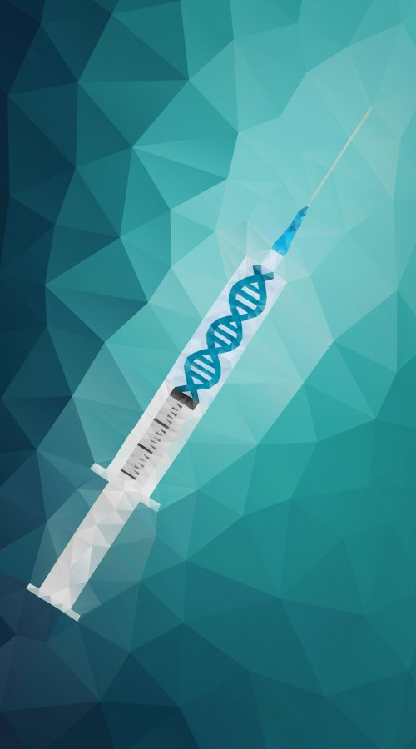
Gene Therapy
The introduction of normal genes into cells in place of missing or defective ones in order to correct genetic disorders.
The defective nature of the gene is usually a result of a mutation.
If the therapy works, and the inserted gene is expressed, the individual will produce a functioning protein.
Aside from inserting working alleles, new research has looked into silencing genes and effectively blocking translation of faulty genes.

Slide 9
Gene Therapy
Use your textbook to find the meanings of the following phrases:
Somatic cell gene therapy:
Germ line gene therapy:
What is the advantage of germ line gene therapy?
Why is it seen as a more powerful alternative to somatic cell gene therapy?
Gene therapy that works by inserting functional alleles into body cells.
Gene therapy that works by inserting functional alleles into gametes or zygotes.

Slide 10
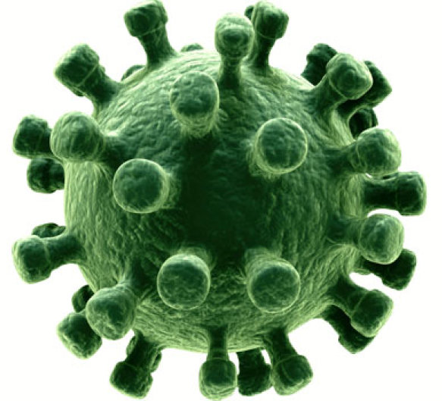
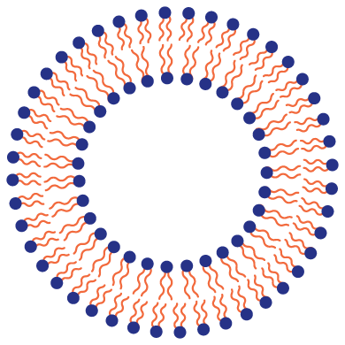
Somatic Cell Gene Therapy
As we’ve seen, CF is a disorder that arises due to inheriting two faulty, recessive alleles for the CFTR protein.
Individuals lack the functioning protein product.
Alterations to the genome in somatic cells are not passed to the patient’s offspring.
Two methods are used to insert working alleles into cells:
Liposomes
Viruses

Slide 11
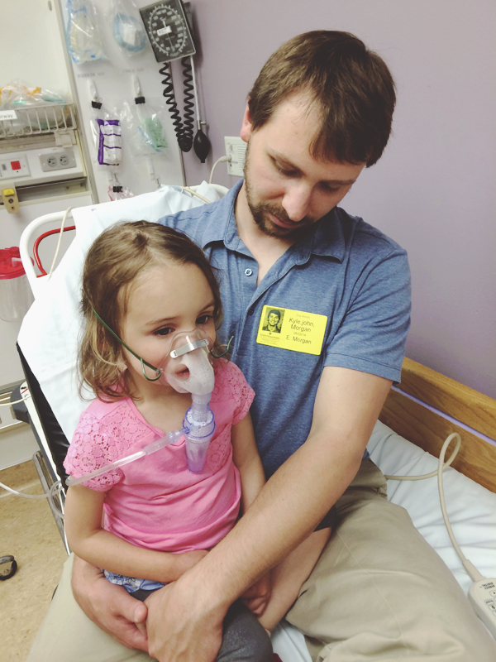
1. Liposomes
What is the advantage of using liposomes to insert alleles into cells?
Liposomes are small spheres made of a lipid bilayer.
The functioning allele is packaged within liposomes, which are then placed into an aerosol inhaler.
When sprayed into the noses of CF patients, some liposomes will pass through the plasma membrane of respiratory tract cells.
Some will also pass through the nuclear envelope.
The host cell will now use the gene to express the CFTR protein.
Complete the task on the worksheet – Close your textbook.
Notes:
Answer: Cells membranes and nuclear envelopes are also made of lipids. The liposomes will easily bind to these membranes, allowing the alleles to enter the cells.

Slide 12
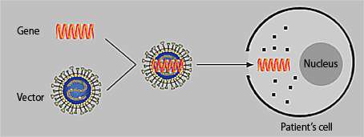
2. Viruses
Viruses that usually infect human cells can be genetically modified so that it encases the functioning allele to be inserted into the patients’ cells.
The virus needs to be engineered so that it is unable to cause disease.
Potential problems:
Even non-virulent viruses may provoke an immune or inflammatory response.
The patient may become immune to the virus.
The virus may insert the gene into a location that disrupts regulation of cell division, possibly causing cancer.
The gene may disrupt the regulation of other genes.

Slide 13
Germ Line Gene Therapy
Germ line gene therapy involves altering the genomes of gametes or zygotes.
The offspring will also inherit the foreign allele(s).
This type of therapy therefore has the potential to change the genetics of the descendants of the original patients.
There are concerns that the genes may find their way into a location that could disrupt the expression or regulation of other genes, or increase the risk of cancer.

Slide 14
Plenary
What are the similarities and differences between somatic cell gene therapy and germ line gene therapy?
What are some of the issues related to gene therapy using viral vectors of the working alleles?

Slide 15
Learning Objective
Success Criteria
Understand the principles of gene therapy.
Learn about the techniques used in gene therapy and which cells are targeted.
State the difference between somatic cell and germ line gene therapy.
Describe how liposomes and viruses can be used to insert healthy alleles into patients’ cells.
Explain how cystic fibrosis can be treated using gene therapy.

