Slide 1
Microorganisms & Biotechnology
Module 6.4
Cloning & Biotechnology

Slide 2
Learning Objectives
Understand what Biotechnology is.
Learn about examples of where biotechnology has been used to produce useful products.
Understand the use of microorganisms in biotechnology.

Slide 3
Success Criteria
State areas of our lives which have been affected by biotechnology.
Give example of biotechnological processes.
Explain how certain organisms can be used in biotechnology.

Slide 4
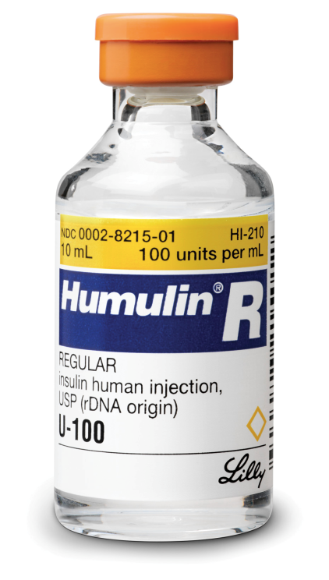
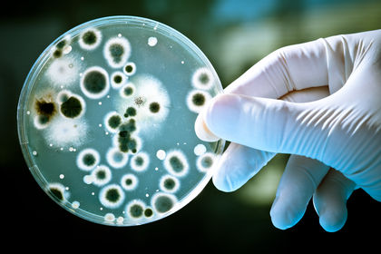
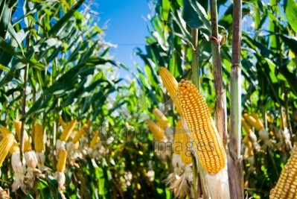
What is Biotechnology
Biotechnology is:
The technological processes that make use of living organisms or parts of them to manufacture useful products.
Can you think of any examples?

Slide 5
Biotechnology Applications
Brewing
Baking
Cheese Making
Yoghurt Production
Penicillin Production
Insulin Production
Bioremediation

Slide 6
Why use microorganisms?
Economic Considerations
Short Life cycle
Growth requirements

Slide 7
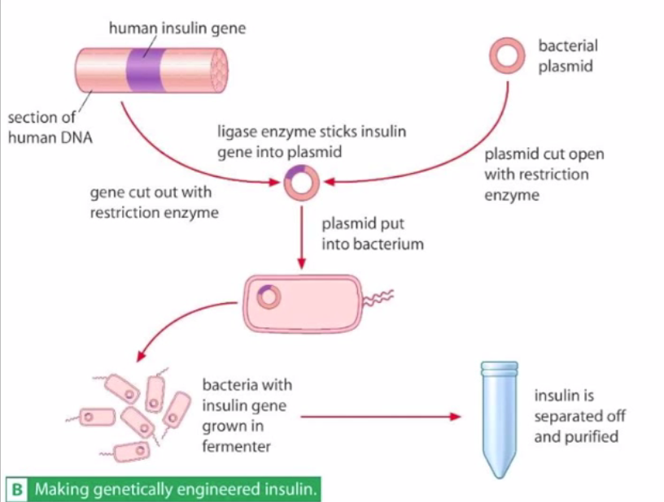
Pharmaceutical Example: Insulin
Insulin is a hormone used by diabetic patients whose own production is not sufficient.
The human insulin gene is spliced into the genome of E. coli bacteria.
The bacteria are cultured on a very large scale.
They secrete the insulin protein as they grow.

Slide 8
Penicillin Production
Antibiotic derived from Penicilium fungi
Fungi grown in fermentation tank
Penicillin separated off

Slide 9
Bioremediation
Microorganisms break down environmental contaminants
E.g. oil & organic waste
Remove or neutralise the contaminants by metabolic processes

Slide 10
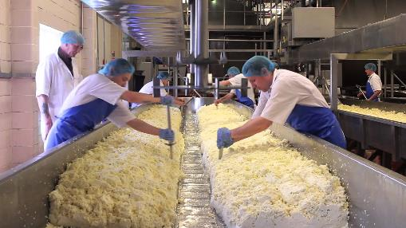
Dairy Industry
Microorganisms have been used for hundreds of years to produce traditional foods such as dairy products.
Yoghurt
Yoghurt is milk that has undergone fermentation by bacteria. The bacteria convert lactose to lactic acid.
The acidity denatures milk proteins, causing it to coagulate.
Cheese
Milk is mixed with the enzyme rennin, which coagulates the milk.
A curd is separated, in which bacteria continue to grow, producing lactic acid.
Certain cheeses can be flavoured by adding fungi.

Slide 11
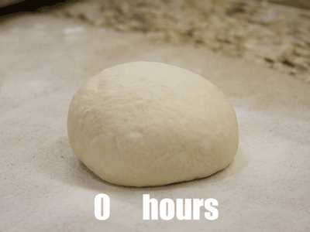
Baking
What organism is used in bread-making?
Yeast
Yeast begins to respire anaerobically when dough is left to rest in a warm place.
The yeast produces ____________ ___________ gas.
The gas forms bubbles, which causes the bread to rise.
The yeast also produces ethanol during the fermentation reaction, but this evaporates during the cooking process.

Slide 12
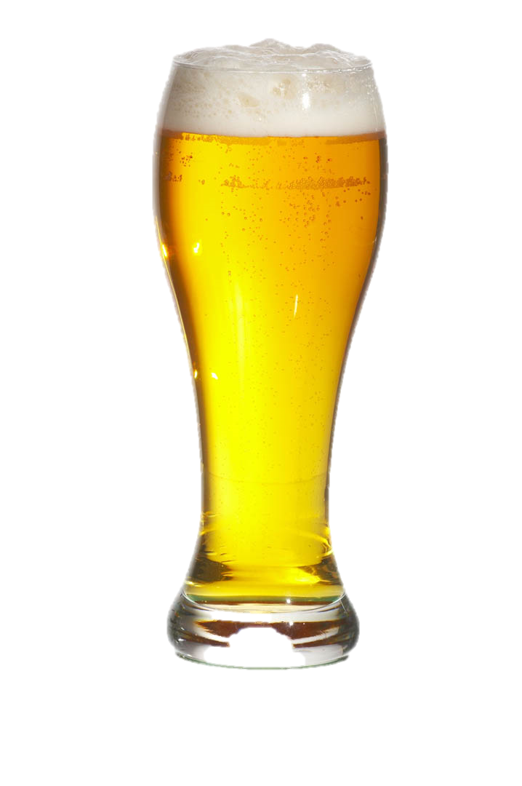
Alcoholic Beverages
Like bread, alcoholic beverages are also the product of the anaerobic respiration of yeast.
Wine:
Yeast naturally grows on the skin of some grapes.
When grapes are crushed the yeast is able to use the fructose & glucose to produce carbon dioxide and alcohol.
Beer:
Germinating barley grains produce maltose, which is respired by yeast.
Again, anaerobic respiration causes the production of carbon dioxide and alcohol.

Slide 13
Stretch & Challenge Questions
In the production of cheese, the milk is acidified before the rennin enzyme is added. Suggest reasons why.
Extra calcium salts are often added to milk during the cheese-making process. Suggest why.
Rennin comes from the stomach of a calf. Mammal stomachs are acidic. The enzymes have low optimum pHs.
The calcium may act as a cofactor, aiding enzyme action.
The calcium binds proteins together by forming bonds. This may change texture/hardness of cheese.

Slide 14
Learning Objectives
Understand what Biotechnology is.
Learn about examples of where biotechnology has been used to produce useful products.
Understand the use of microorganisms in biotechnology.
Understand the ‘growth curve’ of microorganisms placed in a closed culture environment.

Slide 15
Success Criteria
State areas of our lives which have been affected by biotechnology.
Give example of biotechnological processes.
Explain how certain organisms can be used in biotechnology.
Be able to describe and explain the ‘growth curve’.

