Slide 1
Module 1: Communication and Homeostasis

Slide 2
Glossary
Negative Feedback
A process in which any change in a parameter brings about a reversal in that change
Positive Feedback
A process in which any change in a parameter brings about an increase in that change
Homeostasis
Maintaining a constant internal environment despite external changes
Endocrine gland
Secretes hormones directly into blood capillaries
Exocrine gland
Secretes substances into a duct
Hormone
Molecule released into the blood that acts as a chemical messenger
Target Tissue
Contains cells with receptors in their membranes complementary to a specific hormone molecule

Slide 3
Communication

Slide 4
Outline the need for communication systems within multicellular organisms
Need to monitor & respond to changes in the internal and external environment
Co-ordinate the activities of different organs

Slide 5
Cell Communication
Cells need to communicate with each other by a process called cell signalling
E.g. Neuronal (electrical) and hormonal (chemical) systems

Slide 6
Principles of Homeostasis
Receptors:
receives information
Control Mechanism:
respond to information
Effectors:
perform the appropriate action
Negative feedback:
restore original state

Slide 7
Ectotherm
Responses that maintain constant core body temperature: physiological, behavioural
Reference to peripheral temperature receptors, hypothalamus and effectors in the skin and muscle
Heat energy from outside the body
Physiological | Behavioural

Slide 8
Endotherm
Responses that maintain constant core body temperature: physiological, behavioural
Reference to peripheral temperature receptors, hypothalamus and effectors in the skin and muscle
Release heat energy within their body e.g mammals and birds
Physiological | Behavioural

Slide 9
Nerves

Slide 10
Roles of sensory receptors
Convert different form of energy in to nerve impulses (transducer)
For Example
Photoreceptor
Mechanoreceptor

Slide 11
Sensory Neurone: Structure & Function
Transmit from a receptor to the CNS
Dendron:
Axon:

Slide 12
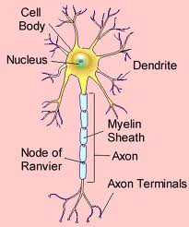
Motor Neurone: Structure & Function
Transmit impulses from CNS to effector
Dendrites:
Axon:

Slide 13
Resting Potential
Potential Difference across the membrane:
Inside has charge of -70mV compared to outside
Sodium Potassium Ion Pump
2 K+ ions in
3 Na+ ions out
Membrane is impermeable to Na+ but some K+ ions leak out

Slide 14
Action Potential
When membrane is depolarised and pd across the membrane reaches -40mV (generator potential)
Voltage gated Na+ channels open
Sodium ions move in (DEPOLARISATION)
Changes pd to +40mV
Na+ channels close & voltage gated K+ channels open (REPOLARISATION)
Changes pd to about -75 to -90mV (HYPERPOLARISATION)
Most of K+ channels close and Na+/K+ pump restores resting potential

Slide 15
Action Potential: Transmitted in a Myelinated neurone
Nerve impulse jumps from one Node of Ranvier to the next
Saltatory Conduction
Presence of action potential at one node sets up depolarisation at the next (local circuit)
Refractory Period
When membrane is hyperpolarised another action potential can’t form: action potential can only go one way

Slide 16
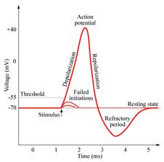
Action Potential: Voltage Graph

Slide 17
Significance of the frequency of impulse transmission
Actiona potential is an all or nothing response
Stronger signal at the receptor results in many action potentials

Slide 18
Compare and contrast structure and function
Myelinated Neurones | Non-myelinated neurones
CNS & Somatic nervous system Faster due to saltatory conduction Sped up by myelin sheath (Schwann Cells containing high amount of myelin wrapped around axon) | Autonomic nervous system Slower Sped up by increasing diameter of axon

Slide 19
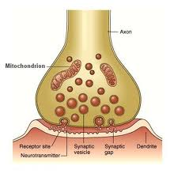
Structure of the Cholinergic Synapse

Slide 20
Role of Neurotransmitters: How a synapse works
Action potential reaches axon terminal
Calcium ion channels open and calcium ions move in
Synaptic vesicles fuse with presynaptic membrane (requires ATP)
Acetylcholine (ACh) diffuses across gap and binds to receptors on postsynaptic membrane
Na+ channels open and action potential occurs
Acetylcholinesterase breaks down ACh and choline is absorbed through presynaptic membrane

Slide 21
Roles of the Synapse in the Nervous System
One direction of transmission
May be excitatory or inhibitory
Spatial summation
When two synapses on the same neurone get action potentials at same time depolarisation of postsynaptic membrane is greater
Temporal summation
When two action potentials arrive one after the other the depolarisation of the postsynaptic membrane is greater
Facilitation
Arrival of first action potential makes the postsynaptic membrane more responsive to the next

Slide 22
Hormones

Slide 23
First and Second Messengers: adrenaline & cAMP
Adrenaline doesn’t enter the target tissue
Adrenaline is the first messenger
Adrenaline binds to receptor on cell surface, activating adenyl cyclase inside the cell
Adenyl cyclase increases concentration of cAMP
cAMP is the second messenger
cAMP activates cascade of enzymes

Slide 24
Functions of the Adrenal Gland
Adrenal Cortex
Makes certain steroid hormones
Control concentrations of Na and K in the blood
Control metabolism of sugars and proteins
Adrenal Medulla
Makes adrenaline
Increases heart rate

Slide 25
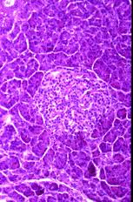
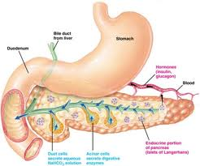
Histology of the Pancreas

Slide 26
Role of the Pancreas
Endocrine | Exocrine
Islets of Langerhans Alpha Cells: secrete hormone glucagon Beta Cells: secrete hormone insulin | Secrete digestive enzymes that travel via a duct to the small intestine

Slide 27
Regulation of Blood Glucose Concentration
Blood Glucose Rises
Alpha and Beta cells detect change
Alpha cells stop secreting glucagon
Beta cells secrete insulin
Target tissues: muscle, fat, hepatocytes
glucose uptake and respiration increases
Hepatocytes convert glucose to glycogen

Slide 28
Regulation of Blood Glucose Concentration
Blood Glucose Falls
Alpha and Beta cells detect change
Beta cells stop secreting insulin
Alpha cells secrete glucagon
Target tissues:
Take up less glucose
Less glucose respiration and more respiration of fats or amino acids
Hepatocytes convert glycogen to glucose

Slide 29
Insulin Secretion
Beta cells have negative resting potential, caused by ATP sensitive K+ channels
When blood glucose levels increase, ATP enters Beta Cells and is repired
Closes K+ channels
Membrane depolarisation causes Ca ions to enter
Insulin released by exocytosis

Slide 30
Compare and Contrast Diabetes Mellitus
Type 1 (Insulin-dependent) | Type 2 (non-insulin-dependent)
Lack of insulin Destruction of all/most Beta Cells Inject insulin | Target tissues become less responsive to insulin Controlled by diet

Slide 31
Diabetes Treatments
Human Insulin from GM Bacteria
E. coli make human insulin as they have been given the gene
Decreases risk of immune response
Patients respond faster
Removes ethical issues of using animal insulin
Stem Cells
Using embryonic stem cells to make insulin
Placed in porous capsules in abdomen to prevent rejection

Slide 32
Control of Heart Rate in Humans
Hormonal | Nervous
Adrenaline (increase) | Accelerator Nerve (increase) - Stretch receptors in muscles - Low blood pH Vagus Nerve (decrease) - High bp detected by carotid sinus

Slide 33
Module 2: Excretion

Slide 34
Glossary
Excretion
Removal of metabolic waste (waste from reactions inside cells) from the body

Slide 35
Importance of removing metabolic wastes from the body
Carbon Dioxide
Can increase the pH of the blood
Excreted via the lungs
Nitrogenous waste
Makes the toxic ammonia
Liver turns it into urea
Removed from the blood by the kidneys

Slide 36
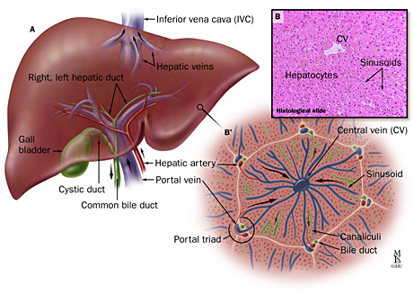
Histology of the Liver

Slide 37
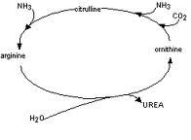
Formation of Urea
Amino group removed from amino acid (deamination)
Forming ammonia
Combined with carbon dioxide in the ornithine cycle
Makes urea

Slide 38
Roles of the Liver
Liver made up of several lobes
Hepatocytes are arranged in lobules
Roles
Detoxification of e.g. Alcohol
Formation of urea
Glucose homeostasis

Slide 39
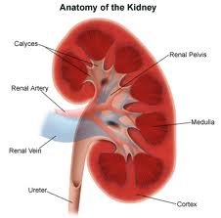
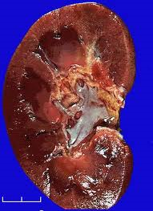
Histology of the Kidney

Slide 40
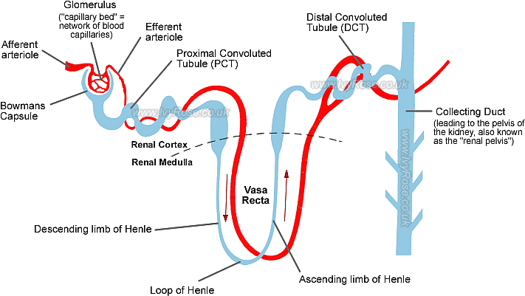
Nephron

Slide 41
Production of Urine
Ultrafiltration (Glomerulus & Bowman’s Capsule)
High pressure in glomerulus caused by narrower efferent arteriole
Filters smaller molecules into the nephron
Basement membrane around capillaries and podocytes of Bowman’s capsule improve filtration
Selective Reabsorption (PCT)
Glucose, amino acids, vitamins and some ions reabsorbed into blood

Slide 42
Control of Water content in the blood
Water is filtered out of blood into nephron
65% absorbed back into blood by osmosis in PCT
In Loop of Henle
Countercurrent mechanism:
Ions pumped out of ascending loop of Henle
Decreases water potential of medulla
Ions diffuse into descending limb to be recycled
Low water potential of medulla around the collecting duct means water moves out of permeable collecting duct
Permeability of collecting duct increased by ADH

Slide 43
Kidney Failure
Problems
Increased retention of water and salts
High blood pressure and odema
Renal Dialysis
Blood passed through membrane where good stuff moves in and bad out by diffusion
Transplant
Fix problem, but need a tissue type match and take immunosuppresants

Slide 44
Urine Samples
Test for Pregnancy
Embryo makes human chorionicgonadatrophin hormone (hCG)
Found in urine 6 days after conception
Pregnancy test:
Monoclonal antibodies tagged with blue bead bind with hCG
Antibodies move
Immobilised enzymes bind to antibodies and hold beads into a blue line
Test for Anabolic Steroids
Urine sample analysed with mass spectrometry

