Slide 1
PAG6 TLC

Slide 2
Need to book
Repro
Example results or Page 19 of delivery guide
Example method
FLIPPED learning sheet for start of nucleotides
Applied chromatography practical (amino acids)
Should have given 2 weeks notice for this

Slide 3
Learning Objective
Know how to carry out chromatography
Outline the principles of paper and thin layer chromatography to separate biological compounds
Calculate Rf values
Success Criteria

Slide 4
What is chromatography?
Chromatography can be used to separate components in a mixture. Both quantitative (measureable) and qualitative (non-numerical) data can be obtained.
- Outline the principles of paper and thin layer chromatography to separate biological compounds

Slide 5
Background
Chromatography is used to separate mixtures of substances into their components. All forms of chromatography work on the same principle.
They all have a stationary phase (a solid, or a liquid supported on a solid) and a mobile phase (a liquid or a gas). The mobile phase flows through the stationary phase and carries the components of the mixture with it. Different components travel at different rates.

Slide 6
Types of chromatography
- Outline the principles of paper and thin layer chromatography to separate biological compounds
Chromatography | Mobile phase | Stationary phase
Thin layer (tlc) | Liquid solvent | Aluminium or Silicon oxide (often bound together with calcium sulphate and supported on a plastic/glass sheet)
Paper | Liquid solvent | Water (on the surface of absorbent chromatography paper and therefore supported by the cellulose fibres in paper).
Gas-layer (glc) | Inert gas (usually nitrogen or argon) | Liquid – often a silicon gum (supported on suitable solid particles contained in a glass or metal tube).
High-performance liquid (hplc) | Liquid solvent | Small solid particles (packed tightly in a tube, usually stainless steel).

Slide 7
How it works – mobile and stationary phases.
A sample is dissolved in a mobile phase (which may be a gas or a liquid).
The mobile phase is then forced through an immobile, immiscible stationary phase.
The phases are chosen so the components of the sample have different solubilities in each phase.
- Outline the principles of paper and thin layer chromatography to separate biological compounds

Slide 8
The components of the sample are attracted to both mobile and stationary phases.
A component strongly attracted to the stationary phase will be held back.
A component strongly attracted to the mobile phase will pass through quickly (and move further).
This leads to separation of the components.
- Outline the principles of paper and thin layer chromatography to separate biological compounds

Slide 9
Paper Chromatography
Solvent slowly travels up the paper
The different components of the mixtures travel at different rates and the mixtures are separated into different coloured spots.

Slide 10
Thin Layer Chromatography
The stationary phase
E.g. Silica gel
The silicon atoms are joined via oxygen atoms in a giant covalent structure.
At the surface of the silica gel, the silicon atoms are attached to -OH groups
The surface of the silica gel is very polar and, because of the -OH groups, can form hydrogen bonds with suitable compounds around it
The mobile phase
The solvent begins to soak up the plate, it dissolves the compounds in the spot that you have put on the base line.
The compounds present will get carried up the chromatography plate as the solvent continues to move upwards.
How fast the compounds get carried up the plate depends on two things:
How soluble the compound is in the solvent.
How much the compound sticks to the stationary phase

Slide 11
Separation will be affected by:
Molecular size
Molecular shape
Charge
Solubility.
- Outline the principles of paper and thin layer chromatography to separate biological compounds

Slide 12
R_{f} values
- Calculate Rf values
Having run the chromatogram, substances can be identified by their R_{f} values.
R_{f} = Distance moved by the spot
Distance moved by the solvent front
You should measure the distance to the centre of the spot.

Slide 13
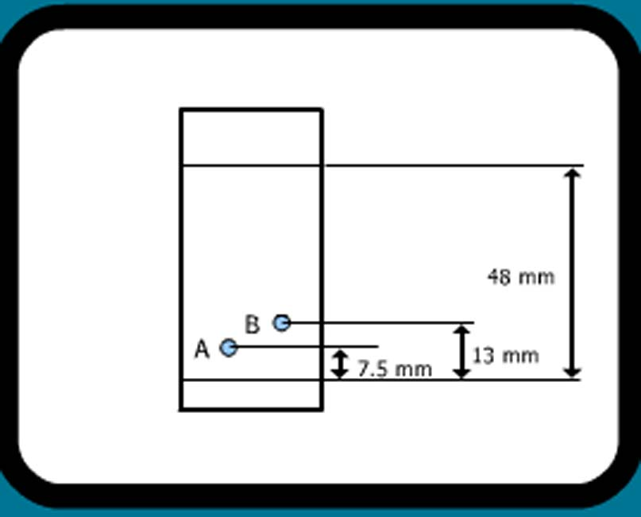
- Calculate Rf values

Slide 14
PAG 6 Background
You have a mixture of amino acids and want to find out which particular amino acids the mixture contained.
Small drops of a solution of the mixture are placed on the base line of the paper.
These spots should be small (less than 0.5cm across).
Allow to dry and add more to the spots to get a concentrated sample.
The paper is then stood in a suitable solvent and left to develop for at least 4 hours
The position of the solvent front is marked in pencil and the chromatogram is allowed to dry and is then sprayed with a solution of ninhydrin. Ninhydrin reacts with amino acids to give coloured compounds, mainly brown or purple
TOUCH THE FILTER PAPER AS LITTLE AS POSSIBLE

Slide 15
PAG6
Chromatography
You need to have in your lab book:
Your results
Your Rf value calculations

Slide 16
Method: Stage 1
TOUCH THE FILTER PAPER AS LITTLE AS POSSIBLE
Take a piece of filter paper and draw a pencil line 1.5cm from the bottom edge.
In pencil, put you name/ initials at the very top of the paper.
Mark 4 points to put your samples – spread them out evenly over the line.(label A, B, C and D at top).
Apply spots of the amino acid samples. These spots should be small (less than 0.5cm across). Practise first.
Allow to dry and add more to the spots to get a concentrated sample. (3 repeats)

Slide 17
Method: Stage 2
Once the spots are dry, place your paper in the chromatography jar. It needs to be placed so the bottom just touches the base of the jar and so the paper will not stick to the sides.
Add the solvent mixture to the jar (less than 1.5cm depth!).
Leave until the solvent rises to almost the top of the paper.
The ninhydrin stain will have to be done later.

