Slide 1
Colorimetry

Slide 2
Need to book
Practical activity 23
Graph paper
Rulers
Pencils
Repro
Practical sheet 23
PPQ x 2

Slide 3
Learning Objective
Know about colorimetry
Explain quantitative methods to determine concentrations of a chemical in solution
Including colorimetry and biosensors
Success Criteria

Slide 4
Examples of Biosensors?
Notes:
Reagent strips (test urine & blood in analysis)

Slide 5
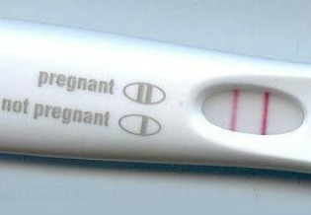
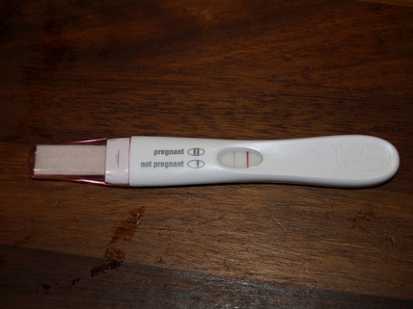
Biosensors: Pregnancy Test
Explain quantitative methods to determine concentrations of a chemical in solution
Testing for hCG (human chorionic gonadotrophin hormone)
Immobilised antibodies on a stick
Antibodies are attached to a dye
Hormone passes up the stick and binds to the complementary antibodies
Making the dye become visible
Second control line to show test is working
2 coloured lines = positive result

Slide 6
What is colorimetry?
Explain quantitative methods to determine concentrations of a chemical in solution
Colorimetric techniques are used to identify coloured solutions and measure their concentration.
Colorimetry relies on coloured solutions absorbing light of a particular wavelength.
However the technique can also be used to analyse colourless substances if they react with a dye.

Slide 7
How does it work?
Explain quantitative methods to determine concentrations of a chemical in solution
Colorimetry uses a machine called a colorimeter.
The sample tubes placed in the colorimeter are called cuvettes.

Slide 8
How does it work?
Explain quantitative methods to determine concentrations of a chemical in solution
Bulb
Colorimeter
Filter
36%
Cuvette with sample
Photocell
Display

Slide 9
Other information
Explain quantitative methods to determine concentrations of a chemical in solution
We can measure either transmission of light or absorbance of light.
A reference sample is used so the samples to be tested can be compared to the reference.
The filter is used so only a narrow band of visible light is absorbed or transmitted by the sample.
If a substance is colourless, colorimetry can still be used if the substance reacts with a dye.

Slide 10
Calibration curves
Explain quantitative methods to determine concentrations of a chemical in solution
These are created by measuring the absorbance or transmission of a number of solutions of known concentration.
A graph is then drawn.
An unknown sample is then tested. By taking its absorbance or transmission the concentration of the sample can then be calculated.

Slide 11
Explain quantitative methods to determine concentrations of a chemical in solution
The curve may actually be a curve
Or it may be a straight line
% Absorbance
Concentration

Slide 12
Explain quantitative methods to determine concentrations of a chemical in solution
Or it may be a straight line
% Absorbance
Concentration

Slide 13
Explain quantitative methods to determine concentrations of a chemical in solution
Take samples % absorbance. Draw across to curve.
% Absorbance
Draw down and read off concentration
Concentration

Slide 14
Task
Explain quantitative methods to determine concentrations of a chemical in solution
Carry out colorimetry practical
Use worksheet [Activity 23] to monitor the time course of protein hydrolysis
Colorimeter
You need to have in your lab book
Results tables
Graphs
Calculations
PAG5
Practical Skills: Graph drawing

Slide 15
Peer Assess Graphs
Marks
Equal scaling on axis
Plotted on at least 50% of graph paper
Absorbance on y axis
Units given
Points plotted correctly

Slide 16
Plenary: Past Paper Question
June 2009 3d
The activity of an enzyme can be measured by testing for the concentration of its product at regular intervals.
Describe how the concentration of a reducing sugar can be measured using a colorimeter [6]

Slide 17
Markscheme

Slide 18
PPQ- Pregnancy Tests
On print outs x2

Slide 19
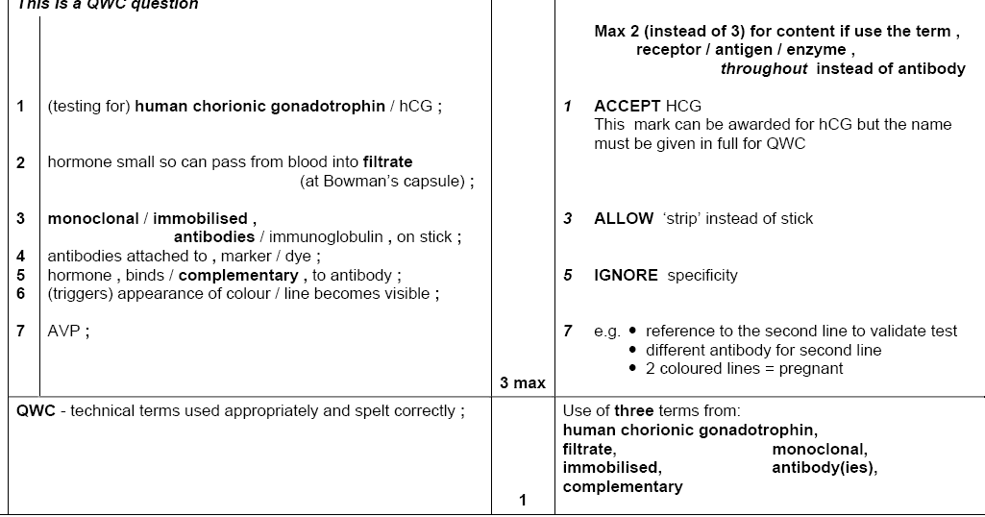
Markscheme 2010

Slide 20
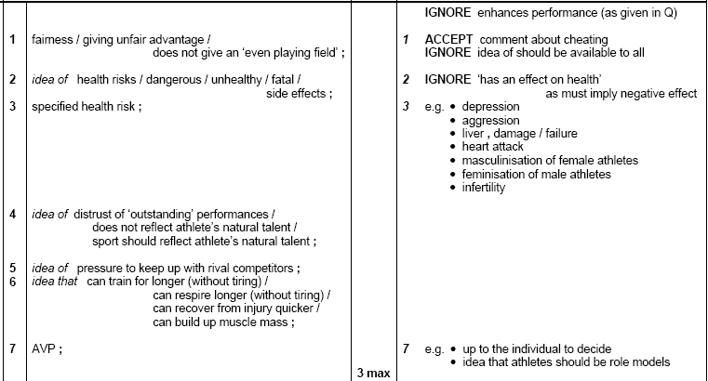

Slide 21
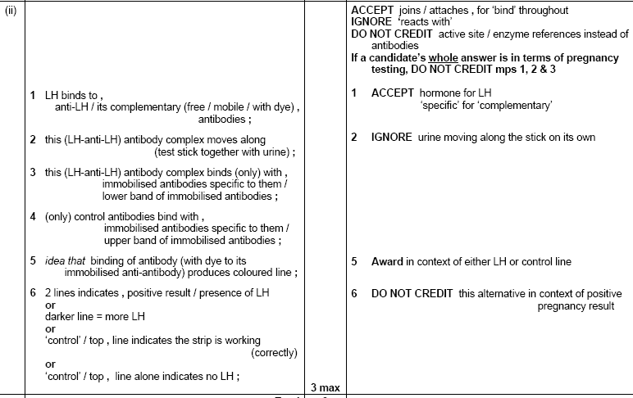
Markscheme 2012

Slide 22
Homework
Complete lab books
Answer questions on practical sheet

