Slide 1
Intro to communication

Slide 2
Learning Objectives Success Criteria
To know about communication within the body
Outline the need for communication systems within multi-cellular organisms
State that cells need to communicate with each other by cell signalling
State examples of cell signalling
Define key terms
Describe secondary messenger systems
Describe the functions of the adrenal glands

Slide 3
Starter Question
What conditions do you need to consider for efficient enzyme action?

Slide 4
Why do multicellular organisms need communication systems?
Internal Changes
External Changes
Co-ordinate activities of different organs

Slide 5
Task: Key terms: What do they mean?
Endocrine gland
Exocrine gland
Hormone
Target Tissue

Slide 6
Answers: Key terms: What do they mean?
Endocrine gland
Secretes hormones directly into the blood
Exocrine gland
Secretes molecules into a duct which carries them to where they are used
Hormone
Molecules released by endocrine glands directly into blood. Act as messengers carrying signal from endocrine gland to target tissue
Target Tissue
Possess specific receptor on their plasma membrane. Shape of receptor is complementary to the shape of the hormone molecule.

Slide 7
Communication on a cellular level
Cell Signalling
Nervous System
Neurones & Synapses
Rapid
Hormonal System
Hormones carried in blood
Only recognised by target cells
Longer term responses

Slide 8
Task: Where are your glands?
Draw round a member of your group
Cut out the different glands and place them where you think they are in the body
Label them

Slide 9
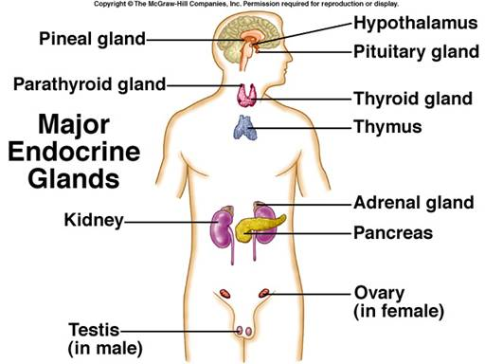

Slide 10
Task: Second Messenger systems
Task:
One person will describe what they see
The other person will draw
Notes:
Use diagram from book p23

Slide 11
Second Messenger System
Task: each draw labelled diagram of cAMP

Slide 12
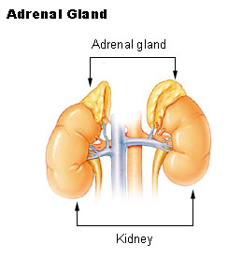
Function of Adrenal Glands
Adrenal Medulla
Responds to stress e.g. pain or shock
Widespread effect as most cells have receptors for adrenaline
Adrenal Cortex
Makes steroid hormones
Task: use p23 to add 2 specific examples of the roles of AM & AC

Slide 13
Outine how adrenaline activates enzymes within the target cell [5]
Plenary

Slide 14
Mark Scheme [5]
Adrenaline binds to receptor on target cell
Adrenaline first messenger
Adrenaline can’t enter the cell
Changes shape of Adenyl cyclase inside cell
Activates adenyl cyclase
Changes ATP into cAMP
cAMP second messenger
cAMP activates enzyme in the cell

Slide 15
Adrenaline Jan 11
See print out of page 10

Slide 16
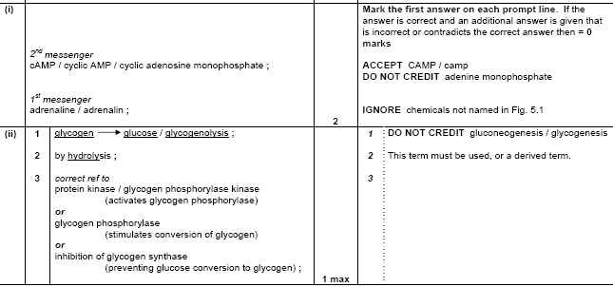
Adrenaline Jan 11 Markscheme

Slide 17
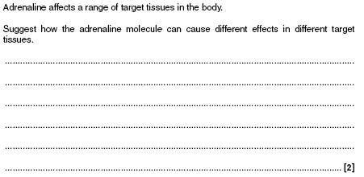
Adrenaline Jan 11

Slide 18
Adrenaline Jan 11 Markscheme

