Slide 1
Diabetes

Slide 2
Spec
(e) the differences between Type 1 and Type 2 diabetes mellitus
To include the causes of Type 1 and Type 2 diabetes and the treatments used for each. HSW12
(f) the potential treatments for diabetes mellitus.
To include the use of insulin produced by genetically modified bacteria and the potential use of stem cells to treat diabetes mellitus.

Slide 3
Learning Objective Success Criteria
Know about diabetes mellitus
Compare and contrast the causes & treatments of Type 1 & Type 2
Discuss the potential treatments of diabetes with reference to GM bacteria and stem cells

Slide 4
Starter: Key Terms
Match key terms and definitions
Notes:
Number this, for students to jot down answers!

Slide 5
Diabetes Mellitus
Disease in which blood glucose concentrations cannot be controlled effectively
Using the fact sheet answer the questions on the worksheet

Slide 6
Type I
Description
Type II
Insulin dependent
Starts in childhood
Beta cells damaged
Virus
Autoimmune
Can’t make enough insulin
Can’t store excess glucose
Non-insulin dependent
Generally adults
Obesity
High sugar diet
Asian/Afro-Caribbean
Family history
Still make insulin
Receptors decline

Slide 7
Type I
Treatment
Type II
Insulin Injections
Control of diet
Later can be controlled by drugs that slow down absorption of glucose

Slide 8
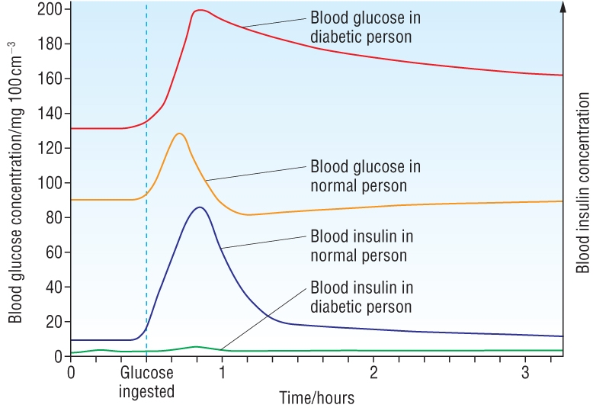
Task: In groups interpret the data

Slide 10
Genetically Modified Bacteria
Copy of human insulin gene put into bacteria
Bacteria make human insulin
Less chance of developing tolerance
Less chance of rejection
Less chance of infection
Cheaper
Less ethical issues

Slide 11
Potential Treatment: Stem Cells
Precursor cells found in pancreas of adult mice
If same in human these cells could be used to replace damaged beta cells in type I diabetes

Slide 12
Plenary

Slide 13
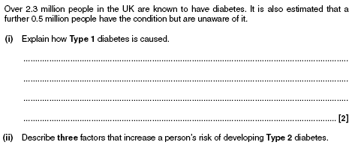
Diabetes Jan 10
[3]
[3]

Slide 14
Diabetes Jan 10 Markscheme

Slide 15
Diabetes Jan 10 Markscheme

Slide 16
Diabetes June 10
See print out June 10 pages 12-13

Slide 17
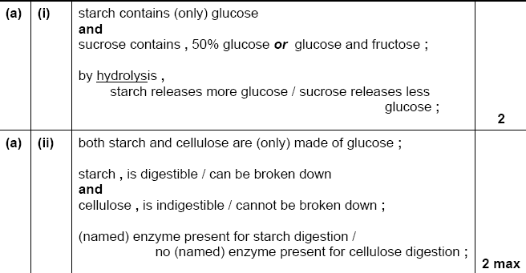
Diabetes June 10 Markscheme

Slide 18
Diabetes June 10 Markscheme

Slide 19
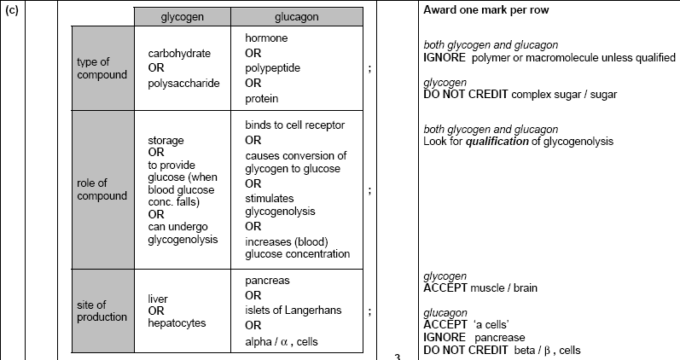
Diabetes June 10 Markscheme

Slide 20
Diabetes Jan 12

Slide 21
Diabetes Jan 12 Markscheme

Slide 22
Diabetes June 11
See print out of Page 10

Slide 23
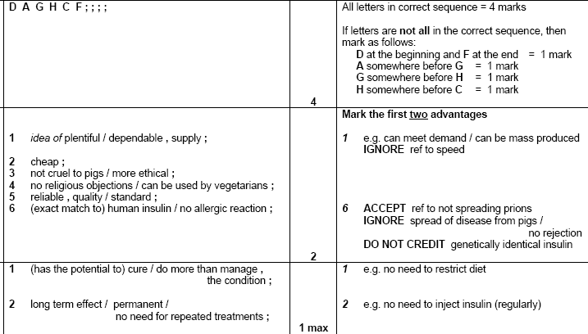
Diabetes June 11 Markscheme

