Slide 1
Semi Conservative DNA Replication

Slide 2
Need to Book
Speakers
A4 paper (coloured)
Pair of Compass & Pencils
Split pins
Scissors
Repro
Meselson and Stalh hand out

Slide 3
Learning Objective
Know how DNA replicates
Success Criteria
Describe semi-conservative DNA replication

Slide 4
Intro: DNA as Chromosomes
Describe semi-conservative DNA replication
https://www.dnalc.org/resources/3d/07-how-dna-is-packaged-basic.html

Slide 5
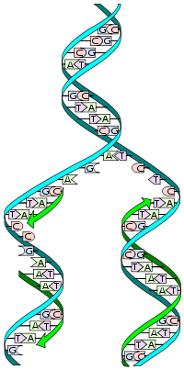
Starter: DNA Replication
Describe semi-conservative DNA replication
What do you remember from GCSE?

Slide 6
Semi Conservative DNA Replication
Describe semi-conservative DNA replication
DNA helix untwists
Hydrogen bonds between bases break and the DNA ‘unzips’
Free nucleotides hydrogen bond to exposed bases
Covalent bonds form between phosphate of one nucleotide and the sugar of the next
Ends up with 2 identical DNA molecules

Slide 7
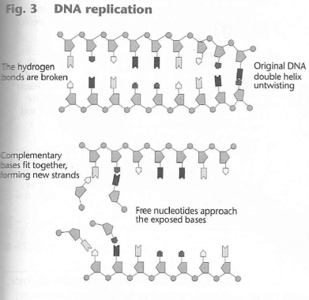
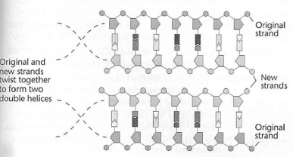
Semi conservative replication
Describe semi-conservative DNA replication

Slide 8
Roles of Enzymes
Describe semi-conservative DNA replication
DNA Helicase
Breaks the hydrogen bonds connecting the bases
DNA Polymerase
Attaches free nucleotides to the exposed bases on each strand
DNA ligase
Attaches all strand segments together

Slide 9
What happens next?
Describe semi-conservative DNA replication
A
T
C
G
G
C
C
G
A
T
C
G
A
T
T
A
Notes:
this shows a double stranded length of DNA

Slide 10
A
T
C
G
G
C
helicase causes the 2 strands of DNA to separate
C
G
A
T
C
G
A
T
T
A
Notes:
And the separation of the strands

Slide 11
A
T
C
G
G
C
helicase causes the 2 strands of DNA to separate
C
G
A
T
C
G
A
T
T
A

Slide 12
What happens next?
Describe semi-conservative DNA replication
A
T
C
G
G
C
C
G
A
T
C
G
A
T
T
A

Slide 13
A
T
C
G
G
C
C
G
A
T
C
G
A
T
T
A
T
A
C
G
Notes:
Free nucleotides bind to the exposed strands

Slide 14
A
T
C
free nucleotides are attracted to their complementary base pairs
G
G
C
C
G
A
T
C
G
A
T
T
A
T
A
C
G

Slide 15
A
T
C
free nucleotides are attracted to their complementary base pairs
G
G
C
C
G
A
T
C
G
G
A
T
T
T
A
A
A
T
C

Slide 16
A
T
C
G
G
C
C
G
G
C
A
T
C
T
A
G
G
C
A
T
T
A
T
A
A
T
Notes:
And the formation of the new strands

Slide 17
A
T
T
A
C
G
G
C
G
C
C
G
C
G
G
C
A
T
T
A
C
G
G
C
A
T
T
A
T
A
A
T

Slide 18
Describe semi-conservative DNA replication
What happens next?
A
T
A
C
T
G
G
C
G
C
G
C
C
G
G
C
A
T
T
A
C
G
G
C
A
T
T
A
T
A
A
T

Slide 19
A
T
A
C
T
G
G
C
G
C
G
C
C
G
G
C
A
T
T
A
C
finally condensation reactions join the nucleotides together…catalysed
by DNA Polymerase
G
G
C
A
T
T
A
T
A
A
T

Slide 20
A
T
A
C
T
G
G
C
G
C
G
C
C
G
G
C
A
T
T
A
C
G
G
…forming 2 identical strands of DNA….
C
A
T
T
A
T
A
A
T

Slide 21
A
T
A
C
T
G
G
C
G
C
G
C
C
G
G
C
A
T
T
A
C
G
G
…because the strands each contain half of the original material…
C
A
T
T
A
T
A
A
T

Slide 22
A
T
A
C
T
G
G
C
G
C
G
C
C
G
G
C
A
T
T
A
C
G
G
…it is called the semi-conservative method.
C
A
T
T
A
T
A
A
T
Notes:
(The free nucleotides could be shown in a different colour to explain how radioactive markers were used to determine the semi-conservative method of replication)

Slide 23
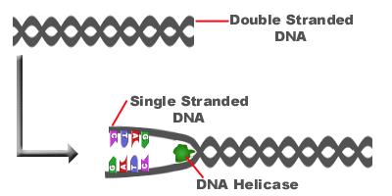
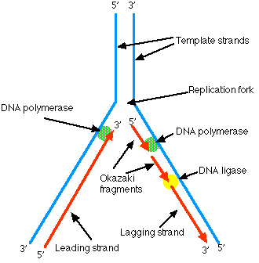
DNA replication
Helicase uncoils the DNA and splits it into 2 template strands.
DNA polymerase adds nucleotides in a 5’ → 3’ direction.
Since the DNA strands are anti-parallel the template nucleotides have to be added in opposite directions.
One strand moves in the same direction as the replication fork (leading strand)
On the other template strand it moves in the opposite direction (lagging strand)
DNA Ligase joins the fragments

Slide 24
DNA Replication
Describe semi-conservative DNA replication
https://www.youtube.com/watch?v=27TxKoFU2Nw
http://www.wiley.com//legacy/college/boyer/0470003790/animations/replication/replication.htm

Slide 25
Importance of DNA Replication
Describe semi-conservative DNA replication
Conserves the genetic information accurately
However, random, spontaneous mutations can occur (1 in 10⁸ base pairs)
Enzymes are used to proofread and edit out incorrect nucleotides therefore reducing the number of mutations

Slide 26
Task: Make a summary of Semi Conservative Replication
Describe semi-conservative DNA replication
Draw a cartoon of DNA replication
OR
A stages wheel

Slide 27
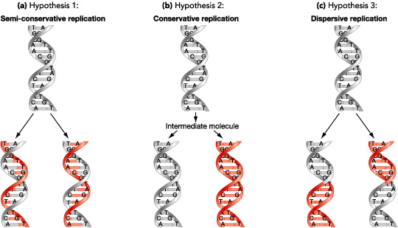
Why semi-conservative replication?
There are 3 possible mechanism for replication:

Slide 28
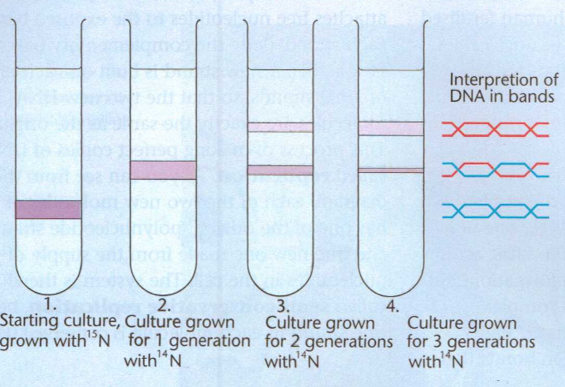
Evidence: Meselson and Stahl
Describe semi-conservative DNA replication

Slide 29
Experimental work:
Meselson and StaHl
Describe semi-conservative DNA replication
Grew bacteria in a medium containing heavy nitrogen (isotope 15N)
Then put the bacteria in a growth medium containing light nitrogen (14N)
The first generation of bacteria had DNA made from 15N, when the bacteria replicated the new half of the DNA strand was made from 14N

Slide 30
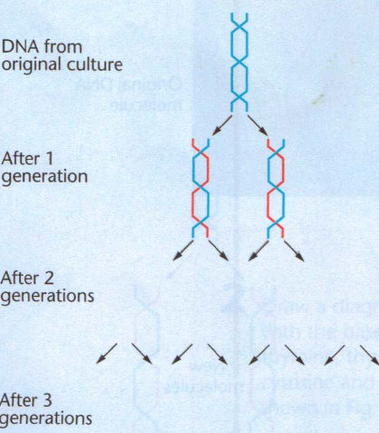
Copy and Complete
Describe semi-conservative DNA replication

Slide 31
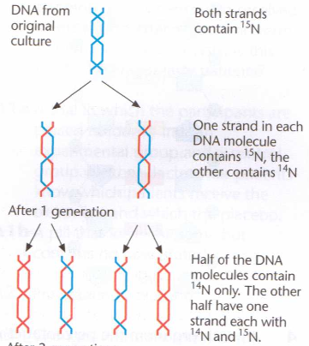
Answers
Describe semi-conservative DNA replication

Slide 32
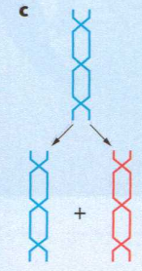
Evidence for semi conservative replication of dna
Describe semi-conservative DNA replication

Slide 33
Answers
Describe semi-conservative DNA replication

Slide 34
Plenary: Quick Quiz
Describe semi-conservative DNA replication
Define the term antiparallel
A DNA strand have the base sequence ATTAGGCTAT, write the complementary strand
A DNA molecule is 20% Thymine, what %age of each of the other types of bases would it contain?
What type of diseases can result from DNA copying going wrong?
Parallel, but with chains running in opposite directions
TAATCCGATA
20% A, 30% C and 30% G
Cancers may occur (when a mutation happens in a forming gamete genetic diseases can occur e.g. sickle cell anaemia)

Slide 35
Plenary Answers
Describe semi-conservative DNA replication
Parallel, but with chains running in opposite directions
TAATCCGATA
20% A, 30% C and 30% G
Cancers may occur (when a mutation happens in a forming gamete genetic diseases can occur e.g. sickle cell anaemia)

