Slide 1
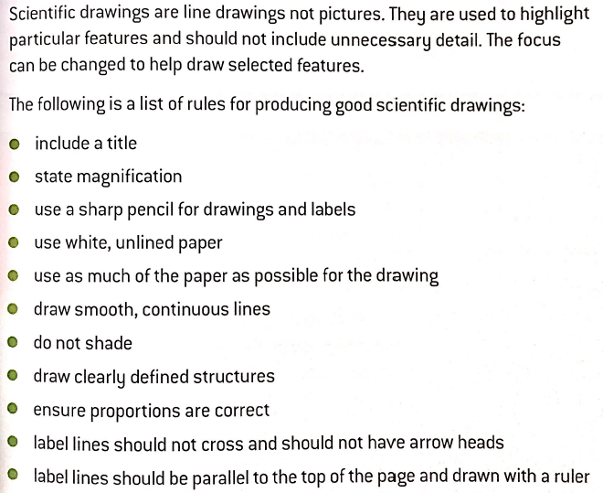
Drawing skills

Slide 2
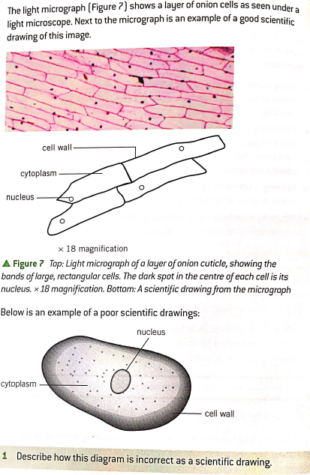
Correct drawing
Incorrect drawing !!
Shading present
Label lines not touching correct place (cell wall)
Label lines not parallel with top of page
No magnification given

