Slide 1
Ectotherms & Endotherms

Slide 2
Learning Objective Success Criteria
Know about endotherms & ectotherms
Describe the physiological and behavioural responses that maintain a constant core body temperature in ectotherms & endotherms

Slide 3
Starter: Marine Iguanas
http://www.youtube.com/watch?v=czpPbDGHOZA

Slide 4
Task: Independent LEarning
Person 1:
How do Ectotherms maintain a core body temperature?
Physiological Responses
Behavioural Responses
Person 2:
How do Endotherms maintain a core body temperature?
Physiological Responses
With reference to peripheral temperature receptors, hypothalamus & effectors in skin and muscles
Behavioural Responses
Notes:
Create A4 summary with question on either endotherms or ectotherms, must include definition of those terms. Use pages 8-11 in book.

Slide 5
Assessment Plenary
Explain the key points to the other person in your pair
Can they now answer the questions on either page 9 or 11?

Slide 6
Learning Test: Endotherms June 10
[5]

Slide 7
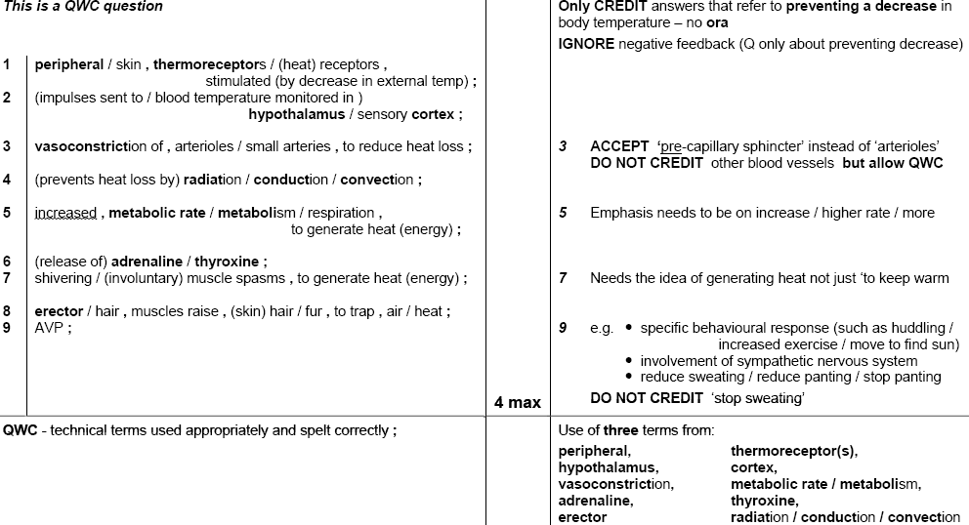
Endotherms June 10 Markscheme

