Slide 1
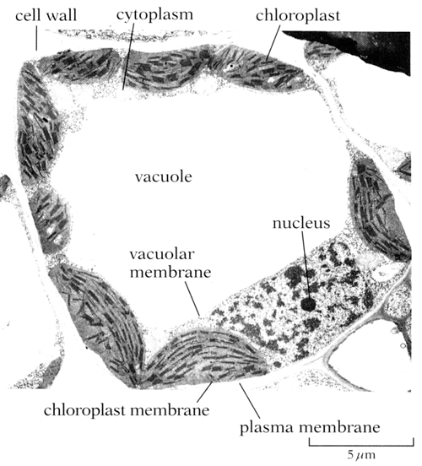
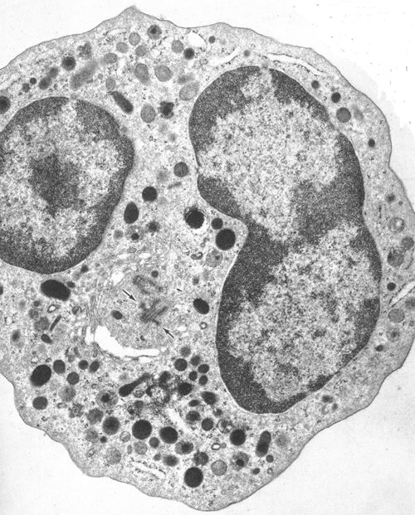
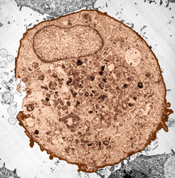
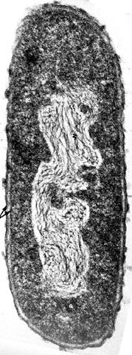
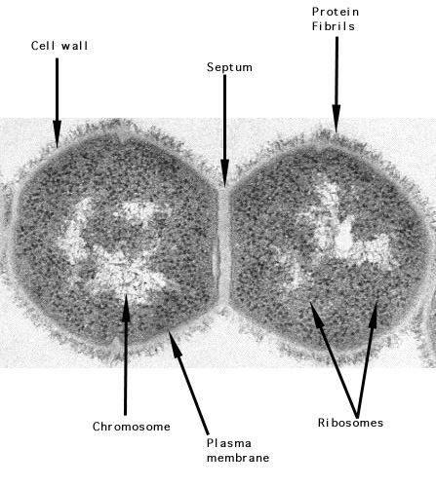
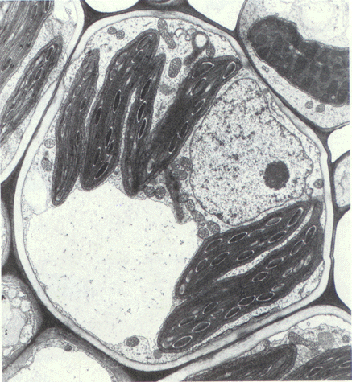
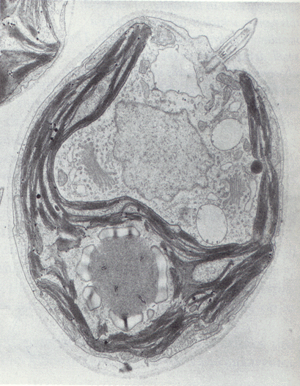

Slide 2
Plant (E)
Animal (E)
prokaryote
Animal (E)
Plant (E)
Proctist (E)
prokaryote
Notes:
Give the students the pictures cut up. Ask them to put them into groups. Hopefully they will recognise three different sorts of cells. Eg membrane bound nucleus and organelles to group Pro and Euk and cell wall vs cell membrane to group plant and animal cells.

