Slide 1
Factors affecting Enzymes

Slide 2
Specification

Slide 3
Enzymes & Enzyme Concentration
Task: read the information and answer the past paper question

Slide 4
The Effect Of Enzyme Concentration
On The Rate Of Enzyme - Catalysed Reactions
Rate of
reaction
The rate of reaction
is directly proportional to the
enzyme concentration
As enzyme concentration
increases, the rate of reaction
increases
In living cells, enzyme
concentrations are usually
much lower than substrate
concentrations
Substrate concentration is
rarely a limiting factor
Increasing concentration of enzyme

Slide 5
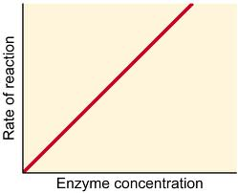
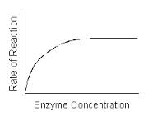
Enzymes and Enzyme Concentration
As EC increases, more active sites become available so more enzyme substrate complexes form
With a fixed concentration of substrate: A point will be reached when all the substrates are occupying active sites

Slide 6
PPQ
Explain the effects of enzyme concentration, substrate concentration and competitive inhibitors on the rate of an enzyme-controlled reaction. [9]

Slide 7
Markscheme
Enzyme concentration (3 max)
1 reaction (rate) increases with increased enzyme; A high / low
2 more active sites available;
3 in excess substrate / as long as enough substrate (molecules available to occupy active site);
4 (as reaction progresses) the rate will decrease as substrate, used up / becomes limiting; R plateau

Slide 8
Markscheme
Substrate concentration (3 max)
1 reaction (rate) increases with increased substrate; A high / low
2 more, molecules available to enter active site / ESC formed; A more successful collisions
3 reaches point where all active sites occupied;
4 no further increase in rate / reaches Vmax; A plateau / levels off
5 enzyme conc. becomes limiting / unless add more enzyme;

Slide 9
Markscheme
Competitive inhibitor (5 max)
1 inhibitor has similar shape to substrate;
2 can, fit / occupy, active site;
3 for short time / temporary / reversible;
4 prevents / blocks, substrate from entering active site;
5 rate determined by relative concentrations;
6 little inhibition / rate little reduced, if substrate conc. > inhibitor conc.; ora
7 ref to chance of, substrate / inhibitor, entering active site;
8 effects can be reversed by increasing substrate conc.
General points
10 drawing a suitable graph to illustrate point made with labelled axes;
11 ref to optimum (rate);

