Slide 1
Do Now
How would you improve the answer to the question below?
Question:
Basing your answer on the ‘induced-fit’ hypothesis, describe how enzymes catalyse reactions.
The substance fits into the active site of the enzyme. Once in the active site the substance gets broken down into products. It then moves out of the active site and allows the next substance to react.

Slide 2
Enzyme Inhibitors
Learning objective
To understand the effects of inhibitors on the rate of enzyme-controlled reactions
Success Criteria
I can describe the action of competitive and non-competitive inhibitors
I can explain the effect of competitive and non-competitive inhibitors on the rate of an enzyme-controlled reaction
I can describe and explain how inhibition can control metabolic sequences involving many enzymes

Slide 3
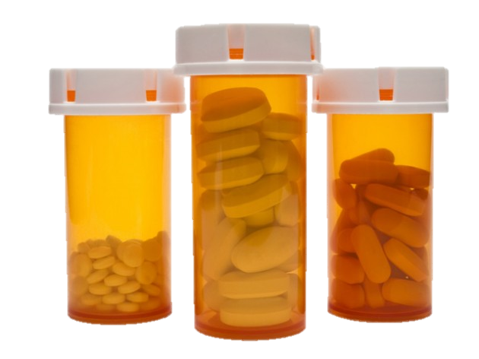
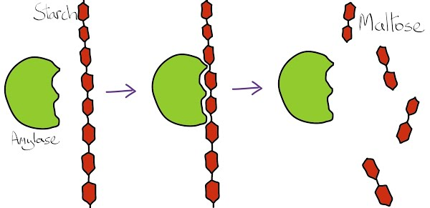
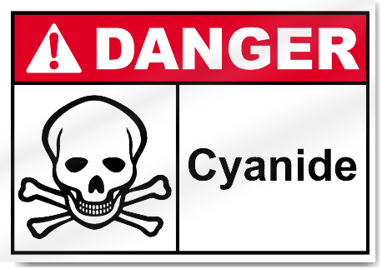
The Big Picture

Slide 4
Inhibitors
Inhibitors are molecules that bind to an enzyme, decreasing it’s ability to convert substrate to product
TASK 1: Use the info sheets provided to find out about competitive and non-competitive inhibitors. Work as a group to find the information required to fill in the task sheet

Slide 5
Quick Check
Which kind of inhibitor binds at the active site of the enzyme?
What does a competitive inhibitor prevent the formation of?
What can be done to increase the rate of reaction?
If a competitive inhibitor binds irreversibly, what is it called?
Where does a non-competitive inhibitor bind?
Which level of protein structure do they affect?
Will increasing the substrate concentration allow the rate of reaction to reach it’s maximum?

Slide 6
Controlling Metabolic Sequences
What do you remember about this diagram that we’ve seen before?
enzyme 1
enzyme 2
substrate 2
How might it be related to todays lesson on inhibitors?
substrate 1
substrate 3
enzyme 3
product molecules

Slide 7
Controlling Metabolic Sequences
Study the diagram with a partner / as a three. Try to explain what it is showing. Annotate your diagram with your ideas
The diagram shows how end product can inhibit it’s own formation, by becoming a competitive inhibitor of the first enzyme in the pathway

Slide 8
Practice Exam Questions

