Slide 1
Pag Next lesson
PAG4 is based on the effect of substrate concentration on the rate of an enzyme-controlled reaction.
Need to book equipment and repro student sheet from folder 6.

Slide 2
Changing substrate concentration
Lesson 5

Slide 3
Success Criteria
Describe and explain the effect of enzyme concentration and substrate concentration on enzyme activity

Slide 4
Starter
Think, pair, share
Effect of enzyme concentration on enzymes
Effect of substrate concentration on enzymes

Slide 5
The Effect Of Substrate Concentration
On The Rate Of Enzyme - Catalysed Reactions
Low Substrate
Concentration
Low product
concentration per
unit time
Increased Substrate
Concentration
More product
formation;
increased reaction rate

Slide 6
The Effect Of Substrate Concentration
On The Rate Of Enzyme - Catalysed Reactions
Further increase
in substrate
concentration
Maximum product
formation; maximum
rate of reaction
Excess substrate
concentration
No further increase
in product formation;
maximum reaction rate
maintained
Enzyme
concentration
is the LIMITING FACTOR

Slide 7
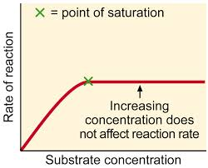
Enzymes and Substrate Concentration
As SC increases there are more successful collisions and more enzyme substrate complexes form.
Point of saturation: increase in SC has no effect, as all the active sites are occupied.
Substrate molecules are having to ‘wait’ for empty active sites.

Slide 8
Effect of substrate concentration on rate

Slide 9
More on Substrate concentration...
Initially, as substrate concentration increases, so does the rate of reaction. Why?
More enzyme-substrate complexes can form.
At this point, substrate concentration is the limiting factor.
As substrate concentration rises further, the reaction will reach its maximum rate.
As mentioned earlier, the point of saturation is reached as all active sites are occupied.
What is now the limiting factor?
Enzyme concentration.

Slide 10
Effect of enzyme concentration on rate

Slide 11
PAG Preparation
Read through the procedure for the PAG next lesson.
Familiarise yourself with the method required to set up the dilutions.
Make sure you bring your lab-book.

Slide 12
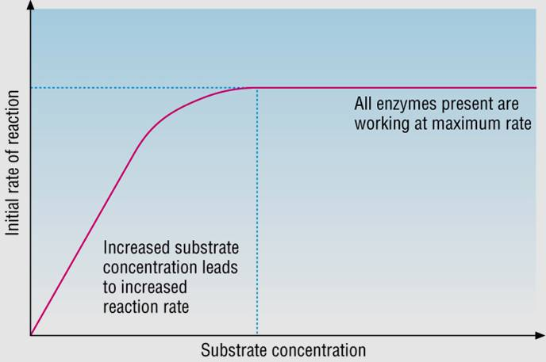
plenary
Copy the graph and add as much detail as you can.

Slide 13
Success Criteria
Describe and explain the effect of enzyme concentration and substrate concentration on enzyme activity

