Slide 1
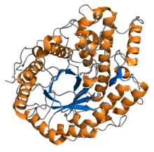
Do Now
Have your improvements back, and change anything that needs changing.
Think, Pair, Share:
What do you remember about enzymes and temperature from GCSE?

Slide 2
Increasing the rate of a chemical reaction
What can we do to increase the rate of a chemical reaction?
Notes:
Talk about the rate of enzyme-controlled reactions being very slow at low temperatures

Slide 3
Increasing temperature will increase the rate of an enzyme-controlled reaction
Particles have more kinetic energy
So substrates collide with the enzymes active site more frequently
More enzyme-substrate complexes are formed
So rate of reaction increases
More product molecules are formed at higher temperatures

Slide 4
At low temperatures
At high temperatures

Slide 5
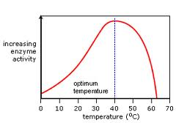
Enzyme temperature graphs
Increased rate: more kinetic energy means more collisions, which means more enzyme substrate complexes form.

Slide 6
Quick Check
Reactions only take place when the substrate collides successfully with the ___________ ____________.
What does this form?
If the reactant mixture is heated, both molecules will gain ________ ___________.
This will increase the rate of ____________ collisions
The rate of formation of _____________ _____________ _____________ increases, and therefore the rate of ____________ formation
This happens up to a particular temperature known as the enzyme’s ______________ ______________

Slide 7
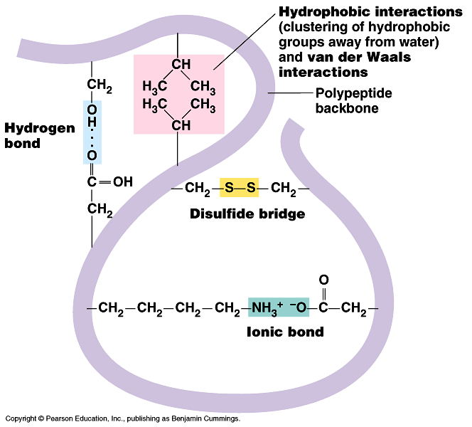
Recap
Q: What bonds hold together the tertiary structure of proteins? (and therefore enzymes)
Hydrogen bonds
Ionic bonds
Disulphide bridges
Hydrophilic / hydrophobic interactions

Slide 8
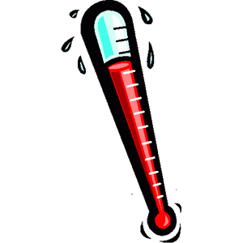
Increasing the rate of enzyme-controlled reactions
What will happen if we continue to increase the temperature? Will the reaction go faster and faster?

Slide 9
Further temperature increase slows down the reaction
Thermal energy breaks bonds within the enzyme
The enzyme denatures – why?
HEAT
pH

Slide 10
Denaturation
If the temperature of the reactant mixture rises above the optimum, the enzymes have too much kinetic energy
The bonds in the structure break, causing the active site to change shape
Fewer enzyme-substrate complexes form. What happens to the amount of product formed?
If more heat is applied, the shape of the active site is irreversibly changed.
The reaction cannot proceed at all, as the enzyme has been denatured
The shape of the active site and the substrate are no longer __________

Slide 12
Practice EQ

Slide 13
(a) (i) Increase to 30 °C / 31 °C and then decreases / optimum or max rate at 30 °C / 31 °C;
Accept: peak at 30 °C / 31 °C
1
(ii) 1. Enzyme denatured / hydrogen bonds / bonds holding tertiary structure broken / tertiary structure changed;
2. Change in shape of active site (of enzymes);
3. Substrate / protein no longer fits / binds (into active site) / few or no ES complexes;
1. Reject: Peptide bonds broken
Denatures active site = 2 marks for mp 1 and 2
2. Q Only allow second point if active site is used correctly
Accept: active site no longer complementary
3. Accept: Substrate cannot bind to enzyme
3

Slide 14
Optimum Temperatures Vary
Some enzymes have an optimum temperature somewhere between 40 and 50 degrees.
These must be heat resistant enzymes.
PCR uses heat resistant enzymes.
The optimum temperature of an enzyme is likely to be related to the organism's environment or to the internal temperature it can maintain.
Take 5 minutes to read about how the optimum temperature of different enzymes varies.
Page 129 in old OCR class textbook.
Page 109 in new, replacement OCR textbook.

Slide 15
Temperature Coefficient (Q₁₀)
The amount the rate of reaction increases when the temperature is raised by 10⁰C is known at the temperature coefficient (Q₁₀)
Equation:
Q₁₀ = rate of reaction at (T + 10)ºC
rate of reaction at T ºC
If Q₁₀ is 2, the rate of reaction doubles for every 10⁰ rise in temperature

Slide 16
Questions
Explain why the rate of an enzyme controlled reaction is lower at 10ºC than it is at 30ºC.
2. Explain why a refrigerated enzyme brought up to 40ºC will catalyse a reaction, but a boiled enzyme will not.
Less kinetic energy at 10ºC.
Enzyme/substrate moving slower.
Not as many successful collisions.
Kinetic energy increased at 30ºC.
More enzyme-substrate complexes – more product formed.
Refrigerated enzyme’s structure has not been damaged.
Active site not changed shape, so enzyme-substrate complexes will form at 40ºC.
Boiled enzyme will have been denatured.
Active site and substrate not complementary so enzyme-substrate complexes do not form.

