Slide 1
Enzymes and Temperature
Lesson 3

Slide 2
Starter
Think, pair, share
Effect of temperature on enzymes

Slide 3
Success Criteria
Describe and explain the effect of temperature on enzyme activity.
Explain what happens to an enzyme when it denatures.

Slide 4
Temperature & Molecular Collisions
Molecules are
constantly in motion
and colliding with
one another.
The speed of motion
and number of
collisions is affected
by the temperature.
AT LOW
TEMPERATURES
AT HIGHER
TEMPERATURES
More enzyme-substrate
complexes and hence
more product
molecules are formed
at the higher
temperature.

Slide 5
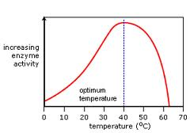
Enzymes and Temperature
Increasing rate: more kinetic energy means more collisions, which means more enzyme substrate complexes form.

Slide 6
Collisions...
Reactions only take place when the substrate collides successful with the ________ _____.
What does this form?
___________ ____________ ____________.
If the reactant mixture is heated, both molecules will gain kinetic energy (move faster).
This will increase the rate of ____________
The rate of formation of enzyme-substrate complexes increases (and hence the product).
This happens up to a particular temperature, called the enzyme’s ___________ ________________.
active site
Enzyme substrate complex
collisons
Optimum temperature
Notes:
Active site, enzyme-substrate complex, successful, optimum temperature.

Slide 7
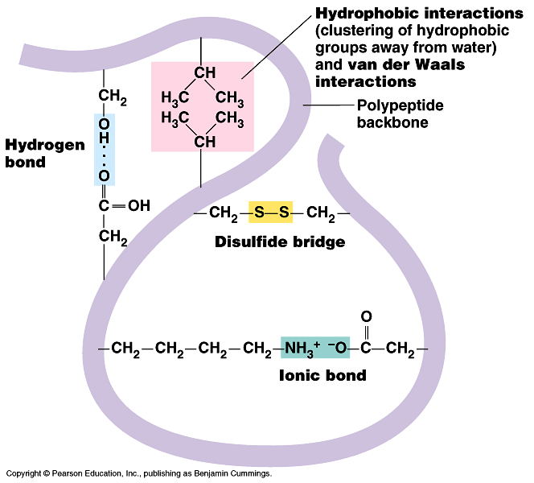
Recap
What bonds hold together the tertiary structure of proteins? (and therefore enzymes).
Hydrogen bonds, ionic bonds, disulphide bridges, hydrophilic/hydrophobic interactions.

Slide 8
Denaturation
If the temperature of the reactant mixture rises above the optimum, the enzymes vibrates too much.
The bonds in it’s structure break, causing the active site to change shape.
Few enzyme-substrate complexes form.
What happens to the amount of product formed?
If more heat is applied, the shape of the active site is irreversibly changed.
The reaction cannot proceed at all, as the enzyme has been denatured.
The shape of the active site and the substrate are no longer __________________________.
complementary
Notes:
complementary

Slide 9
Exam Question
A protease is an enzyme that digests protein. The graph shows how the activity of a protease varies with temperature.
(i) Describe what the graph shows about the effect of temperature on the rate of reaction. (1)
(ii) Explain the shape of the curve between 30 °C and 50 °C. (3)

Slide 10
answers
(a) (i) Increase to 30 °C/31 °C and then decreases / optimum or max rate at 30 °C/31 °C;
Accept: peak at 30 °C/31 °C 1
(ii)
1. Enzyme denatured / hydrogen bonds/bonds holding tertiary structure broken / tertiary structure changed;
2. Change in shape of active site (of enzymes);
3. Substrate / protein no longer fits / binds (into active site) / few or no ES complexes;
4. More enzyme (molecules) denatured as temperature increased;
1. Reject: Peptide bonds broken
Denatures active site = 2 marks for mp 1 and 2
2. Q Only allow second point if active site is used correctly
Accept: active site no longer complementary
3. Accept: Substrate cannot bind to enzyme 3 max

Slide 11
Optimum temperatures vary between enzymes.
Some enzymes have an optimum temperature somewhere between 40 and 50 degrees.
These must be heat resistant enzymes.
PCR uses heat resistant enzymes.
The optimum temperature of an enzyme is likely to be related to the organism's environment or to the internal temperature it can maintain.
Take 5 minutes to read about how the optimum temperature of different enzymes varies.
Page 129 in old OCR class textbook.
Page 109 in new, replacement OCR textbook.

Slide 12
Questions
Explain why the rate of an enzyme controlled reaction is lower at 10ºC than it is at 30ºC.
Explain why a refrigerated enzyme brought up to 40ºC will catalyse a reaction, but a boiled enzyme will not.
Less kinetic energy at 10ºC.
Enzyme/substrate moving slower.
Not as many successful collisions.
Kinetic energy increased at 30ºC.
More enzyme-substrate complexes – more product formed.
Refrigerated enzyme’s structure has not been damaged.
Active site not changed shape, so enzyme-substrate complexes will form at 40ºC.
Boiled enzyme will have been denatured.
Active site and substrate not complementary so enzyme-substrate complexes do not form.

Slide 13
Temperature coefficient (q₁₀)
The amount the rate of reaction increases when the temperature is raised by 10ºC, is known as the temperature coefficient (Q₁₀).
Equation:
Q10 = rate of reaction at (T + 10)ºC
rate of reaction at T ºC
If the Q10 is 2, the rate of reaction doubles for every 10ºC rise in temperature.

Slide 14
Plenary - Exam question.
Page 13-14 of paper.
Sequence of amino acids
Name the bonds
A – ionic
B- hydrogen
C- disulphide bridge

Slide 15
When proteins are heated to a high temperature, their tertiary structure is disrupted.
Explain how this occurs

Slide 16
Success Criteria
Describe and explain the effect of temperature on enzyme activity.
Explain what happens to an enzyme when it denatures.

