Slide 1
Do Now – Starter Quiz
Answer the following questions, to see how much you can remember about enzymes
What are enzymes made of?
What do enzymes do?
What is the name of the substance that an enzyme acts on?
What is the name of the part of an enzyme that has a specific shape?
What two factors are enzymes most affected by?
What term do we use to say when an enzyme has been ‘disrupted’ and so doesn’t work anymore?

Slide 2
Introduction to Enzymes
Learning objective
To recap GCSE learning of enzymes
Success Criteria

Slide 3
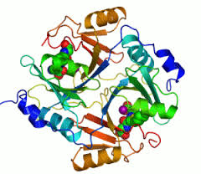
Introduction to Enzymes
Enzymes are globular proteins with a specific tertiary structure
The action of enzymes can either be inside a cell or outside a cell
What is the term given to action inside the cell?
What is the term given to action outside the cell?
Enzymes are known as biological catalysts that speed up (catalyse) metabolic reactions
Q: How do enzymes speed up reactions?
They lower the activation energy, therefore increasing the rate
of the reaction
Intracellular
Extracellular

Slide 4
GCSE Enzymes Recap
Enzymes are highly specific biological molecules
Q: What is the name of the specific part of the enzyme?
Enzymes are very sensitive to changes in both temperature and pH
Q: What is the term used to describe what happens when enzymes are exposed to high temperature?
Enzymes are highly specific molecules, and only specific enzymes will catalyse specific reactions
Substrate
molecule in
the ACTIVE
SITE
Active site
Denature
Enzyme molecule

Slide 6
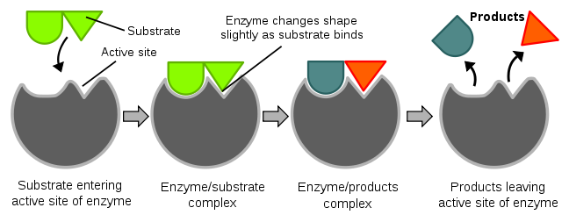
GCSE Enzymes Recap – describing the lock and key model
Use this diagram to see if you can remember how the lock and key model of enzyme action works

Slide 7
The Lock And Key Model
In an enzyme - catalysed reaction, the enzyme binds to the substrate to form an enzyme-substrate complex.
Enzyme
molecule
An enzyme - substrate complex
forms
S
Products diffuse
away from the
active site
A reaction
occurs
forming an
enzyme - product
complex
The lock & key model
proposes that the substrate
binds to the active site
which it fits exactly, like a
key in a lock

Slide 9
Lock and Key Definition
The lock and key theory states that an enzyme will only catalyse a reaction if the substrate has a complementary shape to its active site.
An enzyme-substrate complex will only form if the substrate fits exactly into the active site.

Slide 10
The Induced Fit Model
This model takes into account the fact that proteins (enzymes) have some three-dimensional flexibility.
Substrate binds to the enzyme
at the active site
It states that the shape of active sites are not exactly complementary, but change shape in the presence of a specific substrate to become complementary.
SUBSTRATE
Binding of the substrate
induces the enzyme to change
shape such that there is an
exact fit once the substrate
has bound
Enzyme Molecule
According to this model, reactions can
only take place AFTER induced fit has occurred

Slide 12
TASK
Using p. 105-106 in the textbook, create a comparison table for the lock and key and induced fit hypothesis
Lock and Key Model | Induced Fit Hypothesis

Slide 13
To finish…
One form of pulmonary disease develops because enzymes are released by phagocytes entering the alveoli of the lungs. This enzyme action can break down the elastin in the lining of the bronchioles and the alveoli. Use the example of elastin to explain the induced-fit hypothesis of enzyme action

Slide 14
HOMEWORK
Read through the method for your chromatography PAG

