Slide 1
Excretion

Slide 2
Spec
(a) the term excretion and its importance in maintaining metabolism and homeostasis
To include reference to the importance of removing metabolic wastes, including carbon dioxide and nitrogenous waste, from the body

Slide 3
Intro to Excretion
Hand out specification

Slide 4
Learning Objectives Success Criteria
Understand the importance of excretion
Define the term excretion
Explain the importance in maintaining metabolism and homeostasis

Slide 5
FLIP Learning Test: [5] Endotherms June 10
[5]

Slide 6
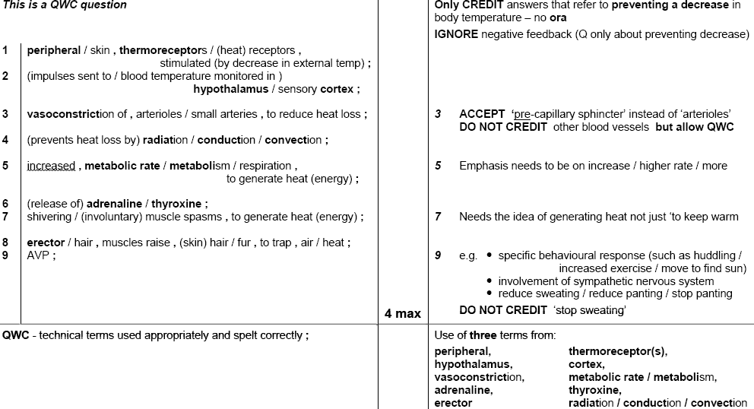
Endotherms June 10 Markscheme

Slide 7
Starter
Think, Pair, Share
Think of 1 fact you knew about excretion from GCSE

Slide 8
A2 Key Term
Excretion
Removal of metabolic waste (waste from reactions inside cells) from the body

Slide 9
Overview of Excretory System
http://www.youtube.com/watch?v=WtrYotjYvtU
We are focussing on kidney & liver

Slide 10
Importance of removing metabolic wastes from the body
Carbon Dioxide
Can increase the pH of the blood
Excreted via the lungs
Nitrogenous waste
Makes the toxic ammonia
Liver turns it into urea
Removed from the blood by the kidneys

Slide 11
Question
Animals that live in water, such as fish, often excrete their nitrogenous waste in the form of ammonia rather than as urea.
explain why it is possible for them to do this, whereas terrestrial animals cannot.
Suggest the advantages to aquatic animals of excreting ammonia rather than urea.

Slide 12
Answers
a. The ammonia will quickly dissolve in the large volumes of water around them, and be so diluted that it will not harm the fish.
b. turning ammonia into urea requires energy in the form of ATP, so by excreting ammonia rather than urea, significant amounts of energy are saved.

Slide 13
Task
Turn the paragraph on Carbon Dioxide on P25 (P37 in old book) into a flow diagram

Slide 14
TASK
Look, cover, write, check
The equations for the break down of nitrogenous compounds on P25 (P37 in old book)

Slide 15
Waste metabolites: More Detail
Urea
Made from deamination of xs amino acids in liver:
Removal of amino group → ammonia + keto acid.
React with CO2 to make less soluble, less toxic→ urea. Energy dependent reaction.
Transported in blood plasma
Filtered in kidney to make urine
Carbon dioxide
Respiratory product from all cell
Transported in blood
1) dissolved in blood plasma
2) directly with Hb
3) Forming hydrocarbonate ions (carbonic anhydrase)
Removed by lungs
Respiratory Acidosis
pH less than 7.35
Characteristic symptoms
Notes:
XS proteins and amino acids can not be stored, they are transported to liverDeamination- removal of amino group from amino acids producing ketoacids and ammonia (highly soluble, toxic) subsequently converted (addition of CO2 to make urea and water) to less soluble, less toxic compound UREA (CO(NH2)2
Respiratory acidosis- slowed/difficulty breathing, headache, drowsy, restlessness, tremor and confusion

Slide 16
Plenary: PPQ

Slide 17
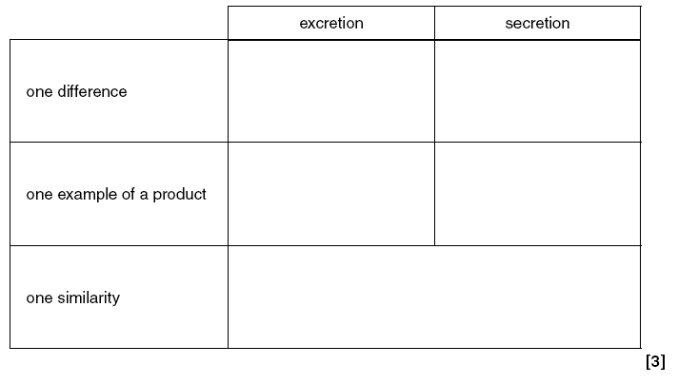
Past Paper Question

Slide 18
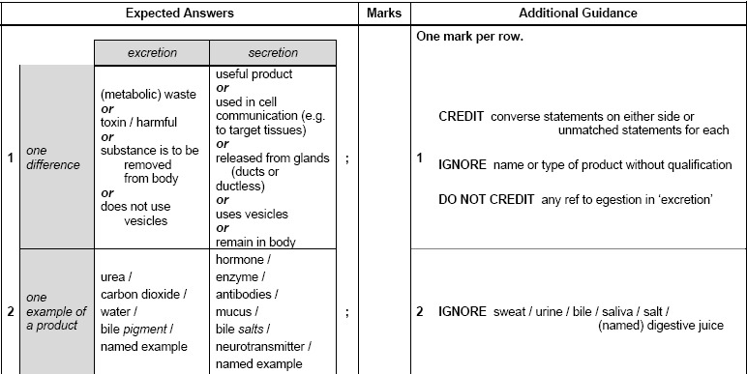
Markscheme

Slide 19
Set flip learning task
See other folder for task powerpoint and worksheet

