Slide 1
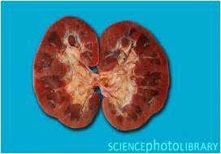
Kidney

Slide 2
Spec
(c) (i) the structure, mechanisms of action and functions of the mammalian kidney (ii) the dissection, examination and drawing of the external and internal structure of the kidney (iii) the examination and drawing of stained sections to show the histology of nephrons
To include the gross structure and histology of the kidney including the detailed structure of a nephron and its associated blood vessels AND the processes of ultrafiltration, selective reabsorption and the production of urine. PAG1, PAG2

Slide 3
Learning Objective Success Criteria
You will know about the structure of the kidney
describe with the aid of diagrams the histology and gross structure of the kidney.

Slide 4
Set your own Success Criteria
Set yourself 2 Success Criteria
One knowledge based
E.g. Describe, explain, justify...
One skills based
Think about how you need to improve Low Power drawings

Slide 5
Gross Structure of Kidney

Slide 6
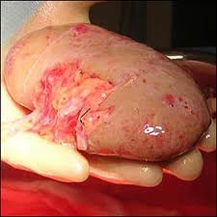
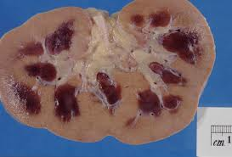
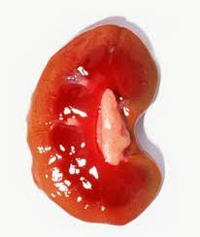
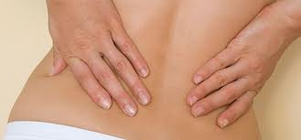
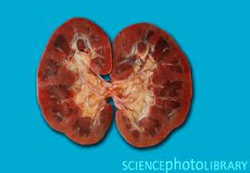
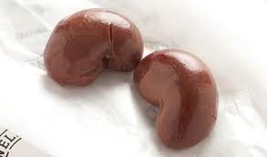
Notes:
S: What do you already know about the kidney?

Slide 7
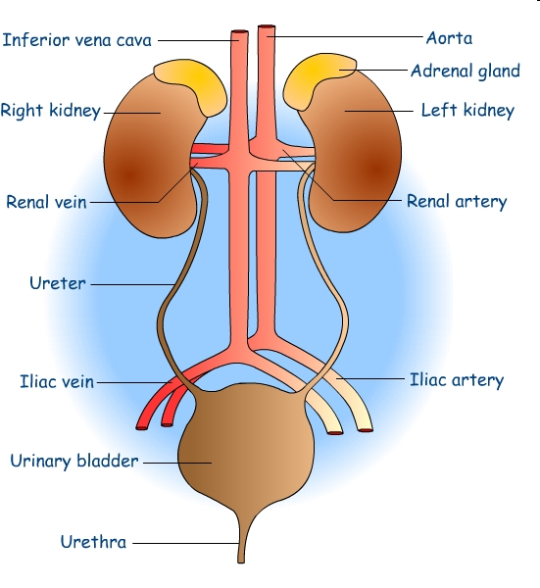
Urinary System

Slide 8
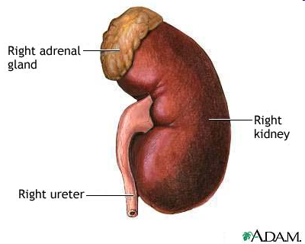
Function of the Kidneys
Excrete urea (made by the liver), water and salt
Filter blood at high pressure
Re-absorb water and useful substances

Slide 9
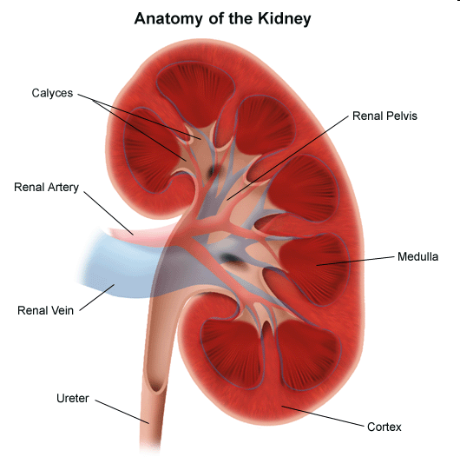
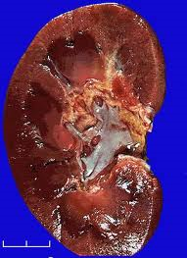
Structure of the Kidney

Slide 10
PAG 2
Success Criteria
Safe use of instruments for dissection of an animal or plant organ
Production of scientific drawings from observations with annotations
What you are being assessed on
labelled, annotated drawings of the kidney dissection
a suitable table with measurements of the 3 main tissues recorded.
answers to the extension questions

Slide 11
Drawing Microscope Slides
Annotations
Whilst a label might be the name of a tissue, an annotation adds a descriptive quality such as shape, size or colour.
Drawings from a microscope
Single, clear lines drawn with a sharp pencil.
No shading or colour on the diagram.
Informative title to be included.
Scale included (e.g. high power, low power, x80, x10) to show approximate magnification.
Low power tissue plans may not include cells.
High power diagrams show a few adjacent cells only; adjacent cells must have complete lines.
Cells or tissues should be in correct proportions.
Label lines drawn in pencil using a ruler.

Slide 12
Low Power Drawing Mark Scheme [10]
Annotations [3]
Whilst a label might be the name of a tissue, an annotation adds a descriptive quality such as shape, size or colour.
Drawings from a microscope [7]
Single, clear lines drawn with a sharp pencil.
No shading or colour on the diagram.
Informative title to be included.
Scale included (e.g. high power, low power, x80, x10) to show approximate magnification.
Low power tissue plans may not include cells.
Tissues should be in correct proportions.
Label lines drawn in pencil using a ruler.

Slide 13
Specialist Groups
Group Number | Specialist | Group Member
1
2
3
4
5
6
7
8
Dissect the kidney by butterflying it
Draw a low power drawing of the structures
Notes:
Triple science students act as specialists and support the additional science students

Slide 14
Peer Assess Low Power Drawing

