Slide 1
Study the picture below for 1 minute, then answer the questions that follow.
How many winning lines included the middle square?
Which section of the grid was always empty?
Did X or O win the game with the black background?
How many bottom right corners featured an X?
How many O’s were there altogether?
3
Top left
x
4
13

Slide 2
AS Biology
Note taking and Study Skills

Slide 3
Important bits!!!
Use the handbook supplied on sign up day, this should be placed in the front of your folders
You will need an A4 ring binder for Biology, along with A4 lined paper which you will use to take notes in lessons. You will have 2 teachers so it is advised to separate out your work using dividers.
You will also need to purchase lab book where you will record your PAGs, as evidence for module 1. This can be from the prep room.
Notes:
Get students to look through the handbook as you work through the next few slides. More info on PAG’s in next intro lesson.
Planned absences – make sure you collect the work from your teacher prior to these. Any unplanned see the teacher if possible before the next lesson, so you can catch up and not fall behind.

Slide 4
Level | Module title | Subject Content
AS/A2 | Module 1—Development of practical skills in Biology | Skills of planning, implementing and evaluation. This covers the practical skills that students develop throughout the course. Assessed via written examinations, this module underpins the entire specification.
AS/A2 | Module 2—Foundations in Biology | Covers concepts required throughout the remaining modules. Includes Cell Structure, Biological molecules, nucleotides and nucleic acids, Enzymes, Biological membranes, Cell diversity and cellular organisation.
AS/A2 | Module 3—Exchange and Transport | Exchange surfaces, Transport in animals, Transport in plants.
AS/A2 | Module 4—Biodiversity, Evolution and Disease | Includes: Communicable diseases, disease prevention and the immune system. Biodiversity, classification and evolution.
A2 | Module 5—Communication, Homeostasis and Energy. | Homeostasis, neuronal and hormonal communication, plant and animal responses. Photosynthesis, Respiration, Excretion.
A2 | Module 6—Genetics, Evolution and Ecosystems. | Cellular control and inheritance, manipulating genomes, biotechnology, cloning and populations.

Slide 5
Teacher 1 – Sarah/Nisreen | Teacher 2 – Harriet/V
Module 2 – Foundations in biology
Block 1A 2. 1 Cell structure (5) 2.5 Biological membranes (6) PAG 5.1 Colorimeter PAG 8.1 Transport in and out of cells | Block 1C 2.2 Biological Molecules (11) PAG 6.1 Chromatography PAG 9 .1 Qualitative testing
Block 1B 2.6 Cell division, diversity and organisation (6) PAG 1.1 Microscopy 2.3 Nucleotides (5) PAG 10.1 Data logger DNA (to be done by teacher 2) | Block 1D 2.4 Enzymes (8) PAG 4.1 Rate of enzyme controlled reaction
Module 3 – Exchange & transport | Module 4 – Biodiversity, evolution & disease
Block 1E 3.1 /3.2 Exchange surfaces & Transport in animals (13) PAG 2.1 Heart dissection | Block 1G 4.2 Biodiversity (7) PAG 3.2 Sampling techniques 4.3 Classification & Evolution (8)
Block 1F 3..3 Transport in plants (8) | Block 1H 4.1 Communicable diseases (8)
Notes:
Within each block there will be a key homework – MAT and an end of block test. These marks will be recorded on your assessment tracking sheet (in handbook) and used to monitor your progress.
There will also be a mock in January covering Module 2. Then one at the end of year 12 (breadth) and the beginning of year 13 (depth) , that will include all of the above units.

Slide 6
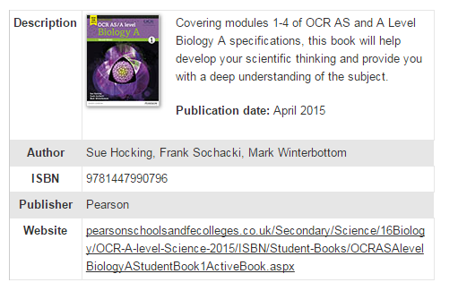
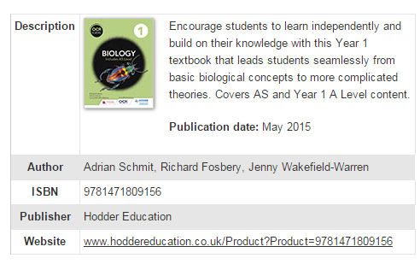
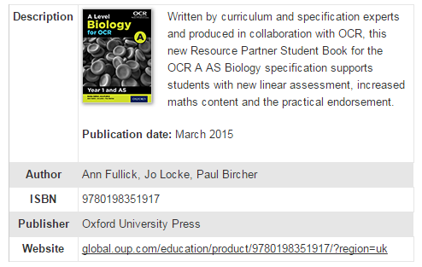
Revision Workbooks
OCR AS/A LEVEL YEAR 1 – Biology A workbook – Foundations in Biology (hodder) ISBN 978-1-4718-4728-5
OCR AS/A LEVEL YEAR 1 – Biology A workbook – Exchange & transport. Biodiversity, evolution & disease (hodder) ISBN 978-1-4718-4730-1
Revise OCR AS/A LEVEL Biology A Revision workbook (pearson)
ISBN 978 1 447 98429 0 (covers AS/A2)
Notes:
Purple book can be ordered from the prep room - £13 and the above workbooks are recommended as they cover individual sections with exam questions

Slide 7
AS Year 1
Assessment Type | Title | Duration | Percentage of total AS mark
Written Exam Paper | Paper 1—Breadth in Biology | 1 h 30 | 50
Written Exam Paper | Paper 2—Depth in Biology | 1h 30 | 50
Notes:
Advise this is a 2 year course! If for some reason students choose not to continue, there will be 2 exams at the end of year 12

Slide 8
A2 – 2 Year course
Assessment Type | Title | Duration | Percentage of total A2 mark
Written Exam Paper | Paper 1 - Biological Processes assesses content from modules 1, 2, 3 and 5 | 2h 15 minutes | 37
Written Exam Paper | Paper 2—Biological Diversity assesses content from modules 1,2,4 and 6 | 2h 15 minutes | 37
Written Exam Paper | Paper 3—Unified Biology assesses content from all modules 1-6 | 1h 30 minutes | 26
Teacher Assessed | Practical Endorsement for Biology (PAG) | Non-Exam | Pass/Fail. Reported separately
All papers at the end of year 13. Paper 1 and 2 both have multiple choice questions in section A. Section B includes short answer questions (structured questions, problem solving, calculations and practical) & extended response.
Unified – synoptic-content from all modules - includes short answer questions (structured questions, problem solving, calculations and practical) & extended response
Notes:
Paper 1 and 2 – multiple choice (15 marks) and section B (85 marks) Paper 3 – 70 marks

Slide 9
Ways to take notes:
Why take notes?
PARAPHRASE – don’t copy everything out
Cornell style
Mind – maps
Skeleton notes
Makes you concentrate on what you are learning
 Helps you understand as you write in your own words/diagrams
 Help you link new knowledge to previous knowledge
Allows you to summarise arguments, information/ideas
Notes are excellent for revision!
You remember things better if you have noted them down.
Notes at the end of a class show that you did not fall asleep!

Slide 10
Cornell
Red text indicates parts you should fill in after the lesson,
as part of your review
Being successful at AS Biology
Making notes in class
Headings for key ideas
Prompts
Questions
Diagrams
Write clearly and neatly
Record main ideas, facts, details, examples
Use colour, underline headings, subheadings
Put keywords at the bottom of this column when you review your notes
Summary –
Clear, neat sentences of main ideas with colour and underlining FOR QUICK REFERENCE

Slide 11
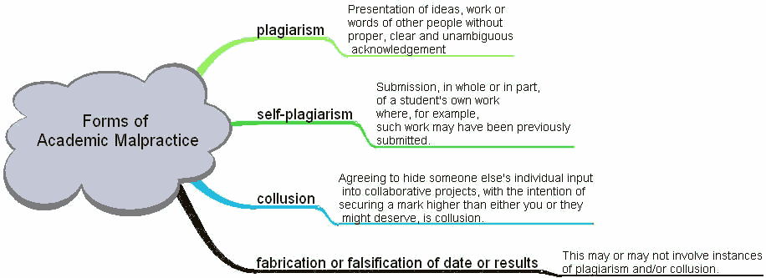

Slide 12
Skeleton
Making notes in class – Write clearly, neatly
What to write
1. Main ideas
2. Facts
3. details
4. examples
Presentation
Colour
Underlining

Slide 13
Review
Use the check lists provided in your handbook, when teachers refer to the spec tick it off when covered
Reviewing your notes - Get into the habit of checking through notes the day they are made or by comparing notes with those of others from your group.
Use the resources on weebly – power points will be added by teachers after the lesson, use these to add detail to notes and review understanding
www.grobybioweebly.com
If you are unsure please do not leave it, ask for help!!!!

Slide 14
Reviewing Notes
If you do not review work, you forget up to 75% in a week and up to 98% in under 3 weeks. So at revision time you start from scratch.
Regular review stimulates understanding of a subject area. Your knowledge grows and becomes joined with other knowledge.
Record key words or concepts, images or sequences. Use your own words, unless you need quotations
Indicate main ideas as headings, subordinate ideas as sub-headings. Use a numbering system. Leave plenty of white space (don't use every line and do leave margins).
identify connections between points rather than just isolated facts and ideas.
include doodles, diagrams, charts etc.. Create these from the information or ideas you have just absorbed.
Use colour!

Slide 15
Paraphrasing – Don’t write everything down!
Activity 1: What makes a good paraphrase?
Two undergraduate students, Jo and Sandra, are writing essays on 'The Role of Stakeholders in Companies' for their business studies course.
They both want to refer to some of the key points made by the writer of the text below, which focuses on the interest that governments have in business enterprises.
Read the text and paraphrase it.
Then, compare it with the two paragraphs written by Jo and Sandra, paraphrasing the writer's main points.
Which student has produced a better paraphrase?

Slide 16
Wartick and Wood
Governments have interests in companies for a variety of reasons. Firms provide the economic basis of the society and are both nourished and regulated by government with the intent of keeping the economy healthy enough to sustain the society and, of course, the government.
Government may attempt to control the harms of business activity to other members of society. In some societies, government runs the economy via central planning mechanisms and state ownership of enterprise.
The role of government is so important, in fact, that we have already devoted chapter 3 to it.
(Wartick and Wood, 1998)

Slide 17
Jo's paraphrase:
Wartick and Wood (1998:103) point out that governments can have a wide range of interests in companies, from supporting them in order to help the economy, to regulating them in order to stop them harming the rest of society.
Sandra's paraphrase:
According to Wartick and Wood (1998), governments have interests for a variety of reasons. They are both nourished and regulated by government, in order to keep the economy healthy enough to sustain the society. On the other hand, the government may also attempt to control the harms of business activity to others in society. In some countries there is a centralised economy, which the government runs.

Slide 18
Paraphrasing
Which is better?
Jo has produced a better paraphrase.
Can you identify what aspects of Jo's paraphrase made it better than Sandra's?

Slide 19
The Maths bit!!!
Within A level Biology 10 % of the marks available within written exams will be for assessment of mathematics (in the context of Biology).
Use the Maths checklist at the end of your handbook. There is also a section at the end of formulae you need to know.

