Slide 1
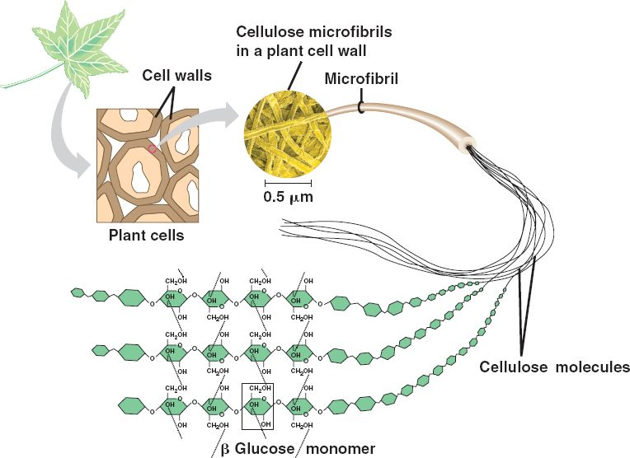
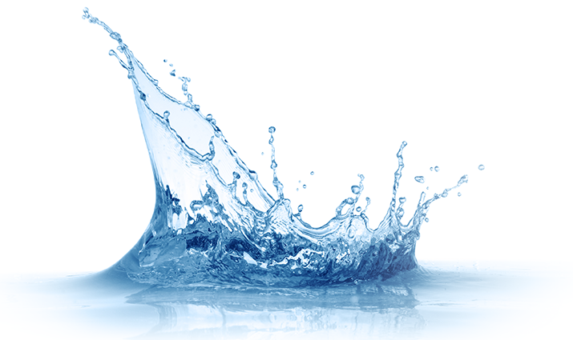
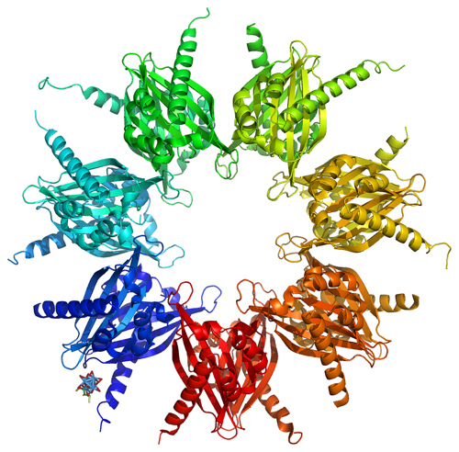
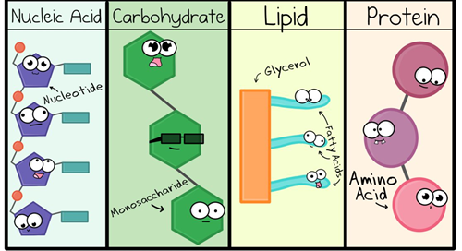
Introduction to Biological Molecules
Lesson 1

Slide 2
Spec:
(b) the concept of monomers and polymers and the importance of condensation and hydrolysis reactions in a range of biological molecules
(c) the chemical elements that make up biological molecules
To include: C, H and O for carbohydrates C, H and O for lipids C, H, O, N and S for proteins C, H, O, N and P for nucleic acids
(p) the key inorganic ions that are involved in biological processes
To include the correct chemical symbols for the following cations and anions: cations: calcium ions (Ca2+), sodium ions (Na+), potassium ions (K+), hydrogen ions (H+), ammonium ions (NH4 +) anions: nitrate (NO3 –), hydrogencarbonate (HCO3 –), chloride (Cl –), phosphate (PO4 3–), hydroxide, (OH–).

Slide 3
Need TO BOok
Molymods
Mini whiteboards
Card sort
Repro
Print slide 12 for students to use

Slide 4
Module 2.1.2
Biological Molecules
Water
Carbohydrates
Proteins
Lipids

Slide 5
FLIP LEARNING: Video
Watch the video and answer the questions on the worksheet
http://www.youtube.com/watch?v=H8WJ2KENlK0

Slide 6
Intro to Biological Molecules
Learning objective
To know about biological molecules
Success Criteria
I can state chemical elements that make up biological molecules
I can identify key inorganic ions involved in biological processes
Describe the general features of condensation and hydrolysis reactions

Slide 7
Starter
Now, sort match the molecules to their function
Biological molecules essential for life…
Lipids
Proteins
Carbohydrates
Water
Vitamins & Minerals
Nucleic Acids
Notes:
Q: can anyone name any of the biological molecules essential for life?
Card sort already made up

Slide 8
Answers
Carbohydrates | Energy storage and supply
Proteins | Structure, transport, enzymes & antibodies
Lipids | Membranes, energy supply & insulation
Vitamins & Minerals | Form parts of larger molecules
Nucleic acids | Information molecules
Water | Support, takes part in reactions & transport

Slide 9
Key Questions
What is a monomer?
A small molecule which binds to many other identical molecules to form a polymer
What is a polymer?
A large molecule made from many smaller molecules called monomers
Notes:
Ask pupils to offer descriptions before revealing the answers to these
Biological molecules are often linked together into polymers (e.g. cellulose that makes up plant cell walls). These are made from identical monomers linked together in a chemical reaction (e.g. glucose monomers linked together to form cellulose).

Slide 10
Group Task: Prior Knowledge Assessment / Flip Learning Check
Complete the table below, using your own knowledge
 | Name of Monomer | Name of Polymer
Carbohydrate
Protein
DNA
Notes:
Copy table into books / onto paper

Slide 11
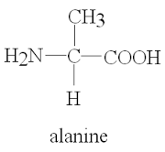
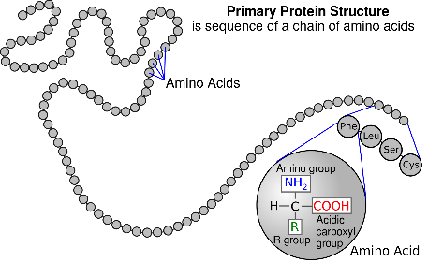
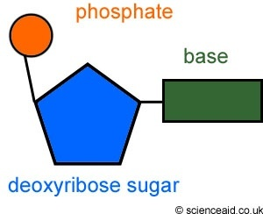
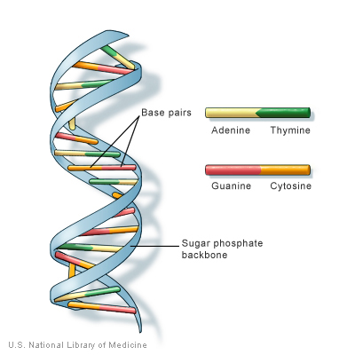
Answers
 | Monomer | Polymer
Carbohydrate | Monosaccharide | Polysaccharide
Protein | Amino acid | Polypeptide
DNA | Nucleotide | DNA and RNA
Notes:
Could quickly go through types of monosaccharide and amino acids
Monosaccharide e.g.? Polysaccharide e.g.?

Slide 12
Intro to Biological Molecules
Learning objective
To know about biological molecules
Success Criteria
I can state chemical elements that make up biological molecules
I can identify key inorganic ions involved in biological processes
Describe the general features of condensation and hydrolysis reactions

Slide 13
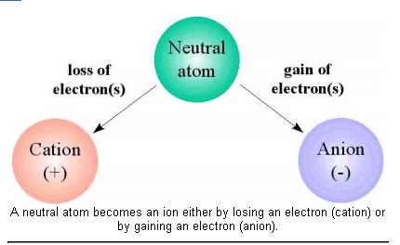
SC: Identify key inorganic ions involved in biological processes
Inorganic Ions
Cations
Positive ion
Lost an electron or electrons
Anions
Negative ion
Gained an electron or electrons

Slide 14
SC: Identify key inorganic ions involved in biological processes
Inorganic Ions
Calcium ions
Chloride
Sodium ions
Potassium ions
Hydrogen ions
Hydroxide
Nitrate*
Hydrogen Carbonate*
Ammonium ions*
Phosphate*
Task: Sort into Anion and Cations
Challenge: State the symbol for each one
Notes:
Denotes they’re a bit more tricky
Cations and anions are vitally important in the body. They make up skeletal structures, maintenance of osmotic pressure, nerve impulse transmission, muscle contraction, and maintaining pH balance.

Slide 15
SC: Identify key inorganic ions involved in biological processes
Inorganic Ions
Anions | Cations
Calcium ions - Ca²⁺ | Chloride – Cl⁻
Potassium ions - K⁺ | Hydroxide - OH⁻
Sodium ions - Na⁺ | Nitrate – NO₃⁻
Hydrogen ions - H⁺ | Hydrogen Carbonate - HNO₃⁻
Ammonium ions – NH₄⁺ | Phosphate – PO₄⁻

Slide 16
SC: I can state chemical elements that make up biological molecules
Chemical Elements – think, pair, share
What is an element?
Notes:
A naturally occurring substance that cannot be chemically made, or broken down into anything simpler. It is the primary constituent of all matter

Slide 17
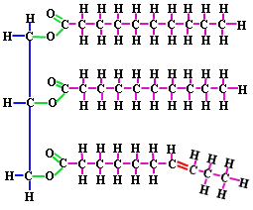
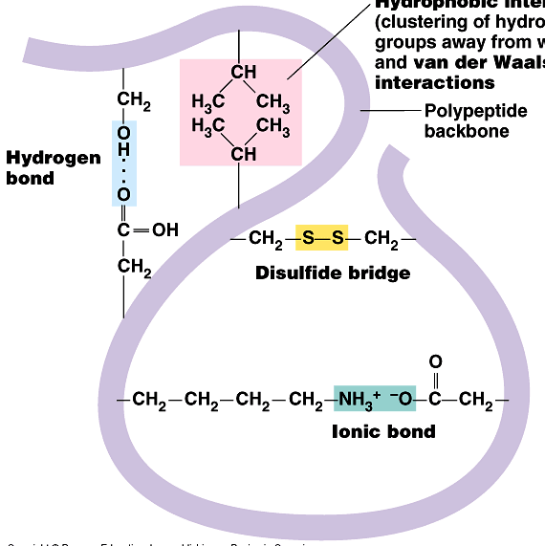
SC: I can state chemical elements that make up biological molecules
TASK: What elements are in each molecule?
Carbohydrates
Lipids
Proteins
Nucleic Acids (e.g. DNA)
Notes:
Repro this slide for pupils to look more closely at

Slide 18
Answers
SC: I can state chemical elements that make up biological molecules
TASK: What elements are in each molecule?
Carbohydrates
C, H & O
Lipids
C, H & O
Proteins
C, H, O, N & S
Nucleic Acids
C, H, O, N, & P

Slide 19
SC: I can state chemical elements that make up biological molecules
Forming Bonds
Carbon can form 4 bonds
Nitrogen can form 3 bonds
Oxygen can form 2 bonds
Hydrogen can form 1 bond
This info will be really useful when you have to draw diagrams of molecules later in the module

Slide 20
SC: I can describe the general features of condensation and hydrolysis reactions
Reactions
All biological molecules undergo two types of reaction:
Condensation reaction– two molecules are joined together with the removal of a water molecule. Water is PRODUCED in the reaction
Hydrolysis reaction – this is when two molecules are split apart with the addition of water

Slide 21
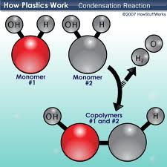
SC: I can describe the general features of condensation and hydrolysis reactions
Condensation Reactions
Condensation Reaction (to put them together)
Forms a covalent bond between the two molecules
A water molecule is produced
Notes:
Draw on board
Reactants of condensation = monomer
Products of condensation = polymer + water

Slide 22
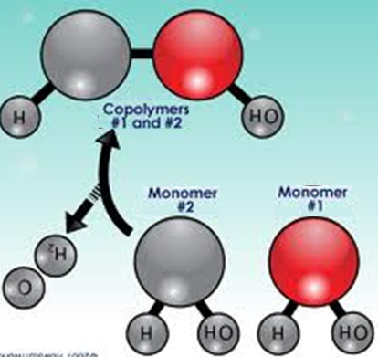
SC: I can describe the general features of condensation and hydrolysis reactions
Hydrolysis Reactions
Hydrolysis Reaction (to split them apart)
Breaks the bond
Uses up a water molecule
Notes:
Draw on board using simple example
Reactants of hydrolysis = polymer + water
Products of hydrolysis = monomer

Slide 23
SC: I can describe the general features of condensation and hydrolysis reactions
TASK: In pairs…
Model hydrolysis and condensation using the molymods, make sure you get the teacher to check your model before you move onto the next one

Slide 24
QUICK Quiz
- Describe the general features of condensation and hydrolysis reactions
What are the two types of reactions in biological molecules?
Condensation and Hydrolysis
What are the reactants of a hydrolysis reaction?
Polymer and water
What are the products of a hydrolysis reaction?
Monomers
What are the reactants of a condensation reaction?
Monomers
What are the products of a condensation reaction?
Polymer and water

Slide 25
FLIP LEARNING
For Friday, please watch the following video and answer the questions on the sheet.
The link to the video, and the sheet, will be put on the homework app.

Slide 26
Plenary
State chemical elements that make up biological molecules
Identify key inorganic ions involved in biological processes
- Describe the general features of condensation and hydrolysis reactions
In groups of 4, write a summary of the 2 SC, each student with a different coloured pen
Each student writes the summary for the 1st one and passes it on
Next student can correct previous student and write next SC

