Slide 1
Photosynthesis Lesson 1
The interrelationship between photosynthesis and respiration

Slide 2
Learning Objectives
Understand that light energy is used during photosynthesis to produce complex organic molecules.
Understand why the products of photosynthesis are essential for respiration.

Slide 3
Success Criteria
State why plants are known as autotrophic and animals, heterotrophic.
Describe what the process of photosynthesis and respiration involve.
Explain the interrelationship between photosynthesis and respiration.

Slide 4
Starter
Watch this GCSE Bitesize classic to help you remember the key fundamentals of plants and photosynthesis!
https://www.youtube.com/watch?v=xEhvsXG8cNs

Slide 5
Nutrition!
Using the definitions for the words below, construct your own definition for the words:
photoautotroph
chemoheterotroph
Troph – nourished by organic molecules in the manner indicated by the prefix word.
Auto – by itself.
Hetero – by another.
Photo – due to, or from light.
Chemo – due to, or from chemicals.

Slide 6
Definitions
An autotroph is an organism that is able to gain nutrition by forming its own organic molecules from inorganic molecules.
Therefore, a photoautotroph is one which constructs its own organic molecules for nourishment, by using light.
A heterotroph is an organism which must gain nutrition directly from organic molecules, as it cannot make its own.
A chemoheterotroph is one which gains nutrition from organic chemicals synthesised by other organisms.

Slide 7
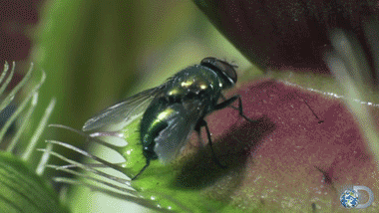
Can you think of an organism that could be described as both a photoautotroph and a chemoheterotroph?
Venus Flytrap - Dionaea muscipula

Slide 8
Mini whiteboard Questions
Balanced symbol equation for photosynthesis
Balanced symbol equation for respiration
Where do the reactants for photosynthesis come from?
Where do the reactants for respiration come from?

Slide 9
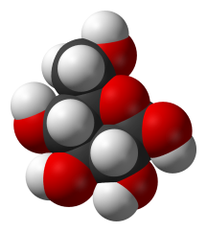
What is Photosynthesis?
Photosynthesis is the process whereby light energy from the Sun is transformed into chemical energy in the form of large organic molecules such as glucose.
The light energy comes from photons, which are ‘particles’ of light.
Glucose
(C₆H₁₂O₆)

Slide 10
Carbon Fixation
Photosynthesis is an example of carbon fixation, which is an endothermic process (requires energy).
Carbon fixation is also a reduction reaction, which means it required the addition of electrons.
Carbon fixation helps to regulate the carbon dioxide concentration in the atmosphere and oceans.

Slide 11
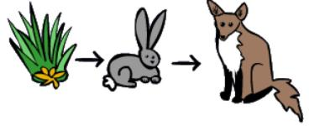
The most fundamental process…
Photosynthesis may be the most important biochemical process on earth, as pretty much every organism requires the products of photosynthesis to carry out aerobic respiration.
Photosynthesis:
carbon dioxide + water → glucose + oxygen
Aerobic respiration:
glucose + oxygen → carbon dioxide + water
Plants are usually the starting point of most food chains.
As autotrophs, they convert simple, inorganic substances into complex, organic molecules like glucose.

Slide 12
Respiration
All living things respire.
This includes photosynthetic organisms – they are unique as they both respire and photosynthesise.
Unlike photosynthesis, respiration is exothermic.
Both photosynthesis and respiration are interrelated and are important in cycling carbon dioxide and oxygen in the atmosphere.
Why is it that plants can be kept in sealed containers?
Notes:
Answer: The oxygen produced during photosynthesis can be used for respiration. The carbon dioxide produced in respiration can be used for photosynthesis. Water released during transpiration can be absorbed again via the roots.

Slide 13
Plenary Task
Explain why most forms of life on Earth rely on directly or indirectly on photosynthesis.
Use page 115 to find out what is meant by a plant’s compensation point.
Suggest which process – aerobic respiration or photosynthesis – evolved first on Earth. Give reasons for your answer.

Slide 14
Learning Objectives
Understand that light energy is used during photosynthesis to produce complex organic molecules.
Understand why the products of photosynthesis are essential for respiration.

Slide 15
Success Criteria
State why plants are known as autotrophic and animals, heterotrophic.
Describe what the process of photosynthesis and respiration involve.
Explain the interrelationship between photosynthesis and respiration.

