Slide 1
Photosynthesis Lesson 2
Chloroplasts and Photosynthetic Pigments

Slide 2
Learning Objectives
Learn the structure and function of chloroplasts.
Understand the role of photosystems and the pigments they contain.

Slide 3
Success Criteria
Recap GCSE-level learning by labelling a plant cell.
Recall the structures present within chloroplasts.
Describe the adaptations of chloroplasts and the roles of structures within them.
Explain the importance of having a variety of different photosynthetic pigments in photosystems.

Slide 4
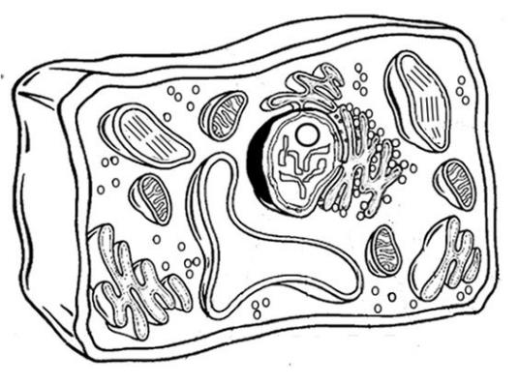
Starter
Label the plant cell with as much detail as you can.

Slide 5
Cell Membrane
Cytoplasm
Ribosome
Rough ER
Chloroplast
Nucleus
Cell Wall
Smooth ER
Mitochondria
Vacuole
Anything not labelled?

Slide 6
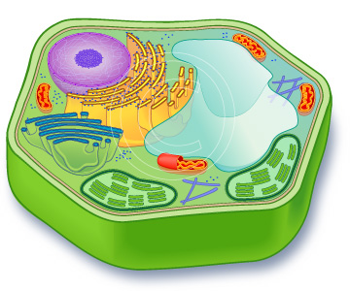
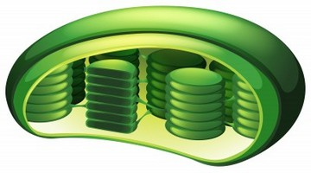
Where does photosynthesis happen?
Photosynthesis is a two-stage (more on this later) process that takes place entirely within organelles known as chloroplasts.

Slide 7
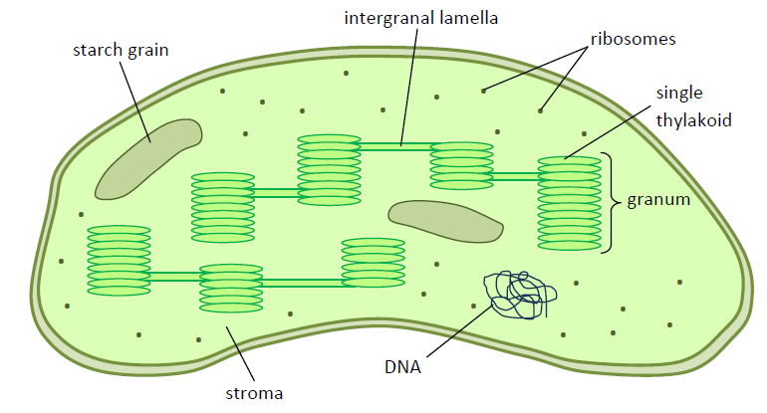
Structure of a Chloroplast
Chloroplasts are disc-shaped, and each has a double membrane (envelope).
Chloroplasts are self-sufficient in their own right.
Research: The endosymbiont theory.

Slide 8
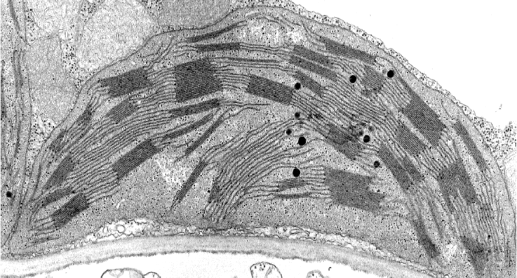
Label the chloroplast
intergranal lamella
starch grain
envelope
granum
stroma
ribosomes

Slide 9
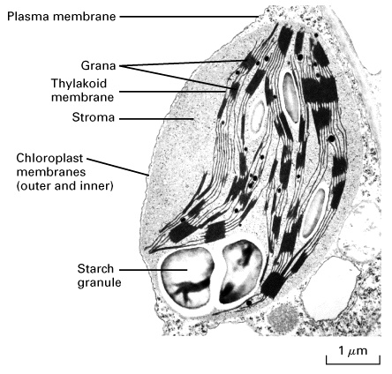
Notes:
Can look different!

Slide 10
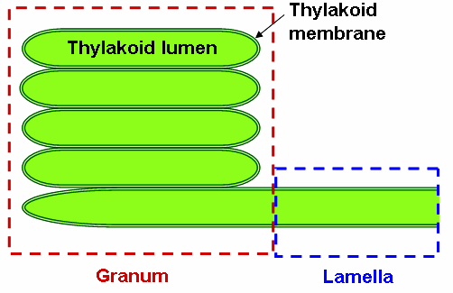
Chloroplast Detail
Chloroplasts contain stacks of flattened membrane compartments.
Each stack is called a granum (plural: grana).
Each compartment in a granum is called a thylakoid.
Thin membrane extensions connect the grana, and are known as the intergranal lamella.
The grana provide a large surface area for the attachment of photosystems.
These contain the photosynthetic pigments such as chlorophyll.

Slide 11
Chloroplast Detail
The fluid surrounding the membrane network is called the stroma.
The stroma contains enzymes essential for the second stage of photosynthesis.
The sugars produced by photosynthesis are stored in chloroplasts, and can be found as starch grains.
Chloroplasts also contain DNA and ribosomes, which can be used to make the proteins and enzymes required to carry out photosynthesis.

Slide 12
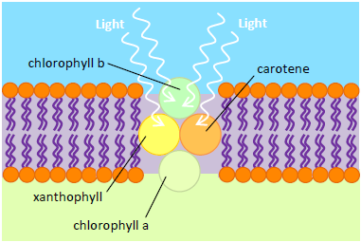
Pigments and Photosystems
Various photosynthetic pigments are arranged into photosystems within the granal membrane.
Photosynthetic pigments absorb light (and therefore energy) of certain wavelengths.
Each pigment absorbs light of a particular wavelength and reflects others.
The energy of the light is then ‘funnelled’ down to chlorophyll at the base of the photosystem.
There are two main photosystems involved in the first stage of photosynthesis – Photosystem I and Photosystem II.

Slide 13
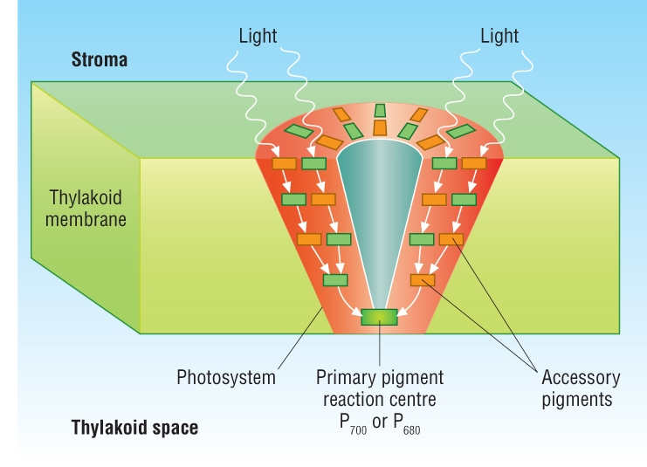

Slide 14
Chlorophylls & Accessory Pigments
There are 3 forms of Chlorophyll:
Chlorophyll a (P₆₈₀) Chlorophyll a (P₇₀₀) Chlorophyll b
Use the ’Chlorophylls’ section of page 117 and 118 to find out more about the types of chlorophyll, paying particular attention to the peak wavelengths of light they absorb.
Accessory Pigments:
Along with chlorophylls, photosystems contain pigments called the carotenoids and xanthophylls.
They absorbs some of the wavelengths of light that chlorophylls don’t.
An absoroption spectrum shows the wavelengths of light absorbed by different pigments

Slide 15
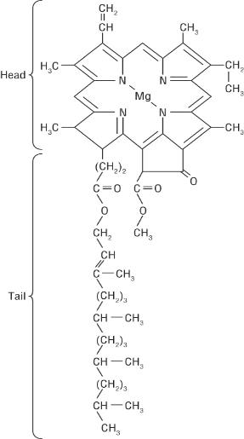
Chlorophyll
Mixture of pigments
Light hitting causes a pair of electrons associated with magnesium to become excited
Porphyrin group
Phytol (hydrocarbon) group

Slide 16
Chlorophyll a
Has two forms: P₆₈₀ and P₇₀₀
Both appear yellow-green
Each absorbs red light but they have a slightly different absorption peak
Both found at centre of photosystems and are known as the primary pigment reaction centre
Also absorbs blue light (wavelength 450nm)

Slide 17
P₆₈₀
Found in Photosystem II
Peak of absorption = light at a wavelength of 680nm

Slide 18
P₇₀₀
Found in Photosystem I
Peak of absorption = light at a wavelength of 700nm

Slide 19
Chlorophyll b
Absorbs light of wavelengths of about 500nm and 640nm
Appears blue-green
Accessory pigment

Slide 20
Carotenoids
Reflect yellow and orange light
Absorb blue light
Do not contain a porphyrin group
Carotene (orange) and xanthophyll (yellow) are the main carotenoids

Slide 21
Task
Draw together everything so far
Sketch a chloroplast outline
Add Thylakoid membranes
Add photosystem outline
Add on primary pigments
Add on accessory pigments

Slide 22
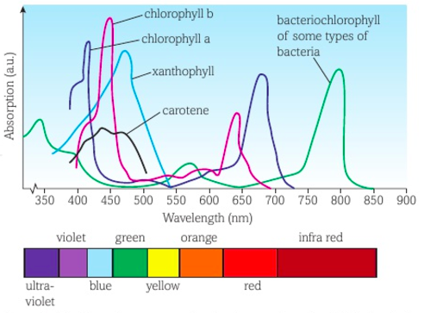
Absorption Spectrum
What do you notice about the photosynthetic pigments found in some photosynthetic bacteria?
Notes:
Answer: They can absorb light in the spectrum either side of visible light – ultraviolet and infra-red.

Slide 23
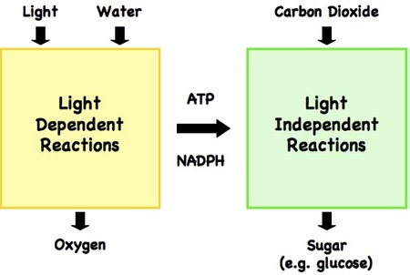
Photosynthesis is a two-stage process…
The first stage of photosynthesis is known as the:
The Light-Dependent Reaction
The second stage is known as the:
The Light-Independent Reaction
The light dependent reactions take place in the grana
The light independent reactions take place in the stroma fluid.

Slide 24
Plenary
Answer exam question.

Slide 25
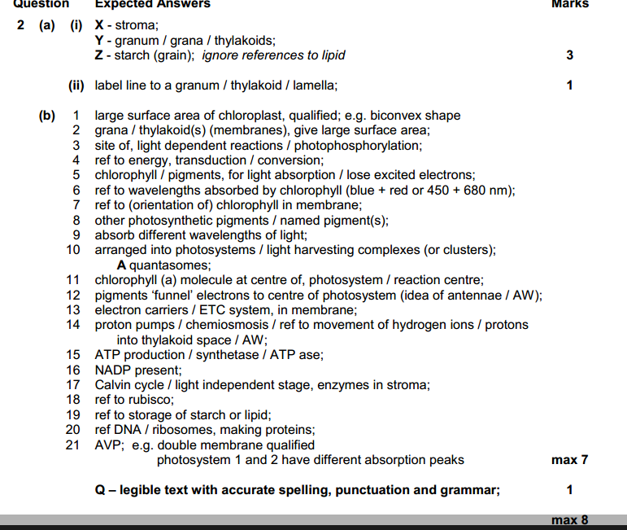
Answers

Slide 26
Learning Objectives
Learn the structure and function of chloroplasts.
Understand the role of photosystems and the pigments they contain.

Slide 27
Success Criteria
Recap GCSE-level learning by labelling a plant cell.
Recall the structures present within chloroplasts.
Describe the adaptations of chloroplasts and the roles of structures within them.
Explain the importance of having a variety of different photosynthetic pigments in photosystems.

