Slide 1
Cloning Animals
Module 6.4
Cloning & Biotechnology

Slide 2
Learning Objectives
Understand how animals can be cloned.
Understand what embryo splitting is.
Understand what nuclear transfer is.
Understand what non-reproductive cloning is.

Slide 3
Success Criteria
Explain the steps involved in splitting embryos and nuclear transfer.
State the advantages and disadvantages of cloning animals.

Slide 4
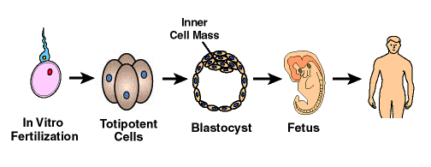
Cloning Animals
In nature, only embryonic cells have the ability to grow through the stages required to generate a new individual.
The cells of the embryo are totipotent stem cells and can differentiate into any adult cell.
These cells can ‘switch on’ any of the genes present in the genome of the organism.

Slide 5
Reproductive Cloning
There are two main methods of reproductive cloning:
Why would we want to clone animals?
Cloning elite farm animals.
Cloning genetically modified animals such as goats that produce spider silk in their milk.
Somatic Cell Nuclear Transfer
Embryo Splitting

Slide 6
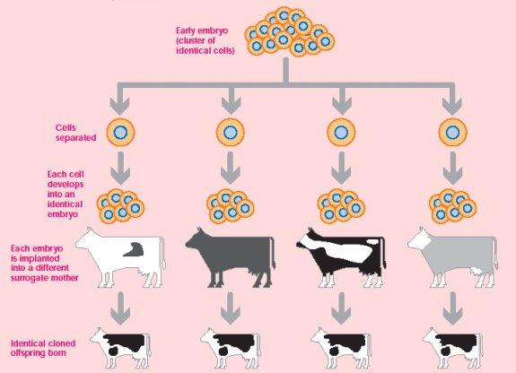
1. Embryo Splitting
One method of artificially cloning animals is called Splitting Embryos.
This method has been used to clone sheep, cattle rabbits and toads.
Cells of a developing embryo are separated and go on to produce a separate, genetically identical organism.

Slide 7
Task
Put the steps involved in Embryo Splitting into the correct order:
Zygote is allowed to divide by mitosis to form a small ball of cells.
Each small mass of cells is placed into the uterus of a surrogate mother.
The cells are separated and allowed to continue dividing.
A zygote (fertilised egg) is created by in vitro fertilisation (IVF)
2
4
3
1

Slide 8
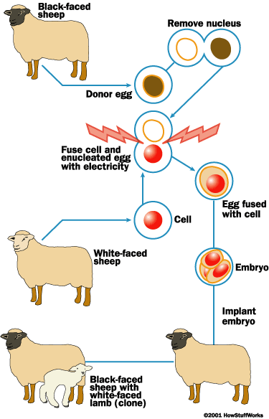
2. Nuclear Transfer
Somatic Cell Nuclear Transfer involves taking the nucleus of an already differentiated adult cell, and placing it in an egg that has had its own nucleus removed.
The egg goes through the stages of development.
It is then transplanted into the uterus of a surrogate mother.
If successful, a clone of the animal that donated the nucleus will be born.
The first animal to be born this way was Dolly the sheep, in 1996.

Slide 9
What are the arguments for and arguments against cloning animals?
Arguments For | Arguments Against
1. | 1.
2. | 2.
3. | 3.
4. | 4
Use page 247 to help.

Slide 10
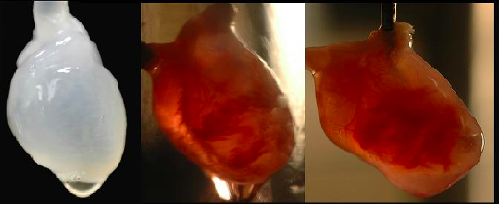
Non-Reproductive Cloning
Artificially cloning plants and animals is not the only use of cloning.
Cloning can be used to produce cells, tissue and organs need to replace those damaged by disease and accidents.
What are the advantages of using cloned cells to generate cells, tissue and organs?
Human hearts have been cloned using ‘scaffolds’ for cells to grow against.

Slide 11
Advantages
As the cells will be genetically identical to the cells of the individual, they will not be rejected by the immune system.
Cloning and culture of cells may end the current problem of waiting for donor organs to become available for transplant.
As the cells are totipotent, any cell type can be generated. Currently, some types of tissue cannot be repaired by transplantation techniques.
Using cloned cells is less dangerous than a major operation such a transplant.
Cloning cells for medical use is often referred to as therapeutic cloning.
There are ethical objections to the use of embryonic cells for this purpose.

Slide 12
Plenary
Answer the 3 summary questions on page 247.

Slide 13
Learning Objectives
Understand how animals can be cloned.
Understand what embryo splitting is.
Understand what nuclear transfer is.
Understand what non-reproductive cloning is.

Slide 14
Success Criteria
Explain the steps involved in splitting embryos and nuclear transfer.
State the advantages and disadvantages of cloning animals.

