Slide 1
Plant Growth

Slide 2
Learning outcomes
Evaluate the experimental evidence for the role of auxins in the control of apical dominance and gibberellin in the control of stem elongation.

Slide 3
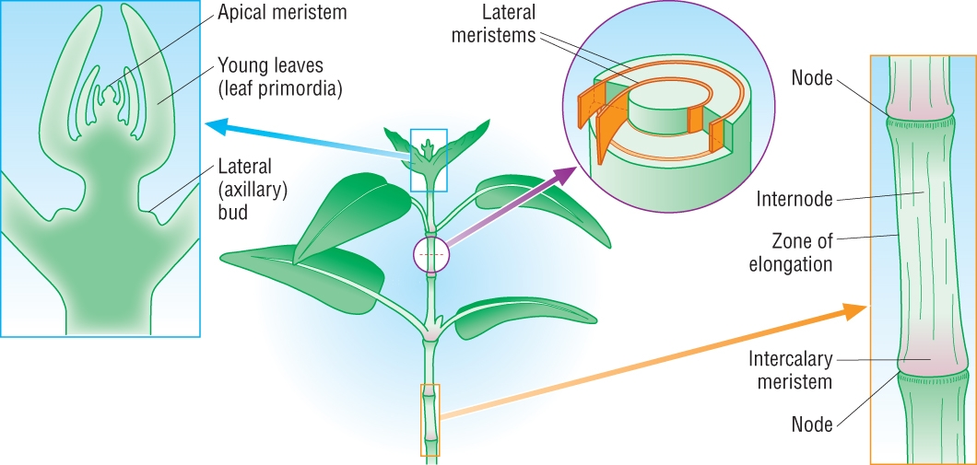
Plant Growth
Roots and shoots get longer
Roots and shoots get wide
Plant growth occurs at meristems
Apical meristem
Lateral bud meristems
Lateral meristems
Intercalary meristems
Gives rise to side shoots
Shoots get longer

Slide 4
Why “plant growth regulators”?
Exert influence by affecting growth
Produced in a region of plant structure by unspecialised cells
Some are active at the site of production
Not specific – can have different effects on different tissues

Slide 5
The Plant growth regulators
There are five main groups
Auxins
Gibberellins
Cytokinins
Abscisic acid
Ethene

Slide 6
Plant growth regulators
Produced in small quantities
Are active at site of production, or move by diffusion, active transport or mass flow.
Effects are different depending on concentration, tissues they act on and whether there is another substance present as well.

Slide 7
Interaction of plant growth regulators
Synergism
2 or more act together to reinforce an effect
Antagonism
Have opposing actions and inhibit (diminish) each others effects.

Slide 8
Auxins
Synthesised in shoot or root tips.
Most common form is IAA (indole-3-acetic acid a.k.a. indoleacetic acid)
Main effects of auxins include:
Promote stem elongation
Stimulate cell division
Prevent leaf fall
Maintain apical dominance.

Slide 9
Auxins and Apical Dominance
Auxins produced by the apical meristem
Auxin travels down the stem by diffusion or active transport
Inhibits the sideways growth from the lateral buds

Slide 10
Apical Dominance

Slide 11
Apical Dominance

Slide 12
Mechanism for apical dominance
Auxin made by cells in the shoot tip
Auxin transported downwards cell to cell
Auxin accumulates in the nodes beside the lateral buds
Presence inhibits their activity

Slide 13
Evidence for mechanism (1)
If the tip is cut off of two shoots
Indole-3-acetic-acid (IAA) is applied to one of them, it continues to show apical dominance
The untreated shoot will branch out sideways

Slide 14
Evidence for mechanism (2)
If a growing shoot is tipped upside down
Apical dominance is prevented
Lateral buds start to grow out sideways
This supports the theory
Auxins are transported downwards, and can not be transported upwards against gravity

Slide 15
Question and reading
Suggest how apical dominance could be an advantage to a plant!

Slide 16
Suggest!!

Slide 17
Gibberellins and stem elongation
Gibberellin (GA) increases stem length
Increases the lengths of the internodes
Stimulating cell division
Stimulating cell elongation

Slide 18
Evidence for GA and stem elongation
Dwarf beans are dwarf because they lack the gene for producing GA
Mendel’s short pea plants lacked the dominant allele that encodes for GA
Plants with higher GA concentrations are taller

Slide 19
Stem elongation
Gibberellins are formed in young leaves and around growing tips. They stimulate the growth of shoots (stem elongation) and leaves. They are also involved in seed germination.
Dwarf plants provide some evidence for the role of gibberellins in stem elongation because when gibberellins are applied artificially to dwarf plants, they can stimulate stem elongation, even in genetically determined dwarfism.
This is because the dwarfism occurs due to the absence or mutation of the gene for gibberellin production.
Notes:
19
Teacher notes
Gibberellins were first isolated in 1934 by two Japanese scientists from the rice fungus Gibberella fujikoroi. They are also found in higher plants.

Slide 20
Gibberellins and seed germination
Gibberellins promote seed elongation.
Seed absorbs water → gibberellin released → enables production of amylase → Starch breaks down into glucose for respiration

