Slide 1
Productivity

Slide 2
Energy transfer in the food chain
Notes:
Teacher notes
This four-stage animated food chain shows a simple feeding relationship within an ecosystem. It can be used to introduce the topic and start students thinking about energy losses in the food chain. The direction of the arrow indicates the direction of energy flow.
See the ‘Photosynthesis’ presentation for more information about photosynthesis.

Slide 3
Learning outcomes
biomass transfers through ecosystems
To include how biomass transfers between trophic levels can be measured
AND
the efficiency of biomass transfers between trophic levels
AND
how human activities can manipulate the transfer of biomass through ecosystems.

Slide 4
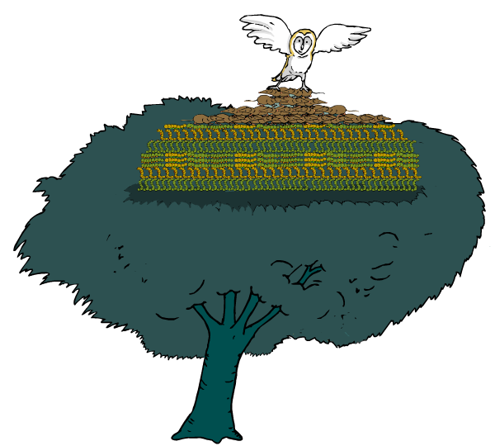
What are pyramids of numbers?
Pyramids of numbers are a quantitative way of representing food chains.
They record the number of organisms at each trophic level in a specified area.
What are the problems of representing food chains in pyramids of numbers?
Pyramids of numbers only give an accurate impression of the flow of energy in a food chain if the organisms are of similar size. Measuring the biomass at each trophic level can give a more accurate picture.

Slide 5
Numbers or biomass?
Notes:
Teacher notes
This activity provides illustrated examples of pyramids of biomass and pyramids of numbers. It could be used to allow students to draw comparisons between these two methods of representing food chains.

Slide 6
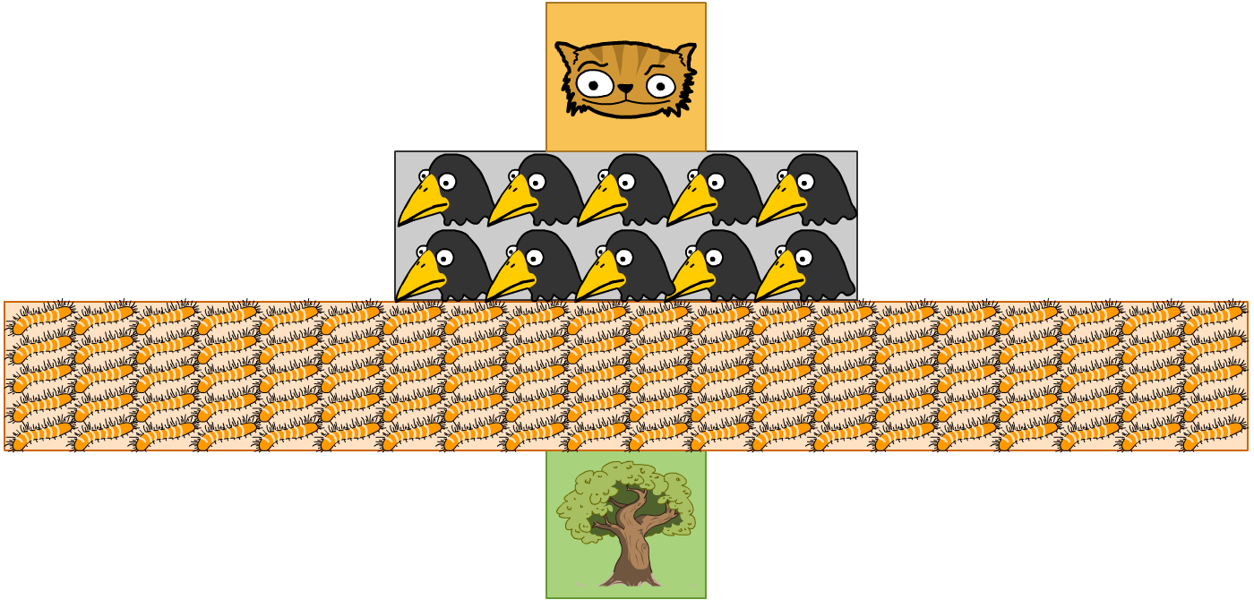
Understanding pyramids of numbers
In a pyramid of numbers, the length of each bar represents the number of organisms at each trophic level in a specified area.
As a single tree can support many organisms, this food chain produces an unbalanced pyramid.

Slide 7
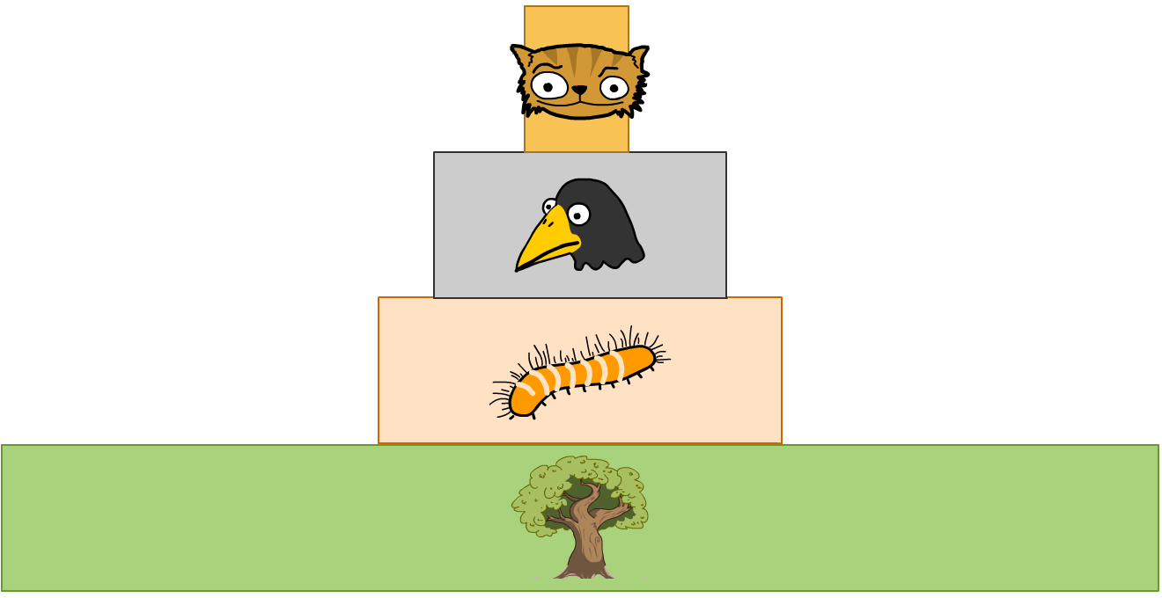
Understanding pyramids of biomass
In a pyramid of biomass, the length of each bar represents the amount of organic matter – biomass – at each trophic level in a specified area.
At each trophic level, the amount of biomass available is reduced, giving a pyramid shape.

Slide 8
Drawbacks of pyramids of biomass
Fresh mass is quite easy to assess, but the presence of varying amounts of water makes it unreliable.
The use of dry mass measurement overcomes this problem but, because the organisms must be killed, it is usually only made on a small sample and this sample may not be representative.
Different species can release different amounts of energy per gram

Slide 9
Calculating the efficiency of biomass transfer
Ecological = Biomass at the higher trophic level X 100
efficiency Biomass at the lower trophic level
Ecological = Biomass of primary consumer X 100
efficiency Biomass of producer

Slide 10
Summary questions
State 2 advantages of using a pyramid of biomass rather than a pyramid of numbers when representing quantitative information on a food chain (2 marks).
Explain how a pyramid of biomass for a marine ecosystem may sometimes show producers (phytoplankton) with a smaller biomass than primary consumers (zoo plankton) (1 mark).
Name suitable units for the measurement of biomass (2 marks).
In a pyramid of numbers: no account is taken of size (1 mark)
The pyramid of individuals of one species may be so great that it is impossible to represent them on the same scale as other species in the food chain (1 mark).
At certain times of year (e.g. Spring) zooplankton consume phytoplankton so rapidly that their biomass temporarily exceeds that of phytoplankton (1 mark).
Grams per square metre (gm⁻²) (1 mark)
Grams per cubic metre (gm⁻³) (1 mark)

Slide 11
Entry of biomass into a food chain
Productivity – the rate at which energy passes through each trophic level
  Gross primary productivity: rate at which plants convert light energy to chemical energy
  Very inefficient process, 40% of light energy enters light reaction from photosynthesis, half of this is involved in glucose production. Only 2/3 of glucose is used to build biomass, the rest is respired.
  Only a small proportion (1-8%) of the energy from the sun enters the food chain: the Net Primary Productivity

Slide 12
Productivity
Net = Gross – Respiratory
production production losses
Gross production: The total quantity of energy that the plants in a community convert to organic matter.
Respiratory losses: Plants use 20% to 50% of the gross production energy for respiration, leaving little to be stored.
Net production: The rate at which the plant stores energy.

Slide 13
Increasing primary productivity
Using p 274-5 make note on how we can increase primary productivity.
Light
Irrigation/drought resistant strains
Temperature
Nutrients
Insecticides/pest resistance
Fungicides/fungal resistance
Herbicides

Slide 14
Energy flow through consumers
It is estimated that in the transfer of energy from producers to primary consumers is only 10% efficient.
There is 90% wastage between trophic levels:
  Some of the plant may not be eaten in the first place
  Some is not digested and lost as faeces
  Much is used for respiration
Carnivores are more efficient at energy conversion, some are able to achieve as much as 20%. This is because they are able to digest their high protein diets more efficiently

Slide 15
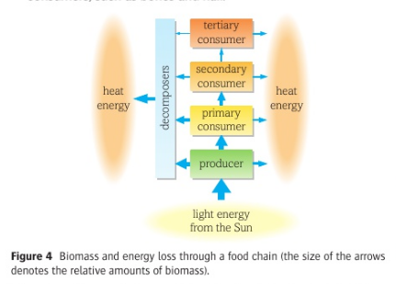
Energy flow

Slide 16
Increasing secondary productivity
Using p 275 make note on how we can increase secondary productivity.
Harvesting animals before adulthood
Selective breeding
Use of antibiotics
Keeping animals indoors

Slide 17
Energy loss in food chains
Notes:
Teacher notes
This activity provides illustrated information about how energy is lost in food chains. It could be used as an introduction to this topic or for revision purposes.

Slide 18
Energy transfer between trophic levels is relatively inefficient.
Question: Give 4 reasons why there is a low percentage of energy transferred at each stage:
Part of the organism is not eaten.
Some parts are eaten but cannot be digested and are lost in faeces.
Some energy is lost in excretory materials e.g. urine.
Some energy losses occur as heat from respiration (directly from the body to the environment).
Why are respiration loses higher in mammals and birds?
Because of their high body temperature. Much energy is needed to maintain their body temperature when heat is being constantly lost to the environment.

Slide 19
Energy transfer between trophic levels is relatively inefficient.
This has the following consequences:
Food chains tend to have 4/5 trophic levels because insufficient energy is available to support a large enough breeding population at trophic levels higher than these.
The total mass of organisms in a particular place (biomass) is less at higher trophic levels.
The total amount of energy stored is less at each level as one moves up a food chain.

Slide 20





How energy efficient is it to eat meat?
Food chains can be used to understand why some foods cost more than others. Which of these chains is the most efficient?
The first food chain is the most efficient because it contains fewest trophic levels, so less energy will be lost.

Slide 21
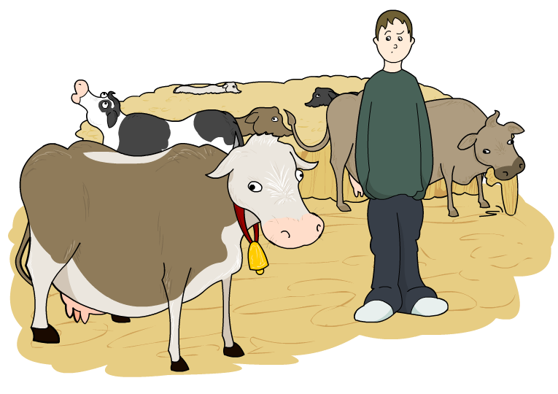

Is eating meat less energy efficient?
Cattle and other livestock are fed grain and cereals. Would it be more energy efficient if humans ate the plant crops instead?
If a one-acre field of corn is used to feed cows, it can support one person.
If the same area is used to feed humans directly, it can support 10 people.
However in some areas crops can’t survive but animals can e.g. sheep on mountainsides

Slide 22
Task
Complete exam questions

