Slide 1
Conservation and preservation

Slide 2
Conservation/preservation
What’s the difference between conservation and preservation?
Conservation – maintenance of biodiversity, including the diversity between species, genetic diversity with species, and maintenance of a variety of habitats and ecosystems.
Preservation – maintenance of habitats and ecosystems in their present condition, minimising human impact.

Slide 3
Learning outcomes
the reasons for, and differences between, conservation and preservation
To include the economic, social and ethical reasons for conservation of biological resources.
how the management of an ecosystem can provide resources in a sustainable way
Examples to include timber production and fishing.

Slide 4
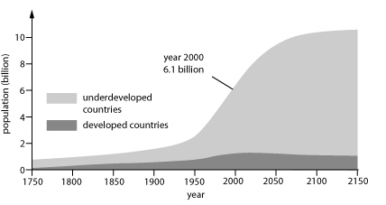
Threats to biodiversity
What are the threats to biodiversity?
Hint:

Slide 5
Threats to biodiversity
Over exploitation of wild populations for food (cod), for sport (sharks) and for commerce (pearls form mussels)
Habitat disruption and fragmentation as a result of intensive agricultural practices, increased pollution or building
Species introduction by humans

Slide 6
Conservation
Requires consideration of social and economic costs to local community
Effective education and liaison with local community
Can involve:
National parks
Green belts
SSSI
Legal protection
Ex situ conservation e.g. zoos and botanic gardens

Slide 7
Management strategies used
Depends on the specific characteristics of the ecosystem and species involved.
List some management strategies:
Raise carrying capacity by providing extra food
Moving individual, encouraging natural dispersion
Restricting dispersal using fencing
Control of predators and poachers
Vaccination against disease
Prevent pollution, restrict succession e.g. mowing, grazing or coppicing

Slide 8
Reasons for conservation
Social | Ethical | Economic

Slide 9
Social | Ethical | Economic
Enrichment (nice to look at) Culturally valuable Ecotourism and recreation | Moral & ethical responsibility for 1.5 million named organisms Every species is valuable in it’s own right Subjective! | Direct value Food source Genetic diversity Drugs Biological control Indirect value Insect pollination Maintaining water quality

Slide 10
Sustainable Management
Potential conflict between our need for natural resources and conservation e.g. wood production and fish production.
Sustainable management aims to maintain biodiversity whilst ensuring supplies and maintaining their economic benefit.

Slide 11
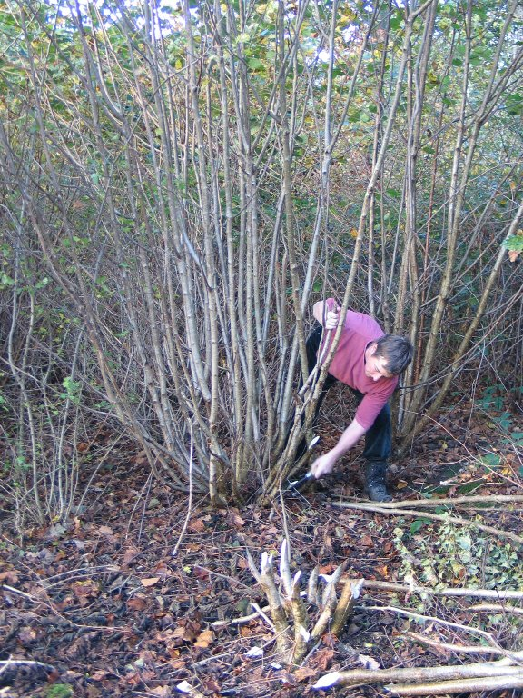
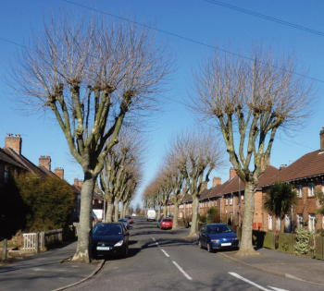
Managing small scale timber production
Coppicing
Harvesting wood but keeping the tree alive
Cut trunk of deciduous tree close to the ground
New stems grow from cut surface
Used for e.g. firewood, fencing, furniture
Done on rotational basis, some trees left (standards) to supply larger pieces of timber. Good for biodiversity
Pollarding
Like coppicing but trunk cut higher up
Protects trees from deer

Slide 12
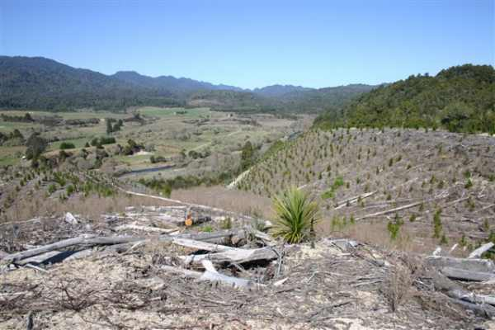
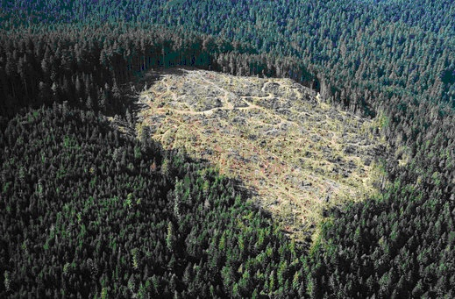
Managing large scale timber production
Clear felling is rarely practiced in UK as it can result in reduced mineral levels, soil erosion and subsequent pollution of rivers.
Balancing wood production and conservation:
Control pests and pathogens
Particular plant species
Position trees optimum distance apart
Modern forestry is based on the following principles:
Replanting after harvesting
Maintain biodiversity
Local people benefit

Slide 13
Managing fish stocks
Fishing must take place at a level which it allows it to continue indefinitely
The optimum is to maintain fish populations at the carrying capacity of their environment
They should be no permanent damage to the local habitat
Fishery must comply with local, national and international regulations
Aquaculture – can provide sustainable fish stocks. It restricts impact on oceanic fish stocks

Slide 14
Flipped learning
(e)the management of environmental resources and the effects of human activities.
To include how ecosystems can be managed to balance the conflict between conservation/preservation and human needs
Masai Mara region in Kenya
Terai region of Nepal, peat bogs
AND
The effects of human activities on the animal and plant populations and how these are controlled in environmentally sensitive ecosystems
Galapagos Islands,
Antarctica,
Snowdonia National Park,
Lake District.
6 groups – prepare a presentation on one of the topics listed

