Slide 1
Effect of hormones on plant growth
Practical – PAG11

Slide 2
Web resources
http://plantsinmotion.bio.indiana.edu/plantmotion/movements/tropism/tropisms.html
http://plantsinmotion.bio.indiana.edu/plantmotion/projects/projects.html

Slide 3
Learning Outcomes
Define the term tropism.
Explain how plant responses to environmental changes are coordinated by hormones, with reference to responding to changes in light direction.

Slide 4
Tropisms
Slow responses resulting in directional growth
“is a directional growth response in which the direction of the response is determined by the direction of the external stimulus”
List the main tropisms – what are their external stimuli?

Slide 5
Tropisms
Phototropism
Geotropism
Chemotropism – pollen tubes grow down the style, attracted by chemicals
Thigmotropism – shoots of climbing plants wind around supports

Slide 6
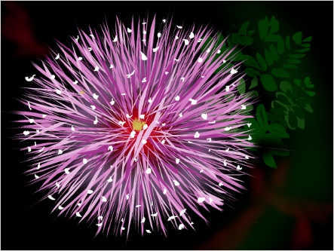
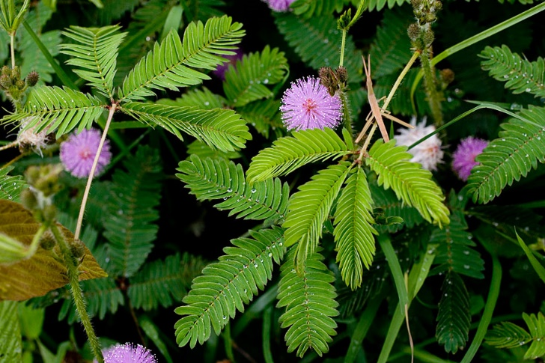
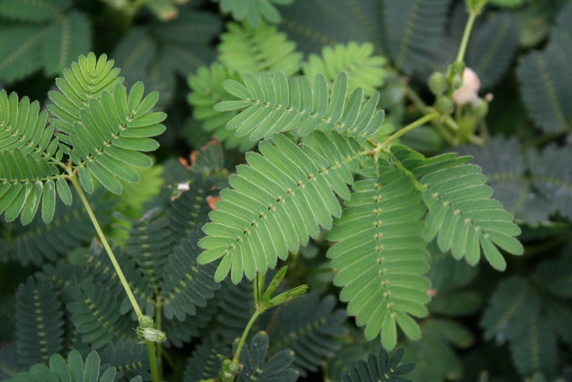
Nastic responses
Non-directional responses to external stimuli
Eg Mimosa pudica – leaves fold in response to touch. (thigmonasty)

Slide 7
How it works
Nastic movements are rapid, reversible movements in a plant.
Electrical potentials across cell membranes, similar to those in our nerve cells, signal plant cells at the base of the Mimosa leaf to rapidly lose water. This causes the leaf to droop.

Slide 8
Phototropism
Phototropism is the response of plant organs to the direction of light.
A shoot shows Positive phototropism
GCSE knowledge: what causes positive phototropism?

Slide 9
Phototropism
This is a growth response towards or away from light
Look at the worksheet detailing some early experiments on phototropisms using oat, barley and wheat coleoptiles.
Try to draw a conclusion to each experiment.

Slide 10
Darwin’s experiment
A growth stimulus is produced in the tip of the coleoptile
Growth stimulus is transmitted to the zone of elongation
Cells on the shaded side of the coleoptile elongate more than the cells on the other side.

Slide 11
Boysen-Jensen’s experiment
Materials which are not permeable to water can stop the curvature response in some circumstances
Materials which are permeable to water do not interfere with the curvature response

Slide 12
Went’s experiment
Angle of curvature is related to the number of tips used
Number of tips used relates to the concentration of auxin in the agar block
Curvature response is due to a chemical which moves from the tip and affects cell elongation

Slide 13
What causes phototropism?
Phototropins
Proteins that act as receptors for blue light
In plasma membrane of certain cells in plant shoots
Become phosphorylated when hit by blue light
If light is directional, then the phototropin on the side receiving the light becomes phosphorylated.
This activates the phototropin on the light side and the phototropin in the rest of the shoot is progressively less active. The gradient this sets up ensures the distribution of auxin.

Slide 14
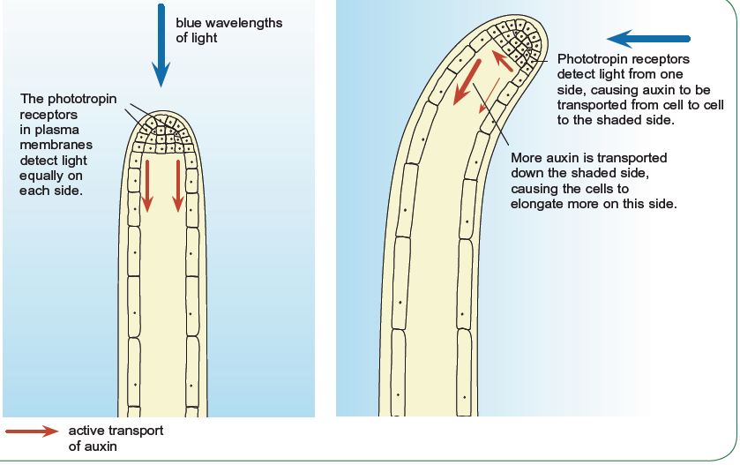
Phototropin, auxin and phototropism

Slide 15
Phototropin, auxin and phototropism
Phosphorylation of phototropin brings about a sideways movement of auxin
More auxin ends up on the shady side of the shoot than on the light side
Involves transporter proteins in the plasma membranes of some cells in the shoot, these actively move auxin out of the cell
The presence of auxin stimulates cells to grow longer
Where there is more auxin there is more growth

Slide 16
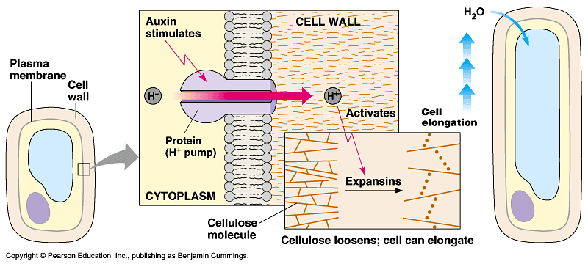
Auxin action – how cells elongate
Auxin increase stretchiness of cell wall
Promotes active transport of hydrogen ions by ATPase enzyme
Build up of hydrogen ions in the cell walls
The Low pH activates enzymes that break cross-linkages between molecules in walls
Cell takes up water by osmosis, cell swell and become longer

Slide 17
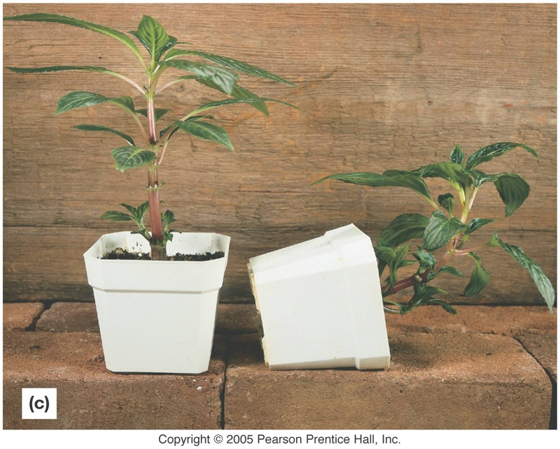
Geotropism
In this Impatiens plant, shoots grow upwards and roots grow downwards in response to gravity.
On which side of the shoot and root do you think auxins are more concentrated?

Slide 18
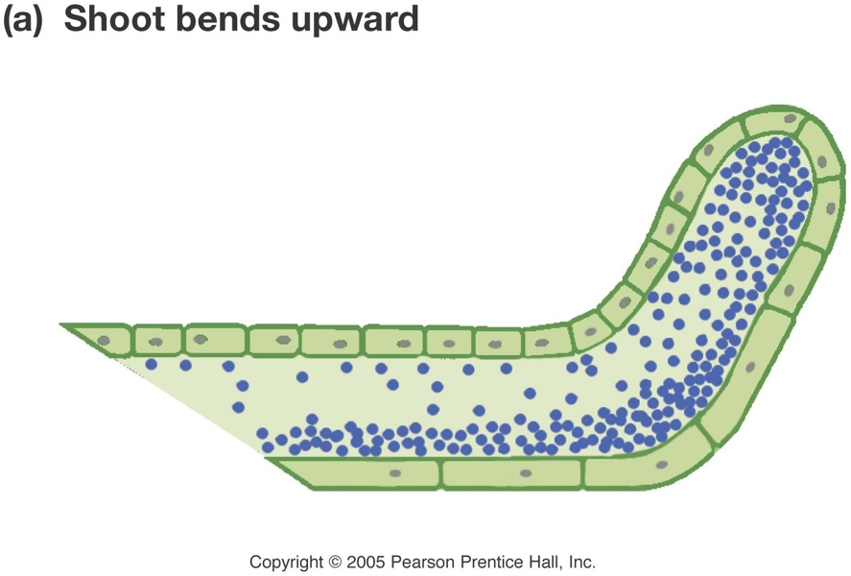
Geotropism in shoots
In shoots, auxins are more concentrated on the lower side of the stem, causing the cells there to elongate.
Why is this geotropism and not phototropism?

Slide 19
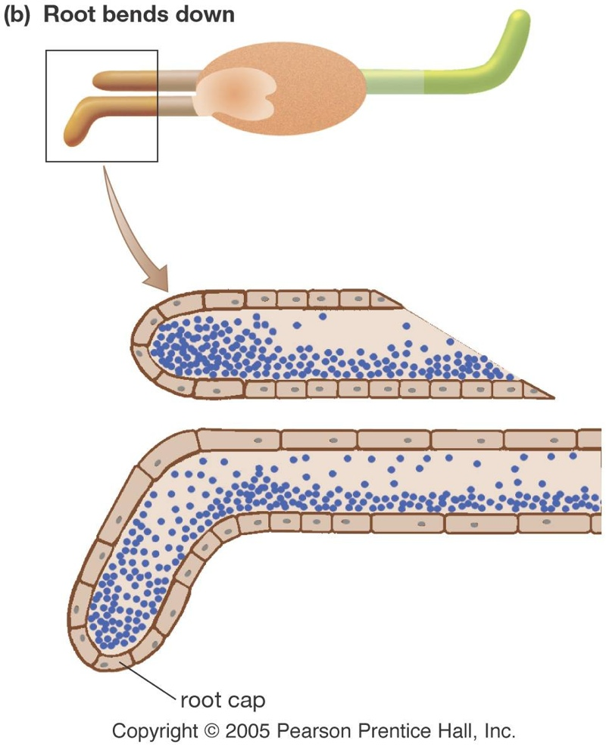
Geotropism in roots
In roots, however, auxin concentration on the lower side of the root suppresses cell elongation.
The upper side of the root continues to grow, causing the roots to bend downward.

Slide 20
Plenary

