Slide 1
Dihybrid crosses, sex linkage and multiple alleles
Patterns of inheritance

Slide 2
Learning outcomes
(i) genetic diagrams to show patterns of inheritance
To include monogenic inheritance, dihybrid inheritance, multiple alleles, sex linkage and codominance.

Slide 3
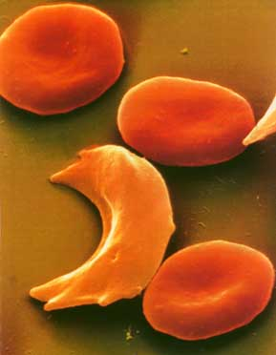
Starter – peer assess Homework
Research and prepare a leaflet on sickle cell anaemia. It should include
Symptoms in tissues (2)
Causes at the genetic level (2)
Affect on protein structure (1)
Codominance (2)
Worldwide distribution and the link to malaria (2)
Why does the sickle cell allele persist? (1)
Sickle cell anaemia is a genetic disease.
Frequency is about 1 in 655 African Americans
The disease is inherited not contracted by infectious routes.
Normal red blood cell
Sickle cell

Slide 4
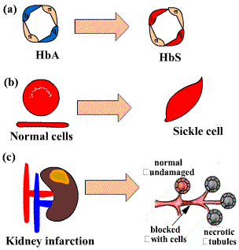
Sickle cell anaemia at the tissue level:
Research and prepare a leaflet on sickle cell anaemia. It should include
Symptoms in tissues (2)
Normal haemoglobin has two of four proteins changed in the mutation.
The normal biconcave disc shape of the red blood cell is changed to a 'sickle' shape.
In addition to not carrying oxygen correctly (anaemia) the cells also causes local clots (infarctions) such as is shown in the kidney tubules. This leads to necrosis (death) of the tubules, kidney damage, kidney failure and possible to death.

Slide 5
Research and prepare a leaflet on sickle cell anaemia. It should include
Causes at the genetic level (2)

Slide 6
Research and prepare a leaflet on sickle cell anaemia. It should include
Causes at the genetic level (2)

Slide 7
Research and prepare a leaflet on sickle cell anaemia. It should include
Affect on protein structure (1)

Slide 8
codominance
Research and prepare a leaflet on sickle cell anaemia. It should include
Codominance (2)
Genotype | Sickle cell anaemia phenotype | Haemoglobin phenotype
Hb^{N}Hb^{N} | Normal | Normal haemoglobin
Hb^{N}Hb^{S} | Normal (Sickle cell trait carrier) | 50% normal haemoglobin 50% sickle haemoglobin
Hb^{S}Hb^{S} | Sickle cell disease | Sickle haemoglobin
If we consider sickle cell anaemia as the phenotype the disorder has a recessive inheritance pattern.
If we consider the type of haemoglobin as the phenotype then the alleles are codominant

Slide 9
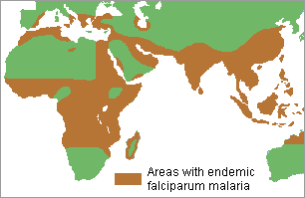
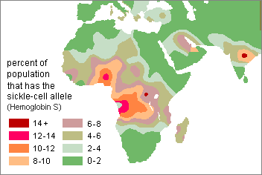
Distribution of Sickle-cell anaemia and malaria
Research and prepare a leaflet on sickle cell anaemia. It should include
Worldwide distribution and the link to malaria(2)
There are many instances when correlation and causation are just a coincidence and there is no causation or mechanism that likes the two variables.
There is however a well established causation between the sickle cell allele and the distribution of malaria.

Slide 10
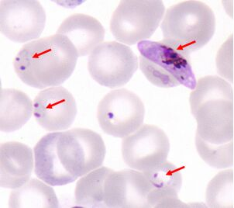
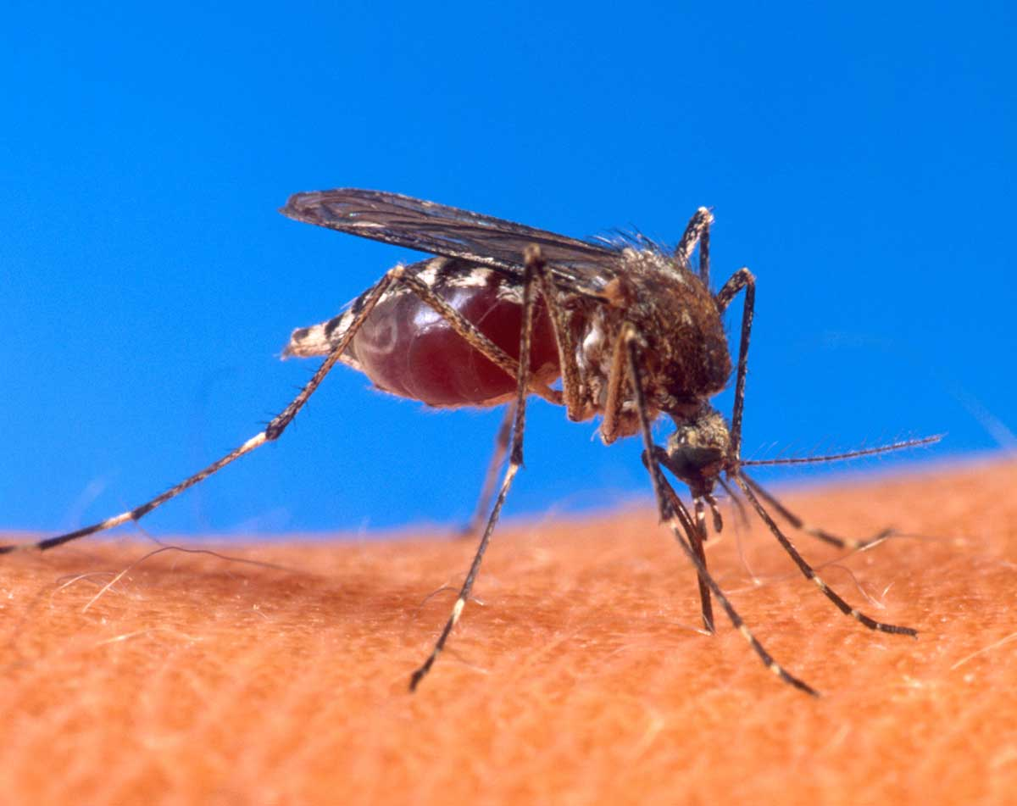
Malaria
Research and prepare a leaflet on sickle cell anaemia. It should include
Worldwide distribution and the link to malaria(2)
Malaria is a parasitic disease caused by a plasmodium cell. It is carried by mosquitoes and invades normal red blood cells, which causes them to lyse.
Symptoms include fever shivering, vomiting and anaemia. Death is common, often due to kidney failure or severe anaemia.
Malaria cannot infect sickle cells, so people with the sickle cell trait (allele) are more resistant to the disease.

Slide 11
Research and prepare a leaflet on sickle cell anaemia. It should include
Why does the sickle cell allele persist? (1)
Why does the sickle cell allele persist?
Hb^{S}Hb^{S} have sickle disease and do not survive well.
Hb^{N}Hb^{N} normal haemoglobin people are susceptible to malaria infection and do not survive well.
People having sickle cell trait ( Hb^{N}Hb^{S} ) have some resistant to the malaria parasite. This is because the Hb^{S} allele makes it difficult for the parasite to live inside the red cells. Sickle cell trait (carriers) therefore survive malaria infection.
The sickle allele survives well in malaria regions accounting for its high frequency in these regions.

Slide 12
Learning outcomes
(i) genetic diagrams to show patterns of inheritance
To include monogenic inheritance, dihybrid inheritance, multiple alleles, sex linkage and codominance.

Slide 13
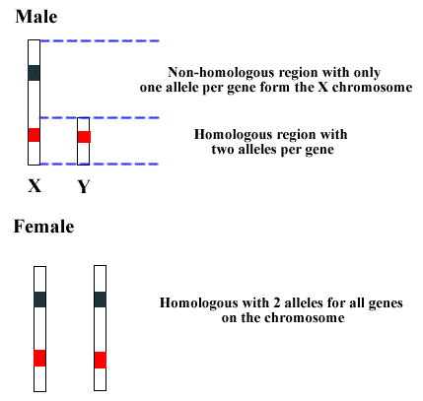
Sex chromosomes and genes.
Male:
Some genes are present on the X-chromosome but missing on the shorter Y-chromosome.
In the non-homologous region of the X-chromosome a male will only have one allele for any gene in this region.
Genes in the homologous region have two alleles per gene and function just as other genes already described.
Female:
The complete length of the X-chromosome has a homologous pair on the other X-chromosome.
Genes on the x-chromosome of female therefore have two alleles just like another gene on the other chromosomes.

Slide 14
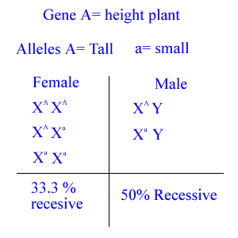
Sex Linkage
Genes on the non-homologous region of the X - chromosome are said to be sex linked.
Phenotypes associated with recessive alleles are more common in males than in females.
The recessive allele (a) is found on the non-homologous region of the X-chromosome.
Males only get one allele for this gene.
Males have a 50% chance of being recessive.
Female have a lower risk (33.3 %) since they always receive 2 alleles.
'Recessive' males can pass on this condition (X-chromosome) to the 'daughter'.
Cannot pass these conditions to the 'sons' as they pass the y-chromosome with no alleles.

Slide 15
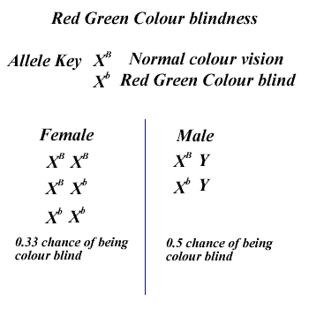
Colour-blindness
Red Green colour-blindness is a sex linked condition.
The gene loci is on the non-homologous region of the X-chromosomes.
Red Green colour blindness is more common in males than in females.
Males always inherit the colour-blind allele form their mothers.
Males cannot pass on colour-blindness to their sons since the Y-allele does not have any of the colour-blindness alleles.

Slide 16
Inheritance of colour-blindness:
Calculate the phenotypic ratio of a cross between a female carrier for red green colour blindness and a normal vision male.
Phenotypes :
Normal female (carrier) x Normal male
Genotypes : X^{B}X^{b} x X^{B}Y
Gametes X^{B} X^{b} X^{B} Y
 | X^{B} | X^{b}
X^{B} | X^{B} X^{B} | X^{b} X^{B}
Y | X^{B} Y | X^{b} Y
50% Female normal vision
25% Male normal vision
25% Male colour blind

Slide 17
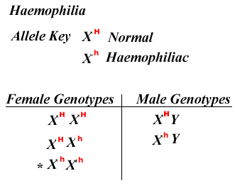
Haemophilia
Haemophilia is a recessive, sex-linked genetic disorder.
Persons suffering from haemophilia are unable to produce clotting factor in blood.
The haemophiliac allele (X^{h}) is recessive to the normal allele (X^{H})
Haemophilia is more common in men than women.
Males inherit the allele from their mother and develop the disease.
Since (until recently) the prognosis was poor such males did not survive to pass on the allele to their daughters (its on the X-chromosome). Therefore female haemophilia would be rare.
Haemophilia can occur in the children of where the mother is a carrier and a the father a normal male. How?
Boys inherit the X^{h} allele from mum and the Y allele from dad

Slide 18
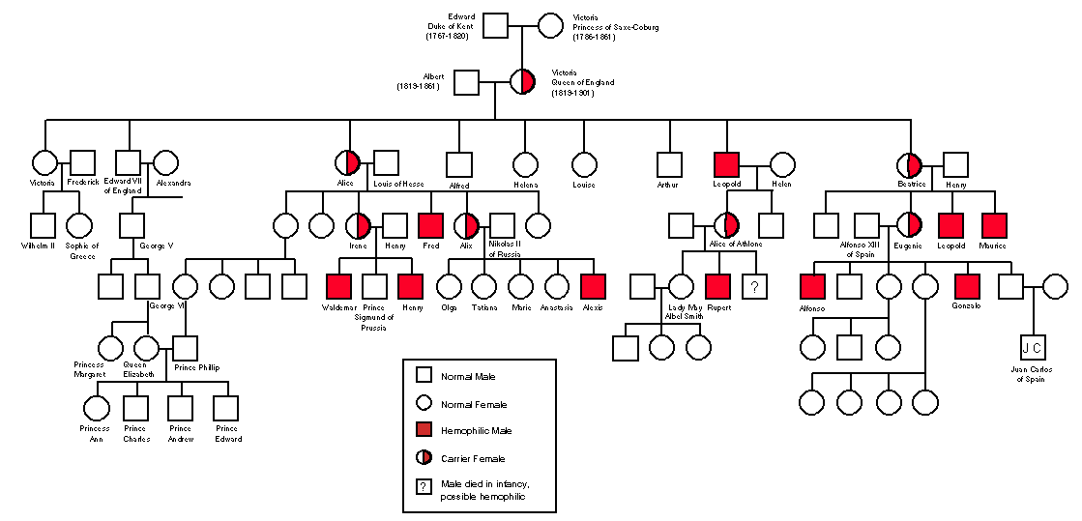
Today with treatment haemophiliac males can survive until sexual maturity but they cannot have daughters who are genetically normal for this condition, why?
Historically the haemophiliac allele has played a significant role in history and not least amongst the royal families of Europe.

Slide 19
Female and sex linkage
Females can be homozygous or heterozygous for the sex-linked alleles
Females carriers for X-linked recessive alleles.
Carrier are individuals that are heterozygous for the allele.
The have both the dominant and the recessive (disease) allele.
Carriers do not have the disease.

Slide 20
Exam question
Haemophilia is a sex-linked trait where X^{H} gives normal blood clotting and is dominant to the haemophilia allele X^{h}.
a. Give the genotypes of
1) a woman with normal blood clotting whose father had haemophilia
2) a normal man whose father had haemophilia.
b. What is the probability that a mating between these two individuals will produce a child, regardless of sex, that has haemophilia?
c. If this couple has a daughter, what is the probability that the daughter will be a carrier of the haemophilia trait? What is the probability a daughter would have haemophilia?
d. If this couple has a son, what is the probability he will have haemophilia?

Slide 21
Exam question
Haemophilia is a sex-linked trait where X^{H} gives normal blood clotting and is dominant to the haemophilia allele X^{h}.
a. Give the genotypes of
1) a woman with normal blood clotting whose father had haemophilia
2) a normal man whose father had haemophilia.
b. What is the probability that a mating between these two individuals will produce a child, regardless of sex, that has haemophilia?
c. If this couple has a daughter, what is the probability that the daughter will be a carrier of the haemophilia trait? What is the probability a daughter would have haemophilia?
d. If this couple has a son, what is the probability he will have haemophilia?
a.
Woman X^{H} X^{h}
Man is X^{H} Y
b.
P =0.25
c.
Carrier P= 0.5,
Haemophiliac P = 0
d.
Haemophiliac son P =0.5
 | X^{H} | X^{h}
X^{H} | X^{H} X^{H} | X^{H} X^{h}
Y | X^{H}Y | X^{h}Y

Slide 22
Multiple Alleles
Genes don’t always have 2 alleles, sometimes they have more. However, each person will only have 2 of them.
Human Blood Groups
The immunoglobulin gene leads to the production of different antigens on the surface of red blood cells
3 Alleles
I^{A} (produces antigen A)
I^{B} (produces antigen B)
I^{O} (no antigens produced)

Slide 23
Human Blood Groups
I^{A} and I^{B} are co-dominant
I^{O} is recessive to both
For the genotypes below state what blood group they would be:
I^{A} I^{A}
I^{B} I^{B}
I^{A} I^{B}
I^{A} I^{O}
I^{B} I^{O}
I^{O} I^{O}
Blood group A
Blood group B
Blood group AB
Blood group A
Blood group B
Blood group O

Slide 24
Human Blood Groups
Complete the following crosses:
Parents: blood group O and blood group AB
Parents: blood group A and blood group B (both heterozygous with the I^{O} allele)

Slide 25
Human Blood Group Answers
Male gametes
I^{A}
I^{B}
Female gametes
I^{O}
I^{A}I^{O}
I^{B}I^{O}
I^{O}
I^{A}I^{O}
I^{B}I^{O}
Offspring phenotypes: 50% blood group A, 50% blood group B

Slide 26
Human Blood Group Answers
Male gametes
I^{A}
I^{O}
Female gametes
I^{B}
I^{A}I^{B}
I^{B}I^{O}
I^{O}
I^{A}I^{O}
I^{O}I^{O}
Offspring phenotypes: 25% blood group AB
25% blood group B
25% blood group A
25% blood group O

Slide 27
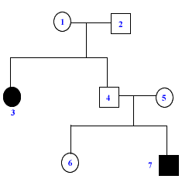
Pedigree charts
The chart show the typical symbols found in a pedigree chart.
Circles are female(1),(3),(5), (6).
Squares are male (2), (4), (7).
Black means that the individual is affected by the condition,(3).
White indicates that the individual is unaffected by the condition.
Mating: Female 1 and male 2 (Horizontal line)
Children: Female (3) and male (4) are the children of (1) and (2).
Individuals (6) and (7) are the paternal grandchildren of (1) and (2).

Slide 28
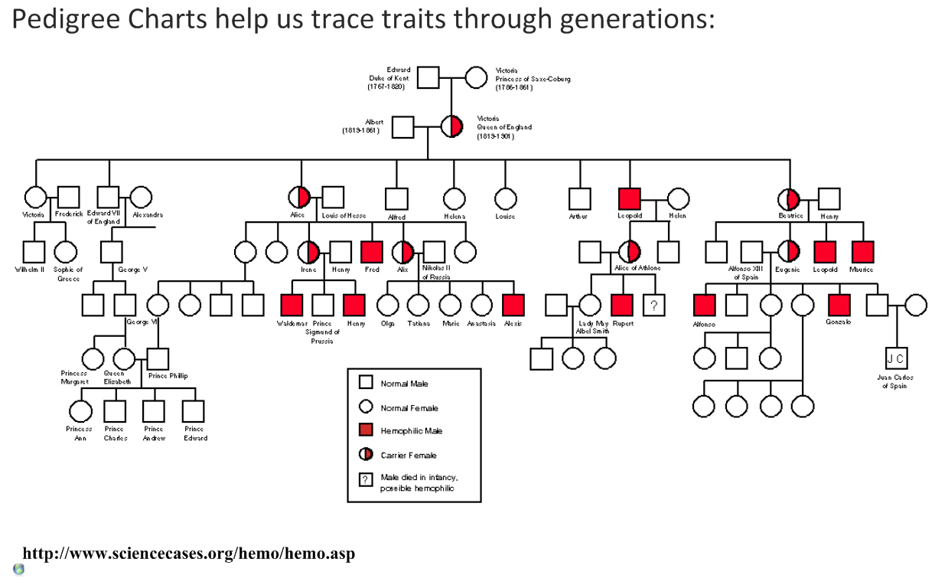

Slide 29
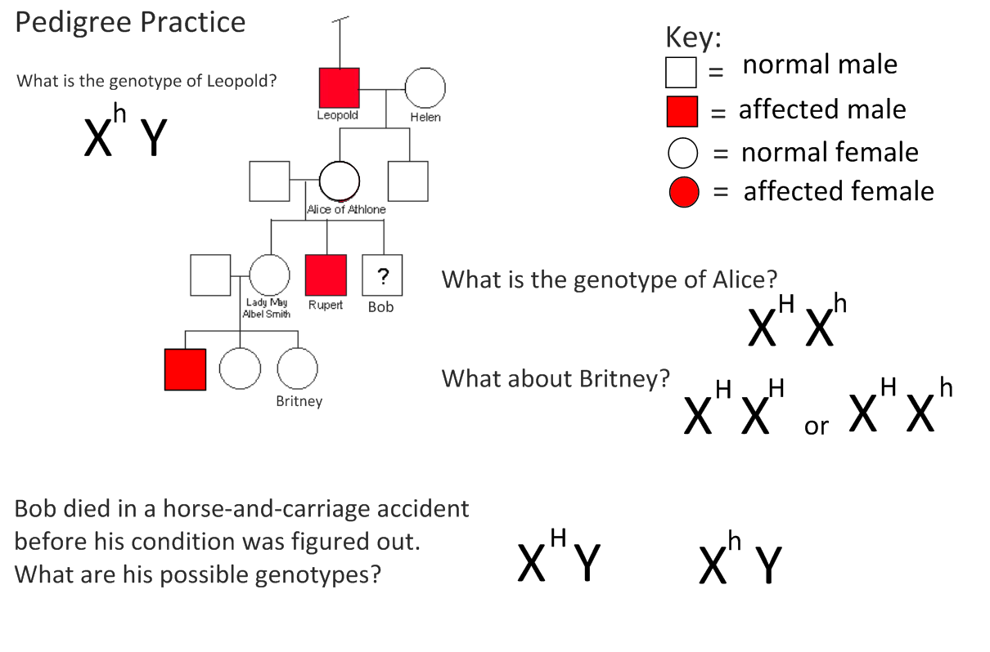
TASK Haemophilia (sex-linked recessive disorder)

Slide 30
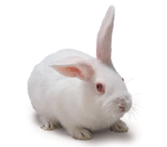
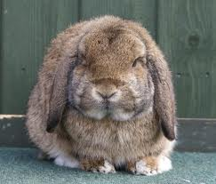
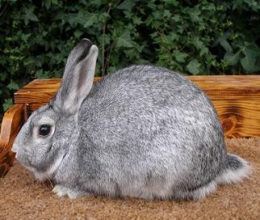
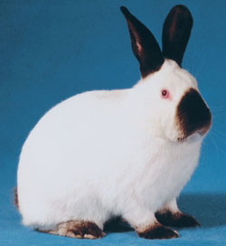
Homework - Multiple Alleles: Hierarchy
Sometimes there are more than 3 alleles, occurring in a dominance hierarchy
Coat Colour in Rabbits
Agouti coat is dominant to Chinchilla coat, which is dominant to Himalayan coat, which is dominant to Albino coat
Lesson 3 Homework Multiple alleles -bunnies.doc
>
>
>

