Slide 1
Decomposers and recycling

Slide 2
Learning outcomes
recycling within ecosystems
To include the role of decomposers and the roles of microorganisms in recycling nitrogen within ecosystems (including Nitrosomonas, Nitrobacter, Azotobacter and Rhizobium)
AND
the importance of the carbon cycle to include the role of organisms (decomposition, respiration and photosynthesis) and physical and chemical effects in the cycling of carbon within ecosystems.

Slide 3
What happens to nutrients?
Nutrients are constantly recycled through the carbon cycle and the nitrogen cycle.
Producers
nutrients in the soil and atmosphere
energy and biomass
energy and biomass
Consumers
microbial decomposition of dead organisms and waste
Decomposers

Slide 4
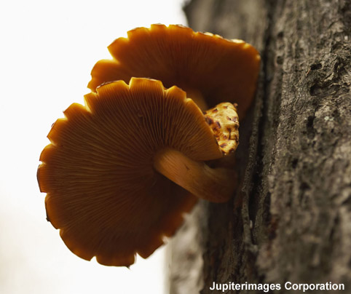
What is a saprophyte?
A saprophyte is an organism that gains nutrients from dead organic matter. This is usually the first stage of decay.
Saprophytes produce enzymes that break down dead matter. They can then absorb the released nutrients.
Bacteria and fungi feed saprotrophically. What would happen if they didn’t exist?
Notes:
Photo credit: © 2007 Jupiterimages Corporation
Teacher notes
‘Saprophyte’ is the older term for saprotroph. As bacteria and fungi are no longer classified as belonging to the plant kingdom, the term ‘phyte’ is now deemed inappropriate to describe these organisms within the scientific community. Please consult the appropriate exam board specifications for further guidance.

Slide 5
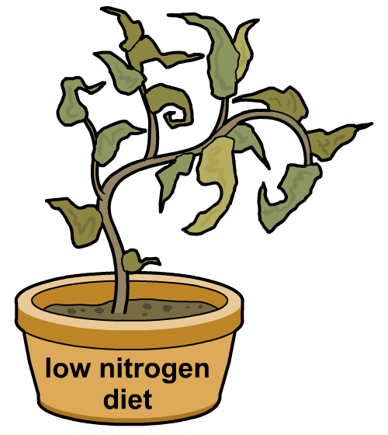
Why is nitrogen so important?
Nitrogen is essential for growth because it is used by plants and animals to make proteins.
Nitrogen makes up about 78% of the atmosphere. However, nitrogen deficiency is the most common cause of poor plant growth.
Why are plants unable to use the nitrogen straight from the air?
Nitrogen gas (N₂) is unreactive and is not easily converted into other compounds. Most plants can only take up nitrogen (by active transport) in the form of ammonia or nitrate.
How is atmospheric nitrogen changed into a useable form?

Slide 7
Nitrogren cycle

Slide 8
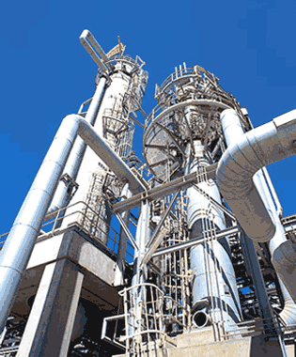
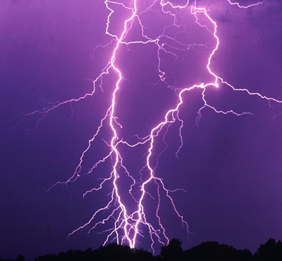
Nitrogen Fixation
Nitrogen gas can be ‘fixed’ into ammonia by humans using the Haber process. This is then used in the production of fertilisers.
A small amount of nitrogen is fixed to nitrate by lightning.

Slide 9
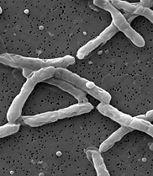
Nitrogen Fixation
Nitrogen fixing bacteria reduce nitrogen gas to ammonia, which they then use to manufacture amino acids. Nitrogen rich compounds are released from them when they die.
Nitrogen fixing bacteria may be free living in soil or water.
Non-symbiotic nitrogen fixing bacterium Azotobacter.

Slide 10
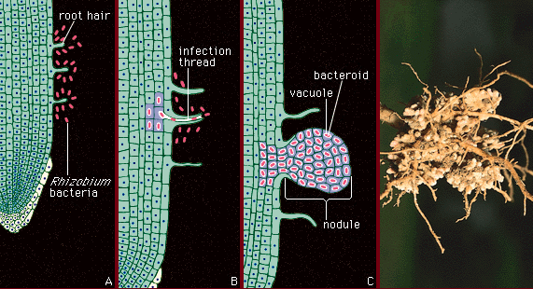
Nitrogen Fixation
The nitrogen-fixing bacteria (Rhizobium) may live in colonies inside the cells of root nodules of leguminous plants such as clover or peas (mutualism).
In return for sugars from the plant, the bacteria fix nitrogen which can be used by the plant for growth.
The nitrogen in the plant proteins is passed on to animals through food chains.

Slide 11
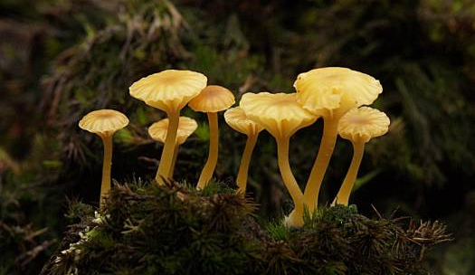
Ammonification
When living organisms excrete waste or die their nitrogen is returned to the soil in the form of ammonium compounds by saprobiotic microorganisms (bacteria and fungi).
Microbial saprophytes break down proteins in detritus to form ammonium ions (ammonification or deamination).
This is where nitrogen returns to the non-living component of the ecosystem.

Slide 12
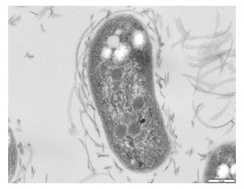
Nitrification
Plants can only take up nitrogen in the form of nitrate.
Ammonium compounds are oxidised into nitrates by nitrifying bacteria in two stages:
first forming nitrite ions (Nitrosomonas)
then forming nitrate ions (Nitrobacter)
This is an oxidation reaction and so releases energy.
These are chemosynthetic bacteria, which means they use the energy released by nitrification to live.

Slide 13
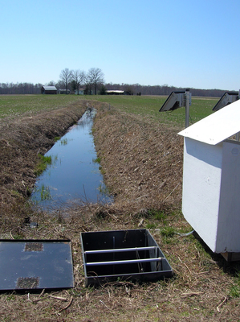
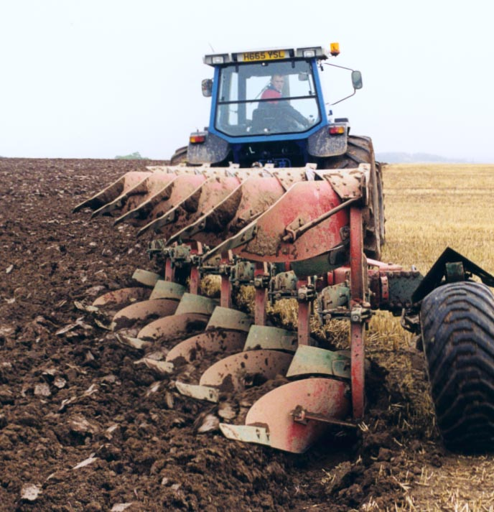
Nitrification
Nitrifying bacteria require oxygen to carry out these conversions so the soil needs many air spaces.
Farmers can increase the aeration of soils by
Ploughing
Good drainage

Slide 14
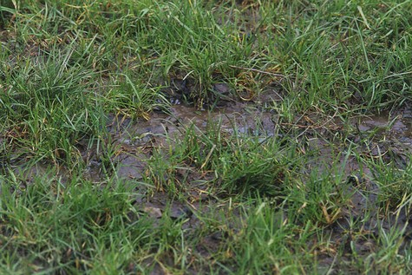
Denitrification
The anaerobic denitrifying bacteria convert nitrate to nitrogen gas , which is then lost to the air.
These are present in greater numbers when the soil becomes waterlogged.
This represents a constant loss of “useful” nitrogen from soil, and explains why fertilisers and nitrogen fixation by the nitrifying bacteria are so important.

Slide 16
Carbon cycle

Slide 17
Task
Complete word search and gap fill
Complete exam questions

