Slide 1
Photosynthesis Lesson 4
The Light-Independent Stage

Slide 2
Learning Objectives
Learn about the reactions that take place in the light-independent stage.

Slide 3
Success Criteria
Be able to describe the stages of the Calvin Cycle.
State the molecules that triose phosphate can be converted into.
Explain why the Calvin Cycle indirectly required light to run.

Slide 4
Starter
Draw the Z Scheme

Slide 5
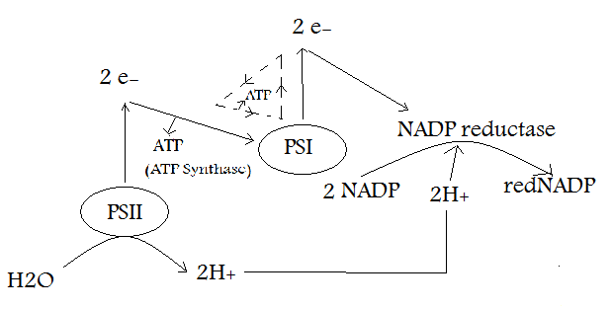
Answer

Slide 6
Role of Water

Slide 7
Photosynthesis
Carbon Dioxide + Water → Glucose + Oxygen
Which molecules were used/made in the light dependent stage?

Slide 8
Photosynthesis
sunlight
Carbon Dioxide + Water → Glucose + Oxygen
chlorophyll
So carbon dioxide and glucose must be in the light independent stage

Slide 9
Light-Independent Stage
Also known as the Calvin cycle
Occurs in the stroma
Products are
Carbohydrates
Lipids
Amino acids

Slide 10
Light Independent Stage

Slide 11
Calvin Cycle
The light-independent stage (also known as the Calvin Cycle) uses the products of the light-dependent to synthesise complex organic molecules.
The Calvin Cycle takes place in the stroma of the chloroplasts.
It does not directly require light, but will soon cease in darkness, as ATP and hydrogen will run out.
Stroma
Light-Dependent Reaction
Light-Independent Reaction
ATP!
reduced
NADP
Thylakoid

Slide 12
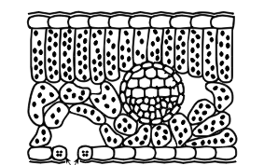
CO₂
The ATP and hydrogen provided by the light-dependent stage is used to reduce CO₂.
The conversion of CO₂ into complex organic molecules is also known as carbon fixation.
Light powers the LD stage, producing ATP and reduced NADP (H⁺ ions).
CO₂ diffuses into the leaf through the stomata is then fixed in the LI stage.
The conversion of CO₂ maintains a concentration gradient. This keeps CO₂ diffusing into the leaf.
CO₂

Slide 13
The Calvin Cycle

Slide 14
Calvin Cycle
CO₂ (1C)
RuBisCO
2GP (3C)
RuBP (5C)
Stage 1:
CO2 combines with a 5C acceptor molecule called ribulose bisphosphate (RuBP).
The reaction is catalysed by the enzyme RuBisCO.
This forms an unstable 6C intermediate, which breaks down into two 3C molecules called glycerate-3-phosphate (GP).

Slide 15
Calvin Cycle
CO₂ (1C)
2ATP
RuBisCO
2GP (3C)
2ADP + P_{i}
2 red.
NADP
RuBP (5C)
Stage 2:
The two molecules of GP are reduced to triose phosphate (TP), using hydrogen from reduced NADP and energy from ATP.
2NADP
2TP (3C)

Slide 16
Calvin Cycle
CO₂ (1C)
2ATP
RuBisCO
2GP (3C)
2ADP + P_{i}
2 red.
NADP
RuBP (5C)
2NADP
Stage 3:
Some of the TP leaves the cycle in order to synthesis organic compounds.
Some of the TP is used to reform RuBP.
2TP (3C)
TP (3C)
TP (3C)

Slide 17
Calvin Cycle
CO₂ (1C)
2ATP
RuBisCO
2GP (3C)
2ADP + P_{i}
2 red.
NADP
RuBP (5C)
Regenerating RuBP needs phosphates, which is provided by ATP molecules.
2NADP
2TP (3C)
ADP + P_{i}
TP (3C)
ATP
TP (3C)

Slide 18
Maths…
Generating one molecule of glucose actually requires six ‘turns’ of the cycle.
The diagram on the following slide has been adjusted to reflect this…

Slide 19
6CO₂
12ATP
RuBisCO
12GP
12ADP + P_{i}
12 red.
NADP
6RuBP
12NADP
10 of the 12 TP molecules are used to reform 6 RuBP molecules.
12TP
5ADP + P_{i}
10TP
5ATP
A molecule of glucose contains 6 carbons, which is why 2TP are required
2TP (3C)

Slide 20
Task
Read the paragraph titled ‘The Calvin Cycle only runs during daylight’ on page 123.
Summarise the information in your notes.

Slide 21
Triose Phosphate (TP)
As you’ve seen, 2 out of every 12 TP molecules are used to synthesise organic molecules such as glucose.
The glucose can then be converted to sucrose, starch and cellulose.
Some TP is also used to synthesise amino acids, fatty acids and glycerol.
Remember that the rest of the TP (10 molecules) is used to regenerate RuBP.
Answer the questions at the bottom of page 123.

Slide 22
Complete the exam question now… Or as homework.

Slide 23
Plenary
On a piece of paper, summarise the light-dependent and light-independent stages of photosynthesis.

Slide 24
Learning Objectives
Learn about the reactions that take place in the light-independent stage.

Slide 25
Success Criteria
Be able to describe the stages of the Calvin Cycle.
State the molecules that triose phosphate can be converted into.
Explain why the Calvin Cycle indirectly required light to run.

