Slide 1
Dihybrid crosses and autosomal linkage
Patterns of inheritance

Slide 2
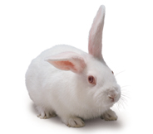
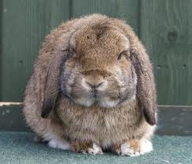
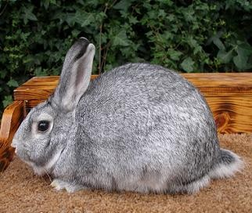
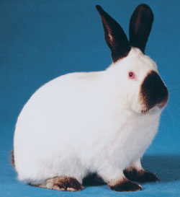
Homework - Multiple Alleles: Hierarchy
Sometimes there are more than 3 alleles, occurring in a dominance hierarchy
Coat Colour in Rabbits
Agouti coat is dominant to Chinchilla coat, which is dominant to Himalayan coat, which is dominant to Albino coat
Lesson 3 Homework Multiple alleles -bunnies.doc
>
>
>

Slide 3
Bunnies
Choose appropriate alleles
C^{A} – Agouti C^{c} - Chincilla C^{h} – Himalayan Cª – Albino
Write down the ten possible genotypes for coat colour, and there phenotypes.
C^{A} C^{A} Agouti C^{c} C^{c} Chincilla C^{h} C^{h} Himilayan
C^{A} C^{c} Agouti C^{c} C^{h} Chincilla C^{h} Cª Himilayan
C^{A} C^{h} Agouti C^{c} Cª Chincilla Cª Cª Albino
C^{A} Cª Agouti

Slide 4
Bunnies
B Draw genetic diagrams to explain each of the following:
An albino rabbit is crossed with a chinchilla rabbit, producing offspring which are all chinchilla. Two of these chinchilla offspring are then crossed, producing 4 chinchilla offspring and 2 albino.
 | Cª | Cª
C^{c} | Cª C^{c} | Cª C^{c}
C^{c} | Cª C^{c} | Cª C^{c}
Albino must be CªCª
Chincilla could be C^{c} C^{c} or C^{c} C^{h} or C^{c}Cª
If F1 offspring are all to be chinchilla then parent must be C^{c}Cª
 | Cª | C^{c}
Cª | Cª Cª | Cª C^{c}
C^{c} | Cª C^{c} | C^{c} C^{c}
3:1 ratio of chinchilla to albino

Slide 5
Bunnies
B Draw genetic diagrams to explain each of the following:
An agouti rabbit is crossed with a Himalayan rabbit, producing 3 agouti offspring and 3 Himalayan
Agouti C^{A}C^{A}, C^{A}C^{c}, C^{A}C^{h} C^{A}Cª Himilayan C^{h}C^{h}, C^{h}Cª
 | C^{A} | C^{h}
C^{h} | C^{A} C^{h} | C^{h} C^{h}
C^{h} | C^{A} C^{h} | C^{h} C^{h}
 | C^{A} | C^{h}
C^{h} | C^{A} C^{h} | C^{h} C^{h}
Cª | C^{A} Cª | C^{h} Cª

Slide 6
Bunnies
B Draw genetic diagrams to explain each of the following:
(iii). 2 agouti rabbits produce a litter of 5 young, 3 of whom are agouti and 2 chinchilla. The 2 chinchilla young are then crossed, producing 4 chinchilla offspring and 1 Himalayan.
Agouti C^{A}C^{A}, C^{A}C^{c}, C^{A}C^{h} C^{A}Cª
 | C^{A} | C^{h}
C^{A} | C^{A} C^{A} | C^{A} C^{h}
C^{c} | C^{A} C^{c} | C^{c} C^{h}
But we need both chinchilla AND himalayan alleles to be present
 | C^{c} | C^{h}
C^{c} | C^{c} C^{c} | C^{c}C^{h}
C^{h} | C^{c} C^{h} | C^{h} C^{h}

Slide 7
Learning outcomes
(i) genetic diagrams to show patterns of inheritance
To include monogenic inheritance, dihybrid inheritance, multiple alleles, sex linkage and codominance.
(ii) the use of phenotypic ratios to identify linkage (autosomal and sex linkage) and epistasis
To include explanations of linkage and epistasis.

Slide 8
Dihybrid crosses
This example is based on Mendel's pea crosses and begins with 'true' breeding or homozygous plants for two unlinked genes (genes on separate chromosomes).
The phenotype which is used includes the colour and the texture of the seeds of the pea plant.
R = Round r = wrinkled
Y = yellow y = green
Round is dominant to wrinkled
Yellow is dominant to green

Slide 9
Drawing a dihybrid cross
R
R
Y
Y
r
r
y
y
X
F1 generation Cross two homozygotes
round yellow with wrinkled green
RRYY x rryy
So only gamete options are RY and ry
Phenotypes = 100% Round Yellow
 | RY
ry | RrYy
R
r
Y
y

Slide 10
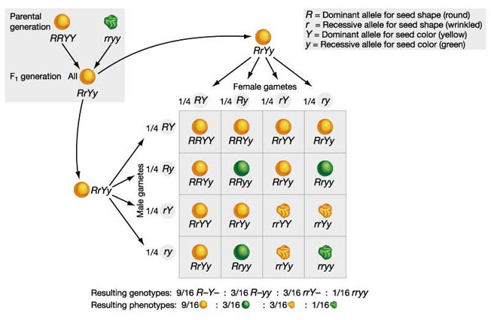

Slide 11
Drawing a dihybrid cross
R
r
Y
y
F2 generation: Cross two heterozygotes
RrYy x RrYy
So gamete options are RY, Ry, rY, ry
R
Y
R
y
r
Y
r
y
 | RY | Ry | rY | ry
RY
Ry
rY
ry

Slide 12
Drawing a dihybrid cross
F2 generation: Cross two heterozygotes
Work out gamete options
RrYy x RrYy
So gamete options are RY, Ry, rY, ry
 | RY | Ry | rY | ry
RY | RRYY | RRYy | RyYY | RrYy
Ry | RRYy | RRyy | RrYy | Rryy
rY | RrYY | RrYy | rrYY | rrYy
ry | RrYy | Rryy | rrYy | rryy
Phenotypes = 9 Round Yellow : 3 Round green : 3 wrinkled Yellow : 1 wrinkled green

Slide 13
Crossing of dihybrid heterozygous parents always gives 9:3:3:1 ratio if the genes are unlinked (on separate chromosomes)

Slide 14
however
Achieving the 9:3:3:1 ratio does not always happen.
What if the genes were on the some chromosome?
They are linked and would be inherited together
Example
Flower colour : P - purple p – red
Pollen grain shape : L – long l – round
What if we crossed true-breeding purple flowered long grain homozygous (PPLL) with true-breeding red flowered round grain homozygous (ppll)
P
P
p
p
L
L
l
l

Slide 15
Linked genes
P
P
p
p
X
Parent genotype PPLL x ppll
Gametes
F1 generation all PpLl
Parent genotype PpLl x PpLl
gametes
l
L
L
l
PL
pl
P
p
P
p
X
L
l
L
l
PL
pl
PL
pl
 | PL | pl
PL | PPLL Purple/long | PpLl Purple/long
pl | PpLl Purple/long | ppll Red/round
WHAT HAVE WE FORGOTTEN ABOUT MEIOSIS?
3:1 ratio
Purple/long : red/round

Slide 16
Linkage without recombination
Linkage between two genes on a single pair of chromosomes : no exchange occurs
Genotype PpLl
What gametes could be produced?
P
P
p
p
L
L
l
l
P
L
P
L
What if crossing over occurred during meiosis?
p
l
p
l

Slide 17
Linkage with recombination
Linkage between two genes on a single pair of chromosomes: exchange occurs between two non sister chromatids
Crossing over is a rare event therefore only a small number of recombinant gametes (from crossing over in meiosis) would be produced
P
P
p
p
L
L
l
l
Smaller number of these
P
L
P
l
p
L
p
l
Smaller number of these

Slide 18
Autosomal linkage with crossing over
PpLl x PpLl
Smaller number of these
We ultimately get less of the recombinant varieties
Purple/round and
red/long
 | PL | Pl | pL | pl
PL | PPLL Purple/long | PPLl Purple/long | PpLL Purple/long | PpLl Purple/long
Pl | PPLl Purple/long | PPll Purple/round | PpLl Purple/long | Ppll Purple/round
pL | PpLL Purple/long | PpLl Purple/long | ppLl Red/long | ppLl Red/long
pl | PpLl Purple/long | Ppll Purple/round | ppLl Red/long | ppll Red/round
Smaller number of these

Slide 19
Less of the recombinant varieties

Slide 20
Now attempt the exam question!

