Slide 1
Succession

Slide 2
Starter Key Terms
Succession
A directional change in a community of organisms over time
Primary Succession
Succession occurring in an area where no living creatures are currently present
Pioneer Community
First organisms to colonise bare ground
Climax Community
Final community in a succession
Deflected succession
Happens when succession is stopped or interfered with e.g. grazing or mowing

Slide 3
Learning outcomes
the process of primary succession in the development of an ecosystem
To include succession from pioneer species to a climax community
AND
deflected succession.

Slide 4
Succession of bare rock or barren land
Succession happens when an area is first colonised. What might happen to cause this?
A retreating glacier depositing rock
Wind or sea piling sand into dunes
Volcanoes erupting and depositing lava
Land subsiding and creating lakes or ponds
Silt and mud being deposited at river estuaries

Slide 5
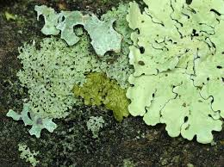
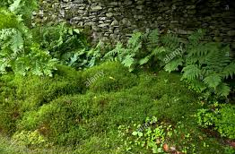
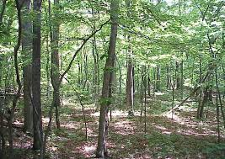
Succession
Algae and lichens begin to live on bare rock
Erosion of rock and build up of dead organic material produces enough soil for mosses and ferns to grow
Larger plants succeed these smaller plants until a final, stable community is reached….the climax community

Slide 6
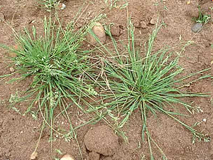
Pioneer Species
The first stage of succession involves pioneer species colonising an inhospitable environment
Pioneer species have features that suit them to colonisation

Slide 8
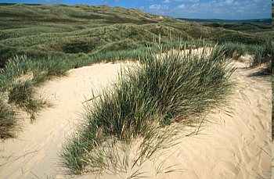
Task
In pairs, come up with a list of features that pioneer species may have, which would help them to colonise inhospitable environments

Slide 9
Features of Pioneer Species
Production of a lot of wind-dispersed seeds to easily reach isolated areas
Rapid germination of seeds
The ability to photosynthesise
The ability to fix nitrogen from the atmosphere
Tolerance to extreme conditions

Slide 10
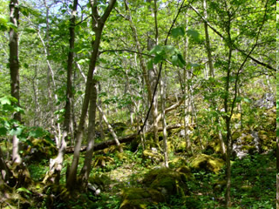
Climax Community
The organisms that make up the final stage of ecological succession
A balanced equilibrium
In the UK, this is deciduous woodland

Slide 11
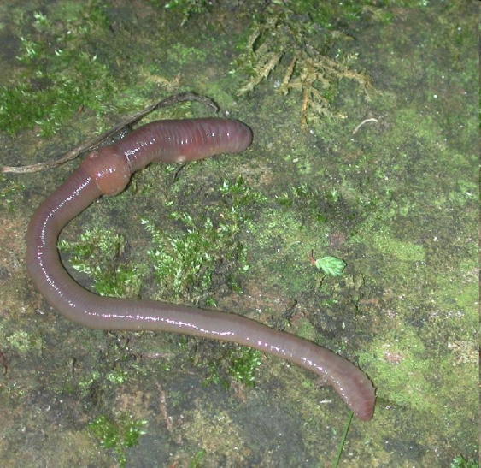
Animal Succession
Animal species present depend on the plant species found in the area
For example, mosses and grasses provide food and habitats for insects and worms. These can then support secondary consumers.

Slide 12
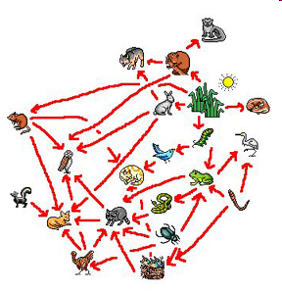
Common features in any succession
The non-living environment becomes less hostile
A greater number and variety of habitats
Increased biodiversity
More complex food webs
Increased biomass

Slide 13
Succession on sand dunes
Using the textbook p280 describe the succession of sand dunes

Slide 14
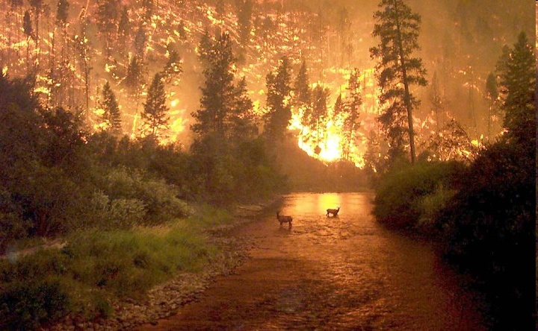
Secondary succession
Succession does not always have to start from bare ground.
Secondary succession occurs on previously disturbed or damaged habitat e.g after a fire
The area will then undergo succession to return to a stable, climax community
This type of succession doesn’t begin with a pioneer species

Slide 15
Preventing and deflecting succession
Human activities can prevent normal climax community from developing – Plagioclimax
Eg Dorset heath land nature reserve
Deflected succession is when succession is prevented by human activity but the plagioclimax is different to any of the natural stages of the ecosystem
Eg mowed or grazed grassland

Slide 16
Task
Complete the exam questions

