Slide 1
epistasis
Patterns of inheritance

Slide 2
Learning outcomes
(ii) the use of phenotypic ratios to identify linkage (autosomal and sex linkage) and epistasis
To include explanations of linkage and epistasis.

Slide 3
Epistasis
This is where one gene masks or suppresses the expression of another. They may work
Antagonistically
Complementary
Antagonistically :
Crosses involving epistatic genes don’t result in the expected phenotypic ratios (9:3:3:1)
The ratio depends whether the epistatic allele is dominant or recessive

Slide 4
Recessive epistatic alleles (Ratio 9:3:4)
If the epistatic allele is recessive then 2 copies will mask the expression of the other gene.
TASK -Mouse coat colour is controlled by two pairs of alleles: B and C
B = black coat colour, b = brown coat colour
C = pigment production, c = no pigment production
Therefore, if a mouse has cc, it will be an albino, if it has Cc or CC it will be black or brown.
Work out the F1 and F2 generation of the following cross
Black x albino
CCBB ccbb

Slide 5
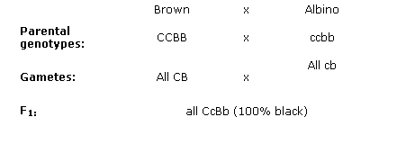
Mouse coat colour is controlled by two pairs of alleles: B and C
B = black coat colour, b = brown coat colour
C = pigment production, c = no pigment production
Therefore, if a mouse has cc, it will be an albino, if it has Cc or CC it will be black or brown.
Black

Slide 6
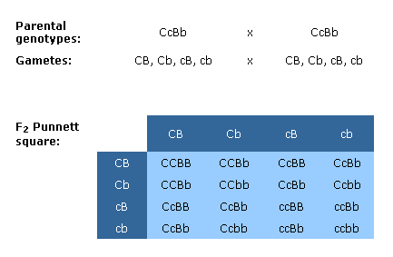
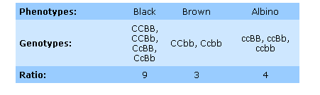
Mouse coat colour is controlled by two pairs of alleles: B and C
B = black coat colour, b = brown coat colour C = pigment production, c = no pigment production
Therefore, if a mouse has cc, it will be an albino, if it has Cc or CC it will be black or brown.

Slide 7
Dominant epistatic alleles (Ratio 12:3:1 or 13:3)
If the epistatic allele is dominant then 1 copies will mask the expression of the other gene.
Task
Hair type in Dillybopper beetles is controlled by 2 genes : Hair (H - bald, h – hair) and type ( S – straight, s – curly). The offspring of the following cross are shown in the table. Explain the phenotypic ratios
Homozygous bald (HHSS) x Homozygous curly (hhss)
Phenotypes of F2 generation
Bald | Straight hair | Curly hair
36 | 9 | 3

Slide 8
Parental phenotype Bald Curly
Parental genotype HHSS x hhss
Gametes HS hs
F1 generation HhSs all bald
Parental genotypes HhSs x HhSs
Phenotypic ratios 12 : 3 : 1
Bald : Straight : Curly
F2 | HS | Hs | hS | hs
HS | HHSS | HHSs | HhSS | HhSs
Hs | HHSs | HHss | HhSs | Hhss
hS | HhSS | HhSs | hhSS | hhSs
hs | HhSs | Hhss | hhSs | hhss
The hair gene has a dominant epistatic allele, which means having one copy will result in a bald phenotype that masks the type of hair gene

Slide 9
Complementary epistatic genes
Parental genotypes: AAbb x aaBB
Parental Phenotypes: White x White

Slide 11
The alleles are complementing each other

Slide 12
Phenotypic ratios
Normal Dihybrid ratio 9:3:3:1
Epistatic ratios
Antagonistic recessive - If the epistatic allele is recessive then 2 copies will mask the expression of the other gene 9:3:4
Antagonistic dominant -If the epistatic allele is dominant then 1 copies will mask the expression of the other gene 12:3:1 or 13:3
Complementary epistasis – the dominant allele for both genes is needed for the characteristic to be expressed 9:7

