Slide 1
Block 1B – Cell division, cell diversity and cellular organisation 2.1.6
Foundations in Biology
Meiosis and genetic variation

Slide 2
SPEC

Slide 3
Starter
Compare mitosis and meiosis

Slide 4
Cell division division of the nucleus and then the cell
Mitosis
For Growth
Produces 2 identical daughter nuclei
Same number of chromosomes to parent cell
No variation
Meiosis
For gamete production
Produces 4 different daughter nuclei
Different number of chromosomes to parent cell
Causes Variation

Slide 5
Lesson Objectives
2.1.6 f,g
Learning Objectives
Success Criteria
To learn why meiosis is necessary.
To understand what happens during meiosis.
To realise how meiosis creates genetic variation.
Describe the significance of meiosis (Grade D-E)
Outline the main stages of meiosis including names of stages and explanation of the term homologous chromosomes (Grade C)
Explain how crossing over and independent assortment results in variation (Grade A-B)

Slide 6
Passing Information to the Next Generation
Humans are similar because we all have the same genes.
What gives us our quirky differences though, is the inheritance of different alleles to those genes.
Gametes join together at fertilisation to form a zygote.
Gametes always have half the normal amount of DNA (HAPLOID) in them, compared to regular body cells.
This is so that when two gametes combine, the resulting zygote contains the correct amount of DNA.
How you doin’?
You look like a rat.

Slide 7
Diploid and Haploid
Normal body cells have the normal number of chromosomes
46
We call these cells DIPLOID. It means that each body cell contains two of each chromosome – one from mum and one from dad.
Gametes though, have half the normal number of chromosomes
23
We call these cells HAPLOID. There’s only one copy of each chromosome.
You might see this explained elsewhere as ‘2n’.
And this might be explained as just ‘n’.
At fertilisation, a haploid sperm will fuse with a haploid egg.... which makes a cell with the normal, diploid number of chromosomes ☺

Slide 8
WHADOOSH!
n
n
2n

Slide 9
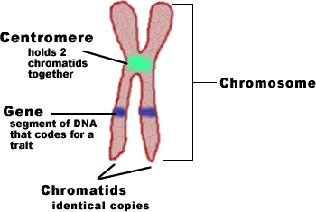
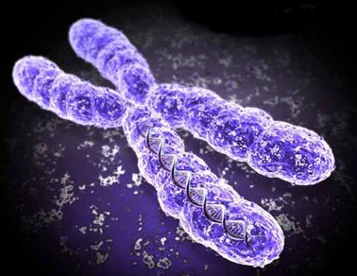
Chromosomes
A duplicated and condensed eukaryotic chromosome with two sister chromatids
Homologous Chromosomes
Chromosomes occur in pairs – there are 23 pairs of chromosomes. Each pair consists of a chromosome from the male (father) and one from the female (mother). The chromosomes that make up each pair of the 22 pairs are the same size and have the same or alternative versions of genes for particular characteristics. Each individual pair of similar chromosomes is called a homologous pair.

Slide 10
Meiosis
Meiosis is a type of cell division used in the formation of gametes (spermatozoa and ova) in animals, and spore formation (which precedes gamete formation) in plants - it is termed reduction division. It happens in the reproductive organs.
Meiosis creates genetically different cells and variation within species
The number of chromosomes is halved - from diploid (46) to haploid (23).
Involves two distinct divisions
Meiosis I – homologous pairs of replicated chromosomes are separated REDUCTION DIVISION
Meiosis II –chromatids separated into individual haploid gametes
Production of haploid (n) gametes ensures the maintenance of the diploid (2n) number in subsequent generations
Meiosis involves certain “mixing” events, and these, along with the random fusion of gametes in fertilisation to form a diploid zygote, results in genetic variation in the offspring which may be of adaptive advantage.

Slide 11
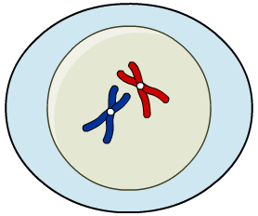
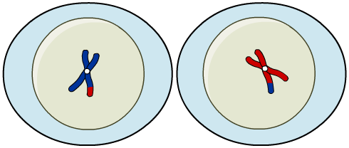
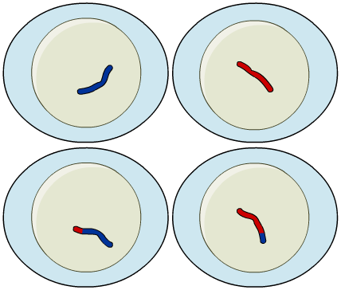
Meiosis I and II
Meiosis is the process of cell division underlying sexual reproduction. It is a two-stage process:
Meiosis I introduces genetic diversity by randomly dividing a cell’s genes in two. It results in two haploid cells.
Meiosis II is similar to mitosis. It splits each chromosome into its two chromatids and places one in each daughter cell. It results in four haploid gametes.
These are genetically different from each other, result from one parent cell – each cell containing half the original number of chromosome

Slide 12
Meiosis Involves 2 Nuclear Divisions
It’s easy to explain why meiosis requires two nuclear divisions. You already know that gametes need to be haploid.... 2 divisions will get you from diploid to haploid.
n
Mum
Dad
2n
n
Meiosis I
Meiosis II
4n
Meiosis begins by just taking a regular, diploid body cell.
n
2n
n

Slide 13
A Quick Summary
Just like any cell in the cell cycle, a regular cell is minding it’s own business as it goes through interphase.
We know that during interphase, a cell with replicate it’s DNA.
Meiosis I then occurs. Homologous pairs are separated, halving the chromosome number.
Meiosis II then occurs. Now, sister chromatids are separated.
Meiosis II is what causes ‘2n’ (diploid) cells to become ‘n’ (haploid) cells.

Slide 14
Meiosis creates genetic variation

Slide 15
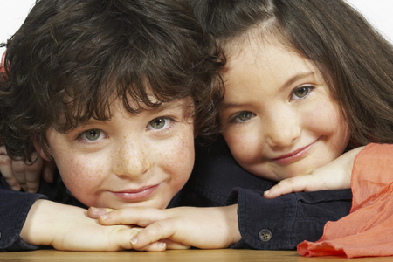
Genetic variation
Sexual reproduction creates genetic diversity within a population, which is vital to a species’ survival.
Two processes during meiosis determine the unique genetic make-up of the four daughter cells:
During meiosis I, homologous pairs of chromosomes swap parts of their genetic material. This is crossing over.
The chromosomes from each pair are randomly allotted to the daughter cells by independent assortment.
Notes:
Photo credit: Jupiterimages Corporation

Slide 16
Genetic Variation
During all of the amazing things that happen during meiosis, two events in particular, are very interesting.
These two processes create genetic variation during meiosis:
Crossing Over
Independent Segregation of Chromosomes
Crossing over occurs during prophase I.
Basically the two chromosomes in each homologous pair twist around each other.
Wherever they ‘touch’, genetic material is swapped between them.
At the end of crossing over the genetic composition of each c’some is now different
Independent segregation happens in metaphase I.
Basically, when the homologous chromosomes line up, they do so randomly.
This means that when they are pulled apart in anaphase, the combination of chromosomes going into the daughter cells is also random.

Slide 17
Crossing Over
During prophase I, the individual chromosomes of each homologous pair, come into very close contact with each other.
They twist and almost look ‘tangled’.
Wherever the chromatids cross over, is called a chiasma
Now we are ready for the next process that confers genetic variation.... INDEPENDENT SEGREGATION OF CHROMOSOMES...

Slide 18
Independent segregation
Lined up chromosomes
Meiosis 1
Meiosis 2
A
A
A
A
A
A
B
B
B
B
B
B
Alternatively the chromosomes may line up the other way around........
For every chromosome this can happen
A
B

Slide 19
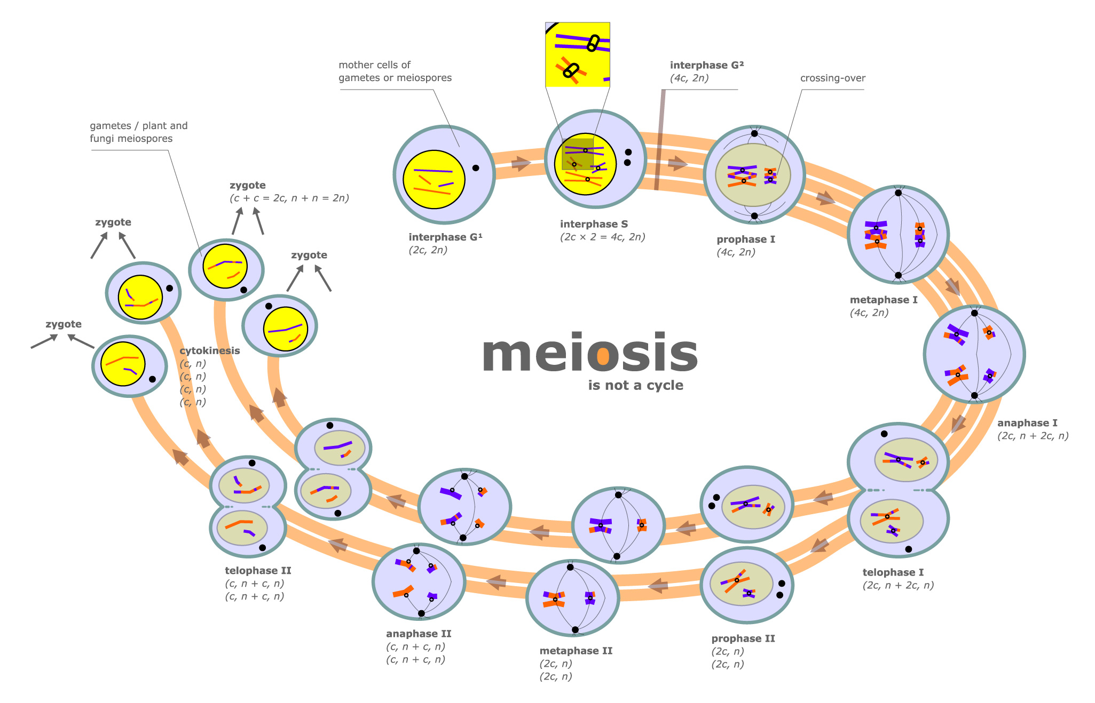

Slide 20
Genetic Variation
Use p150-152 in your textbook
Create a flow chart or storyboard that shows the stages of meiosis, ensure that the stages where variation occurs are indicated. Or label worksheet
Answer question 2
Complete exam questions

Slide 21
Meiosis leads to variation among the offspring of sexual reproduction in 3 ways:
Crossing over – crossing over of genes from one chromatid of one chromosome to the chromatid of the other homologous chromosome
Reduction and fusion of gametes from different individuals – gametes have haploid number of chromosomes – allows a gamete from one of these cells to fuse with another cell with a different haploid set, producing a zygote which has the normal diploid number of chromosomes but a new combination of genes
Independent (random) assortment – when the chromosomes line up as pairs at the equator (metaphase I) of the spindle, it is by chance which “way round” each pair lies.

Slide 22
A. One of the two copies of a chromosome that are joined together by a centromere prior to cell division
B. A type of cell division where the chromosome number is halved
C. One of the different forms of a particular gene
D. A section of DNA that codes for a polypeptide
E. A type of cell division where the daughter cells have the same number of chromosomes as the parent cell
F. A term referring to a nucleus which contains two pairs of chromosomes.
G. A pair of chromosomes (one maternal and one paternal) that have the same gene loci.
H. The position of a gene on a chromosome
Define these words:
Gene
Locus
Allele
Mitosis
Meiosis
Homologous chromosomes
Chromatid
Diploid

Slide 23
Plenary
Meiosis/Mitosis card sort

