Slide 1
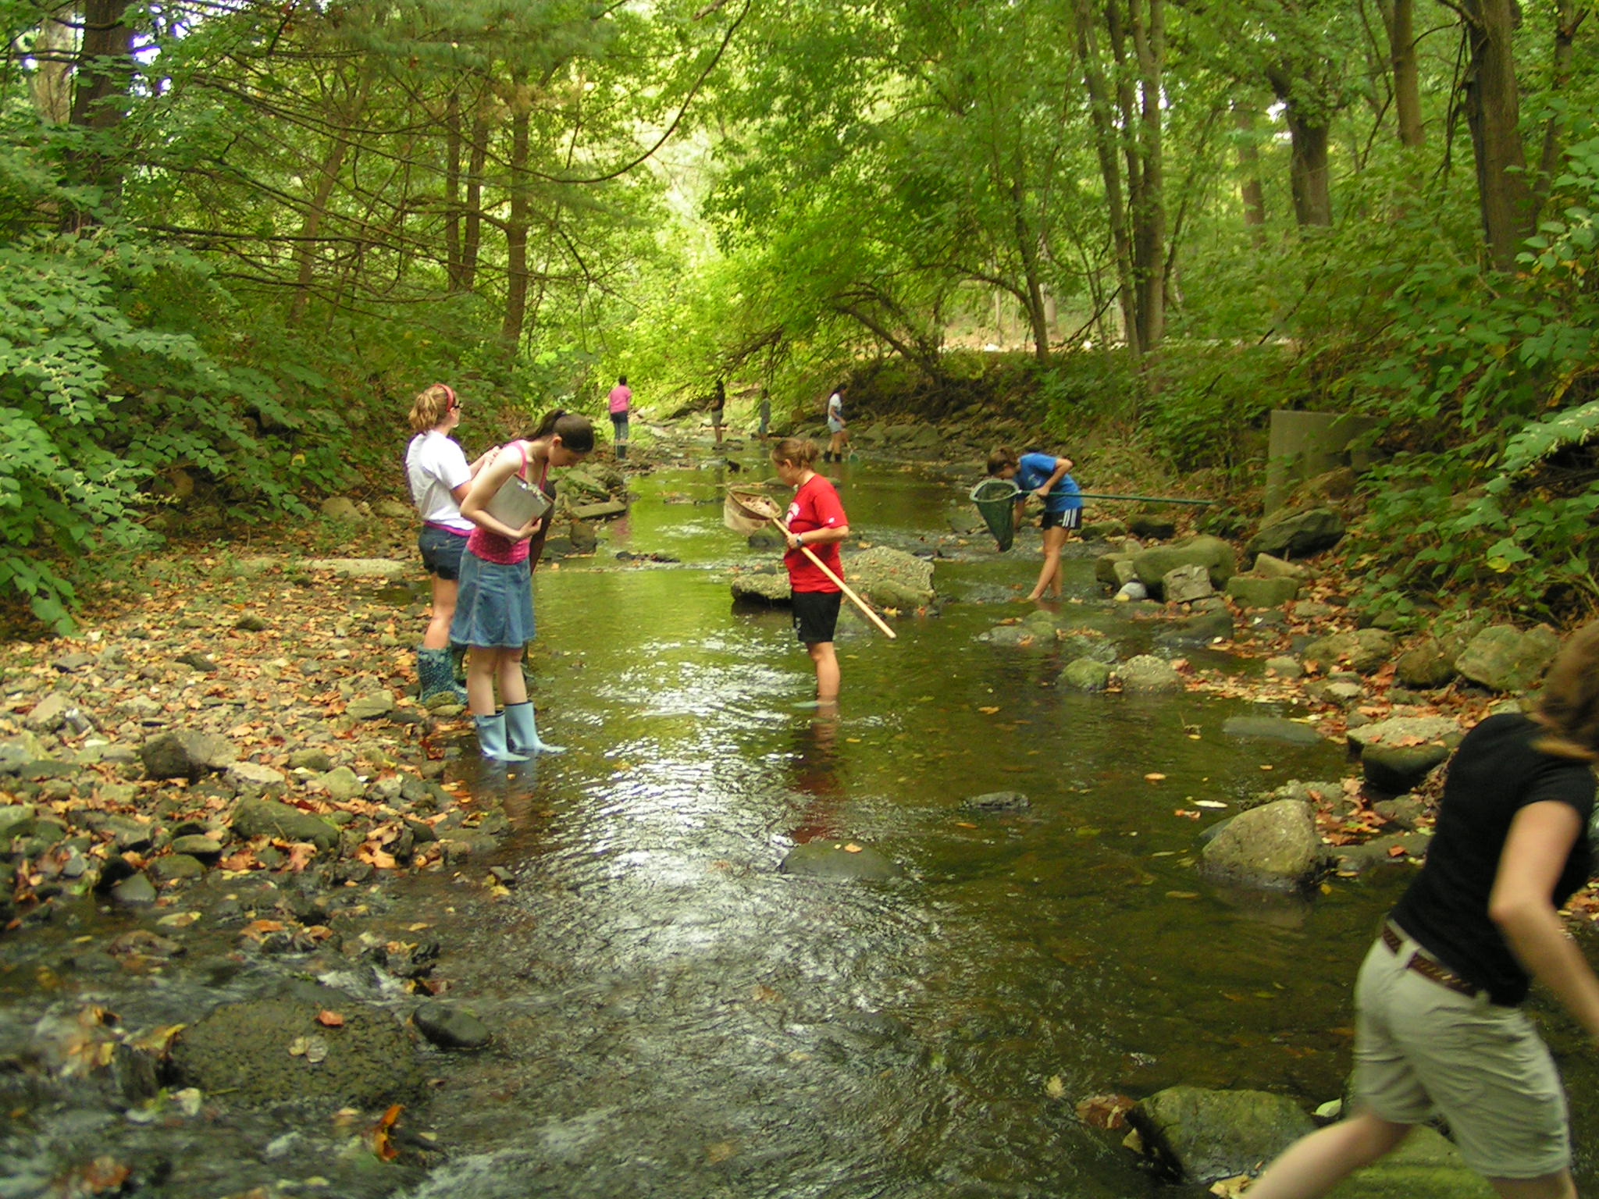
Studying Ecosystems

Slide 2
Starter – Why and how do we sample?
Important in measuring the biodiversity of a habitat
Individuals too numerous to count all in habitat e.g. bacteria, fungi
Select small portion of habitat to study
Multiply number of individuals found by area

Slide 3
Learning outcomes
(e)(i) how the distribution and abundance of organisms in an ecosystem can be measured
(ii) the use of sampling and recording methods to determine the distribution and abundance of organisms in a variety of ecosystems.
PAG3

Slide 4
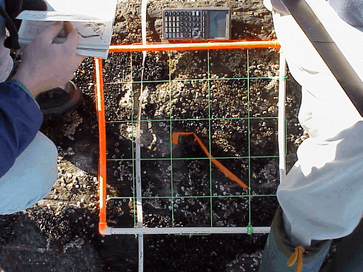
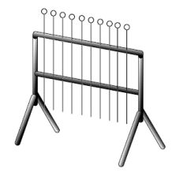
Quadrats
You can collect 2 types of data
Presence or absence of each species
Number of individuals of each species
Percentage cover is more difficult. Using point frame can help make estimates more accurate

Slide 5
Introducing Sampling Techniques
The approach to sampling can be in one of two ways:
1. Random
2. Systematic
Random Sampling:
This is usually employed when trying to eliminate bias. Two numbered axis can be laid out over the sample area. Generation of random numbers provides co-ordinates for areas to study.
Systematic Sampling:
A similar grid is laid over the entire area, but samples are taken at regular intervals. Time-consuming... But more reliable?

Slide 6
More About Quadrats
The number of samples being taken in the area:
The more samples you take in the habitat, the more reliable the results will be... Depends if time is an issue.
Using a cumulative frequency table.
Plot cumulative frequency against quadrat number. The point were the curve levels off tells you how many quadrats to use

Slide 7
Estimate population size
Use this equation to calculate the population size:
Population size = mean number of individuals of the species in each quadrat
of a species fraction of the total habitat area covered by a single quadrat

Slide 8
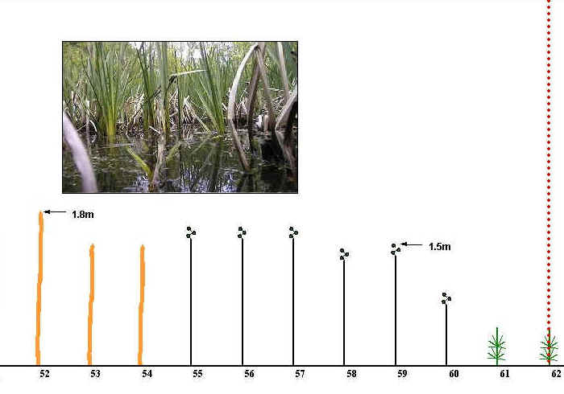
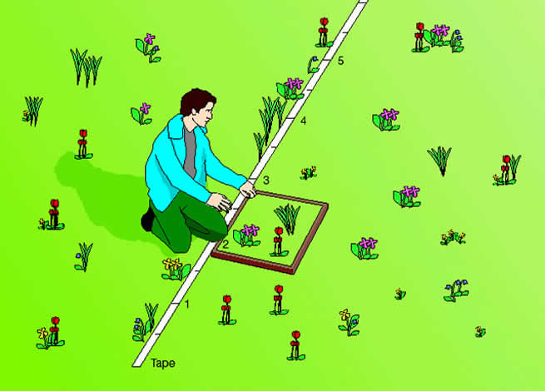
Transect sampling
Used when vegetation changes across a habitat
Line transect – at regular intervals make a note of which species is touching the tape.
Belt transect - at regular intervals place a quadrat next to the line

Slide 9
Kite diagram

Slide 10
PAG 3

