Slide 1
variation and Hardy-Weinberg principle
Patterns of inheritance

Slide 2
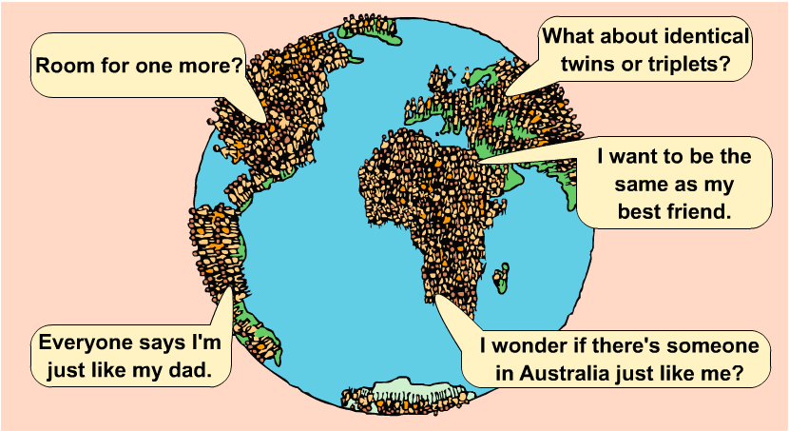
Starter
The current population of planet Earth is more than
7 billion people!
No two people are exactly the same. How is this possible?
What causes variation?

Slide 3
Causes of variation
Your unique characteristics are caused by:
the unique set of genes you have inherited from your parents
the environment in which you have developed.
Differences in some characteristics are due to a combination of both inherited and environmental factors.
Name three examples of this type of characteristic.

Slide 4
Learning outcomes
(d) the genetic basis of continuous and discontinuous variation
To include reference to the number of genes that influence each type of variation.
(f) the use of the Hardy–Weinberg principle to calculate allele frequencies in populations
The equations for the Hardy–Weinberg principle will be provided.

Slide 5
How to classify variation
Characteristics can be classified into two types:
A feature that can be measured and given a value from a range of values shows continuous variation .
A feature that cannot be measured but is one of a few distinct options shows discontinuous variation.
Which type of variation are eye colour and height?

Slide 6
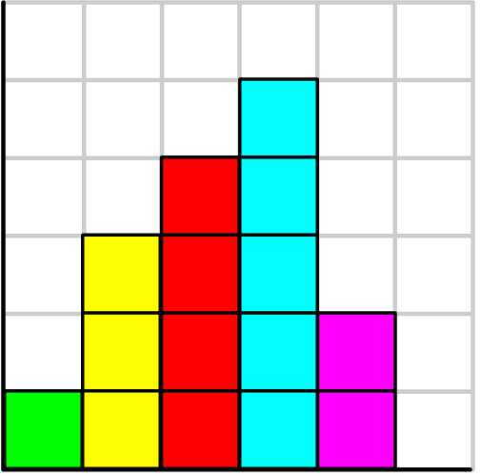
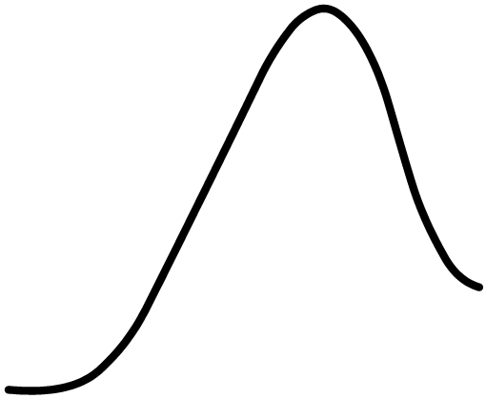
Continuous (quantitative) variation
This type of feature varies over a continuous range of values.
Examples of continuous variation include mass, height, skin colour, intelligence and leaf area.
Bar chart to show the range of
masses in a rugby team
6
5
4
3
number of rugby players
2
1
0
1
70 80 90 100 110 120 130
mass (kg)
Continuous variation is due to the combined effects of a large number of genes (polygenic) and the environment.

Slide 7
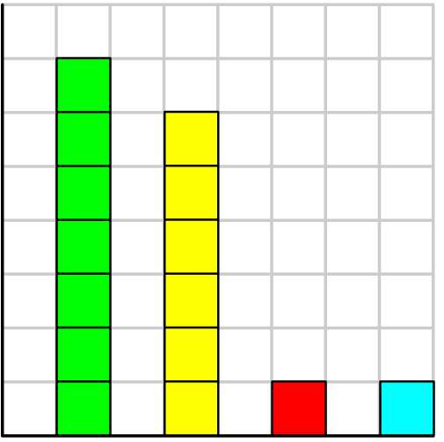
Discontinuous (qualitative) variation
This type of feature can only be one of a few distinct options. Either you have this type of characteristic or you don’t.
Examples of discontinuous variation include blood group, natural eye colour and inherited diseases.
Bar chart to show the frequency
of blood groups in a rugby team
6
5
4
3
number of rugby players
2
1
0
O A B AB
blood group
Discontinuous variation is controlled by a small number of genes (if only one gene it is monogenic) with little environmental influence.

Slide 8
Genetic basis of variation
Discontinuous variation
Continuous variation
Different alleles at a single gene locus have large effects on phenotype
Different gene loci have quite different effects on the phenotype
If more than one gene is involved they act in an epistatic way where one gene masks or influences another
Controlled by 2 or more genes
Each gene provides an additive component
Different alleles have small effect on phenotype
Large number of different, unlinked genes have a combined effect (polygenic)

Slide 9
Variation and selection
Variation is essential for selection. WHY?
When the environment changes, those individuals that are better adapted will survive and reproduce, passing on the advantageous alleles to their offspring

Slide 10
Population genetics
Population genetics studies the genetic structure of populations. It measures the changes in allele and in genotype frequencies from generation to generation.
As we can see only the phenotype it can be difficult to measure the frequencies of different alleles.
For traits that have codominant alleles we can measure the frequencies of alleles through just looking at phenotype
For traits that have recessive and dominant alleles this is more difficult as the heterozygotes show the same phenotype and the homozygous dominant individuals

Slide 11
Hardy-Weinberg equilibrium
In 1908, G.H. Hardy and W. Weinberg suggested a scheme whereby evolution could be viewed as changes in frequency of alleles in a population of organisms.
The Hardy-Weinberg model consists of two equations: one that calculates allele frequencies and one that calculates genotype frequencies.
“Allelic frequency will remain same unless acted upon outside force.”

Slide 12
Assumptions
The population is very large (to make sampling error negligible)
There is random mating within the population
There is no immigration or emigration
There is no mutation
There is no selective advantage for any genotype (no natural selection)
If all these assumptions are met the population can be said to be in Hardy-Weinberg equilibrium

Slide 13
Allele frequency
The frequency of the dominant allele is p
The frequency of the recessive allele is q
Total frequency of the alleles in the population is
p + q = 1

Slide 14
Genotype frequency
The probability of an individuals having the homozygous dominant genotype is p x p (p²)
The probability of an individuals having the homozygous recessive genotype is q x q (q²)
The probability of an individuals having the heterozygous genotype is 2 x p x q (2pq)

Slide 15
The sum of all the frequencies is 1
p² + 2pq + q² = 1
This is called the Hardy-Weinberg equilibrium
p q
p
q
p² | pq
pq | q²

Slide 16
Task
Using the Hardy-Weinberg principle, calculate the percentage of carriers in a population where the occurrence of the condition cystic fibrosis is 1 in 2500 births.
Frequency of cystic fibrosis genotype (q²) 1/2500 q² = 0.0004
Therefore frequency of allele q = √0.0004 = 0.02
Remember p+q = 1 p = 1- q p = 1 – 0.02 = 0.98
Frequency of heterozygous genotype (carriers) = 2pq
2pq = 2 x 0.98 x 0.02 = 0.0392
3.9% carriers
Notes:
To turn probability into % you x by 100

Slide 17
Task
Tay-Sachs disease is an autosomal recessive disorder of the enzyme hexosaminodase. The disorder causes a build-up of fatty deposits in the brain. A child affected by the disease usually dies by the age of four. The frequency of Tay-Sachs disease (tt) in a Mediterranean population is 0.0003.
(a)Calculate the frequencies in the population of allele t and genotype Tt.
Genotype frequency (tt) q² = 0.0003
Allele frequency q = 0.017 so the frequency of allele t is 0.017 or 1.7%
p + q = 1 p = 1 – q p = 1 – 0.017 = 0.983
Frequency of genotype Tt = 2pq = 2 x 0.983 x 0.017 = 0.033 or 3.3%

Slide 18
Task
In a randomly breeding population of mice, 640 had black fur and 360 brown fur. Black fur is dominant to brown fur. The Hardy-Weinberg Principle (p² + 2pq + q² =1) can be used to calculate allele and phenotype frequencies.
(a) Calculate the frequency of the recessive allele.
q² = 360/1000 = 0.36
q = √0.36 = 0.6 = 60%
(b) Calculate the number of homozygous black mice in the sample.
p + q = 1 p = 1 - q p = 1 – 0.6 = 0.4
p² = 0.16
Number of homozygous black mice = 0.16 x 1000 = 160

Slide 19
Learning outcomes
(d) the genetic basis of continuous and discontinuous variation
To include reference to the number of genes that influence each type of variation.
(f) the use of the Hardy–Weinberg principle to calculate allele frequencies in populations
The equations for the Hardy–Weinberg principle will be provided.

Slide 20
Flip learning – Artificial selection
Prepare notes on this topic based on the requirements of the specification
(h)(i) the principles of artificial selection and its uses
To include examples of selective breeding in plants and animals AND an appreciation of the importance of maintaining a resource of genetic material for use in selective breeding including wild types.
(ii) the ethical considerations surrounding the use of artificial selection.
To include a consideration of the more extreme examples of the use of artificial selection to ‘improve’ domestic species e.g. dog breeds.
Be prepared to discuss freely all aspects in the next lesson

