Slide 1
Factors affecting the evolution of a species
Patterns of inheritance

Slide 2
Starter Natural selection recap
Can you remember natural selection from GCSE and AS?
Outline the process of natural selection

Slide 3
Natural selection
Within any species there is variation, due to different alleles
Organisms produce far more young than will survive
There will be competition for limited resources
Only those best adapted will survive, this is called survival of the fittest
Those that survive pass on their ‘successful’ alleles to the next generation
Over generations this leads to evolution as the alleles that cause the advantageous adaptations become more common in the population
These changes may result in new species being formed.

Slide 4
Learning outcomes
(e) the factors that can affect the evolution of a species.
To include stabilising selection and directional selection, genetic drift, genetic bottleneck and founder effect.
(g) the role of isolating mechanisms in the evolution of new species. To include geographical mechanisms (allopatric speciation) and reproductive mechanisms (sympatric speciation).

Slide 5
Selection pressures
Whether the environment is changing or stable affects which characteristics are selected for by natural selection
Stable environment → Stabilising Selection.
Changing environment → Directional Selection

Slide 6
Stabilising Selection
With stabilising selection individuals with alleles for characteristics towards the middle of the range are more likely to survive and reproduce. It reduces the possible range of phenotypes

Slide 7
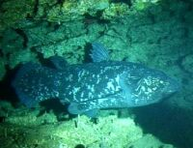
Stabilising Selection
This occurs when the environment doesn't change, therefore there is no pressure for a well-adapted species to change.
Fossils suggest that many species remain unchanged for long periods of geological time.
One of the most stable environments on Earth is the deep ocean
The Coelocanth. This fish species was known only from ancient fossils and was assumed to have been extinct for 70 million years until a living specimen was found in a trawler net off South Africa in 1938. So this species has not changed in all that time.

Slide 8
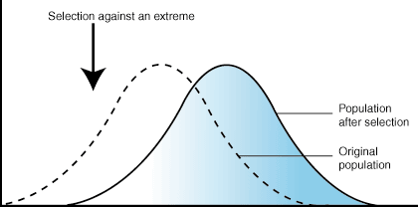
Directional Selection
This occurs whenever the environment changes in a particular way. There is therefore selective pressure for species to change in response to the environmental change
e.g. Darwin's finches
Bacterial resistance to antibiotics.
Pesticide resistance

Slide 9
Directional Selection
Populations do not have to decide to adapt, or mutate, after an environmental change.
The mutation, or combination of alleles giving resistance, have to already be there by chance, otherwise the population may become extinct.
"Environment" includes biotic as well as abiotic, so organisms evolve in response to each other.
Most environments do change (e.g. due to migration of new species, or natural catastrophes, or climate change, or to sea level change, or continental drift, etc.), so directional selection is common.

Slide 10
Directional Selection
Peppered Moth - Camouflage colouration to avoid predation by birds.
Usual type cream coloured – melanic form most common in polluted areas where tree bark had been blacked by soot. Wild type more common in unpolluted areas.

Slide 11
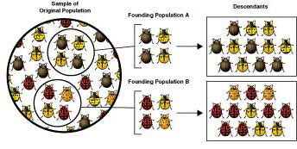
Genetic drift – evolution by chance
Evolution also occurs due to genetic drift.
In genetic drift chance decides which alleles are passed on
Evolution by genetic drift usually has a greater effect in smaller populations where chance has a greater influence

Slide 12
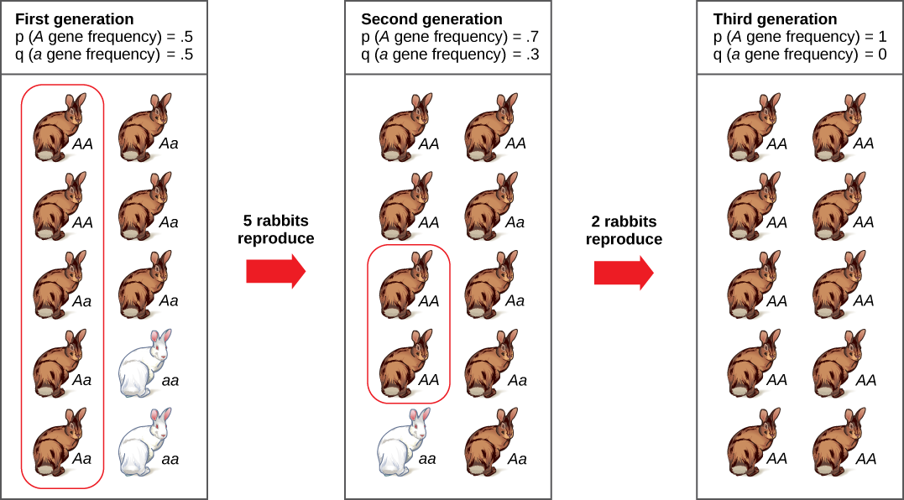
Genetic drift
In extreme cases it can lead to chance elimination of an allele from the population

Slide 13
Genetic drift
Genetic drift can arise after a genetic bottleneck or as a result of the founder effect

Slide 14
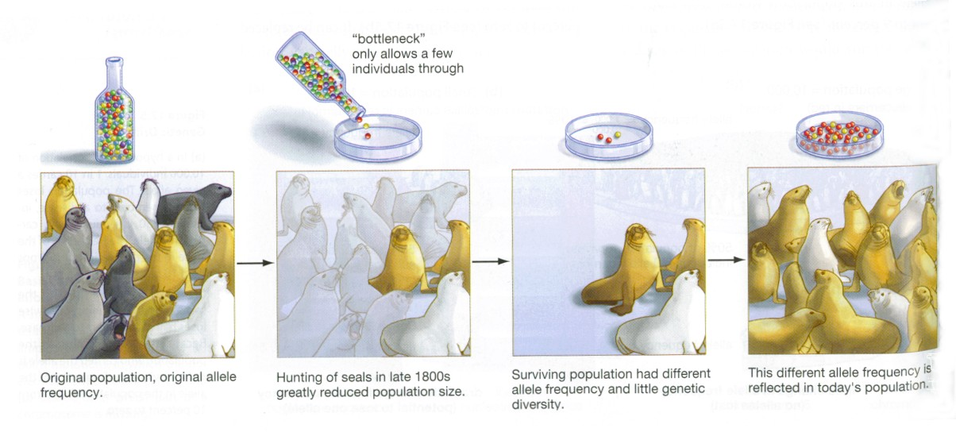
Genetic bottleneck
Evolution by genetic drift can have a bigger effect if there is a genetic bottleneck, e.g. when a large population suddenly become smaller.

Slide 15
Founder effect
Where a small number of individuals can create a new colony, geographically isolated form the original. The new gene pool is small.

Slide 16
Definition of Species
A group of organisms, with similar morphological, physiological, biochemical and behavioural features, which can interbreed to produce fertile offspring and are reproductively isolated from other species.
Speciation is the development of a new species

Slide 17
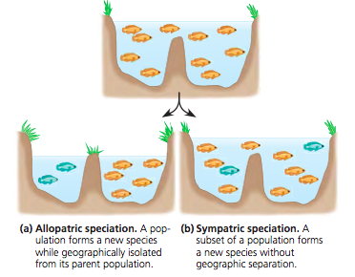
New species usually develop due to:
Geographical isolation
(allopatric speciation)
Reproductive isolation
(sympatric speciation)

Slide 18
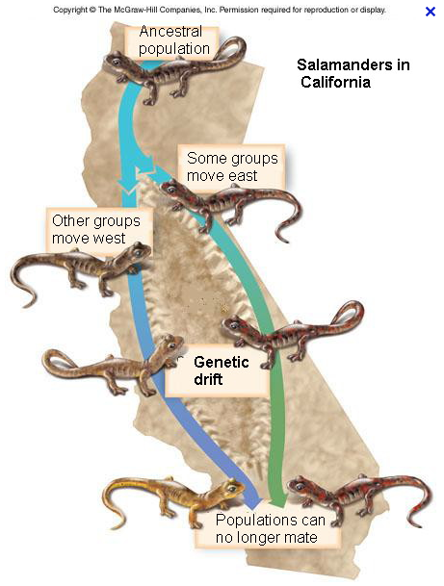
Geographical isolation (allopatric speciation)
A physical battier prevents gene flow between populations
e.g. Darwins finches

Slide 19
Reproductive Isolation (Sympatric Speciation)
There are several causes of reproductive isolation:
Seasonal isolation – mutation or genetic drift means that some individuals of the same species have different flowering or mating seasons
Mechanical isolation – mutation causes changes in genitalia which prevents successful mating
Behavioural isolation - development of different courtship rituals.
Gametic isolation - mutation means that male and female gametes from different populations of the same species are not able to create new individuals – mating can occur but fertilisation fails.

Slide 20
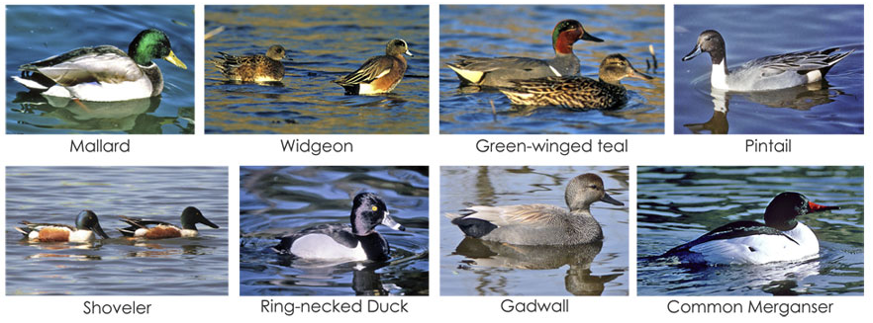
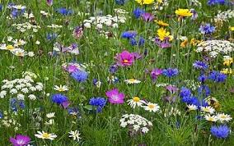
Reproductive Isolation (Sympatric Speciation)
Ducks of different species rarely interbreed due to different mating rituals
Plant interbreeding may be prevented because pollen from one species may not germinate on the stigma of another species.

Slide 21
Task exam question – speciation
(a)(i)Name the type of speciation that occurs when there is no geographical barrier to gene flow. [1]
(ii)Explain how the figure above supports the hypothesis that the type of speciation named in (i) has occurred in seahorses. [2]
Sympatric
ranges of two species, overlap/close together/AW; no geographical barrier; ref to behavioural/genetic/physiological/prezygotic barrier; correct ref to named area of map; max 2

Slide 22
Task exam question – speciation
(b)Explain how disruptive selection occurs in seahorse populations.[3]
(c)In terms of reproductive potential, explain why it is beneficial for large females to mate with large, rather than small, males. [2]
ref to mate selection by size; ie large with large or small with small ref to monogamy; ref to intermediate sizes, at disadvantage/selected against/ora; intermediate do not pass on alleles/ora; suggested reason why intermediate at disadvantage/ora max 3
female produces a lot of eggs; selects male, that can store lots of eggs/has a large pouch/ora; large males fertilise many eggs/ora; chance of more offspring surviving;
or large female and small male produce intermediates/ora; intermediates at disadvantage/ora; max 2

Slide 23
Flip learning – Artificial selection
Prepare notes on this topic based on the requirements of the specification
(h)(i) the principles of artificial selection and its uses
To include examples of selective breeding in plants and animals AND an appreciation of the importance of maintaining a resource of genetic material for use in selective breeding including wild types.
(ii) the ethical considerations surrounding the use of artificial selection.
To include a consideration of the more extreme examples of the use of artificial selection to ‘improve’ domestic species e.g. dog breeds.
Be prepared to discuss freely all aspects in the next lesson

