Slide 1
Lipids

Slide 2
Need to book
Molymods (C,H,O) each group needs 6 carbon, 6 oxygen, 11 hydrogen, 25 single bonds and 6 double bonds
Can repro ppq, but is on slide
Emulsion test to be done with biuret test next lesson so no need to book

Slide 3
Learning Objective
Know about lipids
Describe the structure of the macromolecules triglyceride & phospholipid
Describe the formation (esterification) and breakage of ester bonds to make triglycerides
Explain how the properties of triglycerides, phospholipids and cholesterol molecules relate to their functions in living organisms
Describe the emulsion test for lipids
Success Criteria

Slide 4
Starter
Think, Pair, Share
What is a lipid made up of?

Slide 5
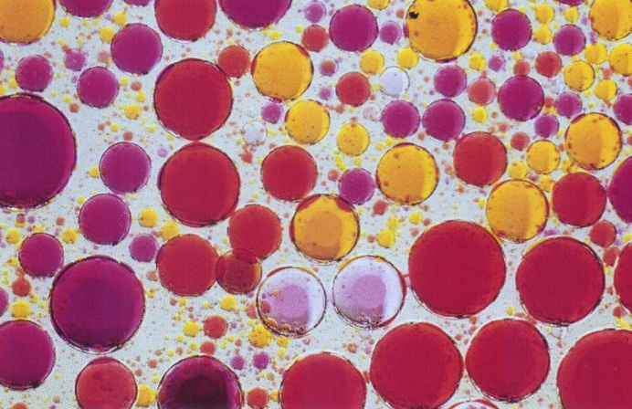
Lipids
Made up of C, H and O
Can exist as fats, oils and waxes
They are insoluble in water
They are a good source of energy (38kJ/g)
They are poor conductors of heat
Most fats & oils are triglycerides

Slide 6
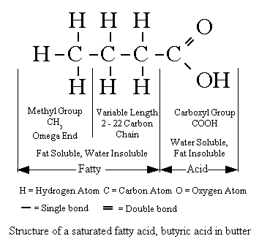
Fatty acids
There is a methyl group (-CH₃) at one end of the chain.
Chain is the formed from a series of covalently bonded carbons saturated with hydrogens.
The chain is non-polar and hydrophobic
The carboxyl group is polar making this ends of the molecule hydrophilic.

Slide 7
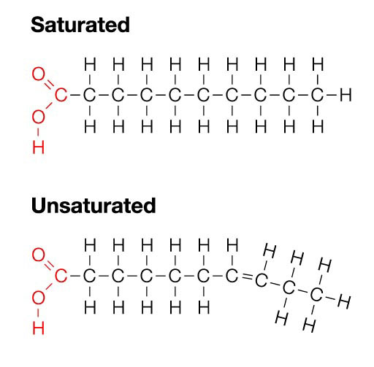
Saturated and unsaturated
Animals fats have saturated fatty acids which are straight molecules and very compact. This is gives them a higher melting point than the plant oils
Plant oils have unsaturated and polyunsaturated fatty acid chains that tend to branch and make the molecule less dense and with a lower melting point.

Slide 8
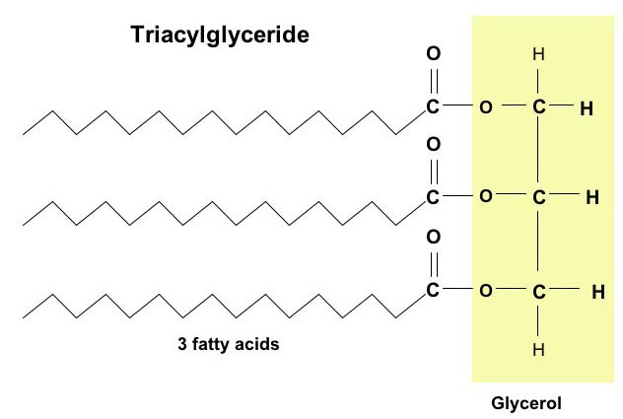
Fatty Acids:
- Describe the structure of the macromolecules triglyceride & phospholipid
Fatty acids are the basis of triglycerides and many other types of lipid.
Three fatty acids combine with one glycerol to form a triglyceride.
These molecules are also the basis of the phospholipid molecules that form the bilayer of the cell membrane.
Macromolecule NOT polymer
Large complex molecules not built from repeating units (monomers)

Slide 9
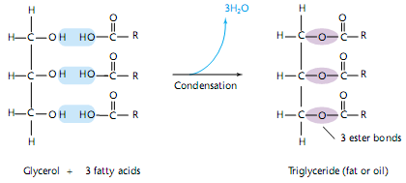
Lipids
In the formation of a triglyceride three fatty acids chains (usually of different length) are bonded to the molecule glycerol.
Ester bonds (-O-) are formed between an -OH group on the glycerol molecule and the carboxylic acid group (-COOH) of the fatty acid.
The triglyceride formed is insoluble. (Hydrophobic).

Slide 10
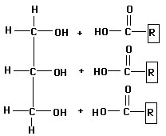
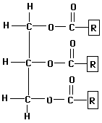
Esterification: Formation of ester bonds
- Describe the formation (esterification) and breakage of ester bonds to make triglycerides
+
Glycerol
3 Fatty acids
Lipid (triglyceride)
Water
Ester Bonds
It doesn’t matter which OH is lost entirely and which just loses a H

Slide 11
Breakage of ester Bonds
- Describe the formation (esterification) and breakage of ester bonds to make triglycerides
+
Ester Bonds
Task: make a triglceride and demonstrate formation and breakage of ester bonds

Slide 12
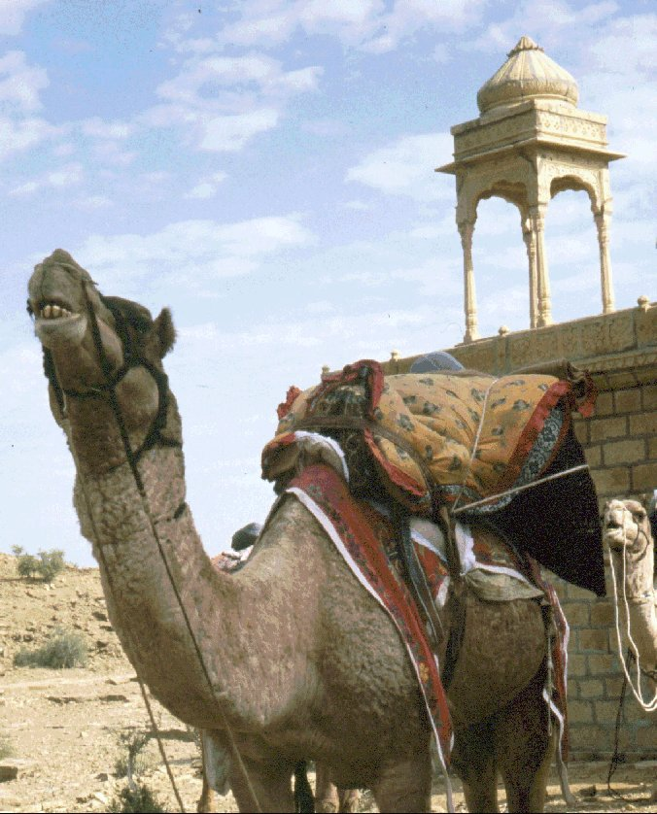
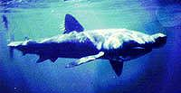
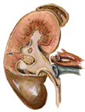
Properties and functions of lipids
Explain how the properties of triglycerides, phospholipids and cholesterol molecules relate to their functions in living organisms
1.A source of energy-Lipids can be respired to release energy in the form of ATP.
2.Good energy store( In adipose cells.) Rich in C-H bonds
3.Metabolic source of water.
4.Insulator (Electrical insulation around nerve cells.)
5.Buoyant
6.Protection of internal organs (Adipose tissue.)-and the surface of a leaf (Cuticle is prevented from drying out.)
7.Some hormones (Steroid) are lipids.

Slide 13
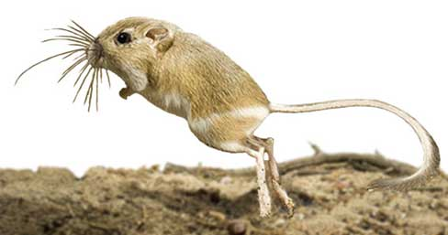
Lipids and respiration-
Explain how the properties of triglycerides, phospholipids and cholesterol molecules relate to their functions in living organisms
Both glycerol and fatty acids can be broken down by respiration into CO₂ and H₂O
The respiration of 1g of lipid gives out about twice as much energy as 1g of carbohydrate
They are insoluble so can be stored in a compact way and do not affect the water potential of the cell
The respiration of lipid gives out more water then the respiration of carbohydrate, enabling some animals, like the kangaroo rat, to not need to drink

Slide 14
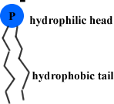
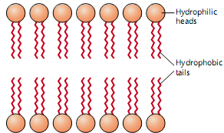
Phospholipids
- Describe the structure of the macromolecules triglyceride & phospholipid
Phospholipids are the principle molecule in the cell membrane they form the 'bilayer' that is the cell membrane.
Phospholipid structure is similar to the triglyceride except one fatty acid chain is replaced by a polar phosphate group.
The molecule is in two parts
Polar hydrophilic phosphate heads.
2 Non polar hydrophobic tails
hydrophilic
phosphate
glycerol
Hydrophobic fatty acids

Slide 15
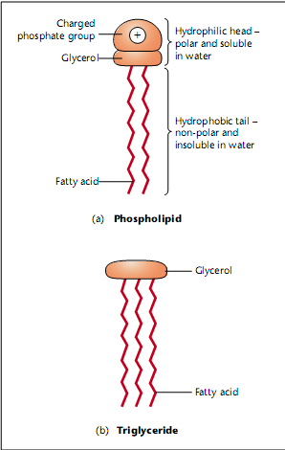
- Describe the structure of the macromolecules triglyceride & phospholipid

Slide 16
Properties of Phospholipids
- Explain how the properties of triglycerides, phospholipids and cholesterol molecules relate to their functions in living organisms
Phosphate ions have extra electrons
Negatively charged
Soluble in water
Hydrophilic (attracted to water)
Fatty acid tails are non-polar
Hydrophobic (repel water)
Readily mix with fat
Hydrophobic/hydrophilic nature
Forms layer on surface of water
Heads in water, tails sticking out
Because of this they are called surface active agents (surfactants)
Bilayers (in membranes)

Slide 17
Membrane fluidity
Fatty acids that make up phospholipids can be saturated or unsaturated and this can control the fluidity of the membranes
Eg organisms living in cold climates have an increased number of unsaturated fatty acids in their phospholipid molecules. This ensures their membranes remains fluid even at low temperatures

Slide 18
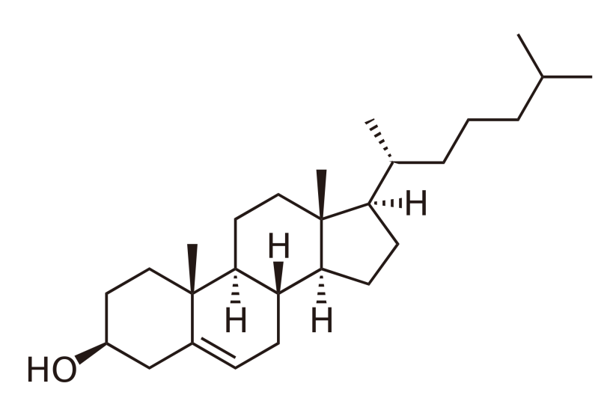
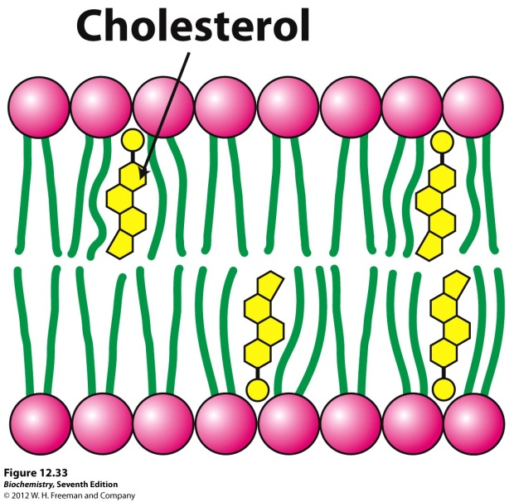
cholesterol
- Explain how the properties of triglycerides, phospholipids and cholesterol molecules relate to their functions in living organisms
Type of lipid with 4 carbon based rings
Small narrow structure and hydrophobic nature allow it to sit between phospholipid tails and help regulate fluidity and strength of membrane
Testosterone, oestrogen and Vitamin D are made from cholesterol.
Lipid nature means they can pass through the phospholipid bilayer

Slide 19
cholesterol
Why can excess cholesterol in humans can be a problem?
In bile, cholesterol can stick together to form gallstones
In blood, can be deposited in the inner linings of blood vessels causing atherosclerosis
What is hypercholesterolaemia?
Genetic disorder were cells manufacture and secrete cholesterol even though there is sufficient in the blood

Slide 20
Lipid Structure & Function
- Explain how the properties of triglycerides, phospholipids and cholesterol molecules relate to their functions in living organisms
 | Structure | Properties | Functions
Triglycerides
Phospholipids
Cholesterol

Slide 21
Lipid Properties & Function
- Explain how the properties of triglycerides, phospholipids and cholesterol molecules relate to their functions in living organisms
 | Structure | Properties | Function
Triglycerides | Glycerol & 3 fatty acids | Compact Insoluble 38kJ/g | Energy Store Doesn’t affect water potential
Phospholipids | Glycerol, 2 fatty acids and a phosphate group | Part hydrophobic, part hydrophilic Less energy content as phosphate group can’t be used | Forms membranes
Cholesterol | 4 carbon based ring structures, hydroxyl group | Thin molecules Part hydrophobic, part hydrophilic. Alcohols can have a high energy content | Fit into the membrane giving strength and stability
Notes:
Glucose is 17kJ/g
Twice as much energy in 1g of fat as 1g of carbohydrate

Slide 22
Testing for lipids
- Describe the emulsion test for lipids
Emulsion test
Add ethanol to sample
To dissolve any lipid
Pour mixture into another test tube containing water
Causes emulsion to form near the top of the water
What are the positive and negative results?
You will carry this test out next lesson

Slide 23
Plenary
- Describe the structure of the macromolecules triglyceride & phospholipid
- Explain how the properties of triglycerides, phospholipids and cholesterol molecules relate to their functions in living organisms
Past paper question
Jun 2010 Q1aiii & b
Describe the structure of a triglyceride molecule [3]
State 3 roles of lipids in living organisms [3]

Slide 24
Markscheme Q1

Slide 25
Markscheme Q2

Slide 26
Homework
Write down 3 synoptic links with this topic to the previous learning

