Slide 1
Liver Function

Slide 2
Spec
(b) (i) the structure and functions of the mammalian liver (ii) the examination and drawing of stained sections to show the histology of liver tissue
To include the gross structure and histology of the liver AND the roles of the liver in storage of glycogen, detoxification and the formation of urea (the ornithine cycle covered in outline only).

Slide 3
Learning Objective Success Criteria
Know about the function of the liver
Describe the role of liver in the storage of glycogen
Describe the roles of the liver in detoxification and formation of urea (outlining the ornithine cycle)

Slide 4
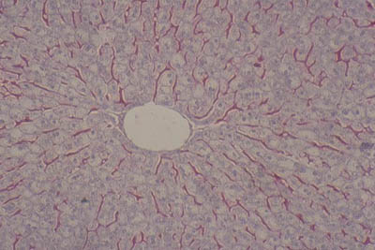
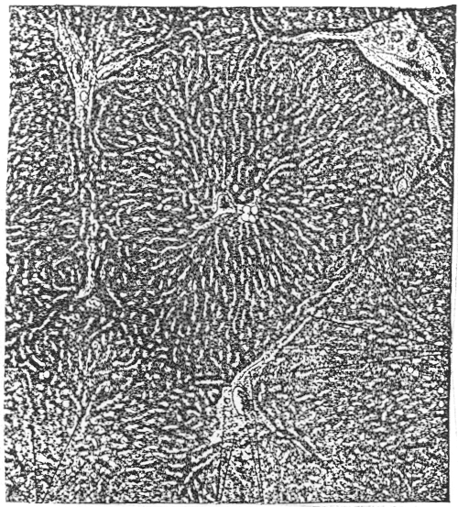
Starter: Histology of liver
What can you label?

Slide 5
EXOCRINE
What does the liver do?
ENDOCRINE
Notes:
Endocrie (hormones) substances into blood
Exocrine substances secreted into vessels ie digestion (bile)

Slide 6
Alcohol
drugs
Controls levels of….
Detoxification of…
Lipid levels (storage in adipose)
Glucose
What does the liver do?
Synthesis
Plasma proteins (inc clotting factors)
Red blood cells
Bile
Cholesterol
Heat
Stores….
Removal of….
Glucose (glycogen)
Iron
Key Vitamins
Bilirubin (haem group from old RBC
Used hormones
Notes:
Endocrie (hormones) substances into blood
Exocrine substances secreted into vessels ie digestion (bile)

Slide 7
What does the liver do?- general
Main categories:
Secretion Glucose, bile, lipids, Bile
Protein & Lipid synthesis: cholesterol synthesis,lipoproteins, plasma proteins (prothrombin, fibrinogen- clotting factors)
Metabolic Functions: Lipids, carbs (gluconeogenesis) and protein control (dealing with xs amino acids: deamination)
Storage metabollites: glycogen, vitamins A, D, and B12, iron (recycling Haem group from rbc’s).
Detoxification
Notes:
Blood clotting: soluble plasma proteins, collagen exposed in damaged blood vesel wall cascade activated fibrinogen → active formenzyme thrombin, Catalyses fibrinogen → fibrin (long chain, insoluble tangels to form scaffold.)
Deamination: removal of nitrogen group from amino acids: to form ammonia, builds up toxic in xs→ reacts with CO2 to make urea→ removed from blood by kidneys → urine

Slide 8
What does the liver do?- general
Main categories:
Bile secretion into ducts to gallbladder digestive, cholesterol transport and absorption.
Storage glucose (glycogen) vitamins A,D,E,K, B12.minerals (copper, iron), saturated fats (chloresterol)
Clearance/Transformation/Purification (metabolism): Ammonia (deamination), transamination of non essential amino acids (ornithine cycle), drugs, Billirubin (RBC breakdown product) Hormones- to prevent continued influence )ie oestrogen, testosterone
Fighting infections: Kupffer cells, activates macrophage system
Notes:
Billirubin formed from breakdown of RBS Hb released by spleen into blood billirubin released into bile for egestion with faeces. : xs in blood jaundice
Vitamin A - for sight.
Vitamin D - needed to make a hormone for the absorption of calcium and phosphate into the blood from food eaten and for their metabolism.
Vitamin B₁₂ - for the formation of red blood cells
Damaged liver: complcations with hormone sugnals if liver can not remove the hormone to terminate signal.

Slide 9
What does the Liver do?
You need to focus on:
The role of liver in the storage of glycogen
The roles of the liver in detoxification and formation of urea (outlining the ornithine cycle)

Slide 10
Detoxification

Slide 11
Storage of Glycogen

Slide 12
Storage of Glycogen
Liver stores sugars in the form of glycogen
Glycogen forms granules in the cytoplasm of the hepatocytes
Glycogen is broken down to release glucose into the blood

Slide 13
Question
What type of reaction will be involved in converting glucose to glycogen?

Slide 14
Answer
A condensation reaction; glycosidic bonds will be formed between glucose molecules.

Slide 15
Formation of Urea

Slide 16
Synthesis of urea (p29)
Proteins are made of long chains of amino acids.
When amino acids are metabolised and broken down during deamination, ammonia is released;
This is a poisonous substance which must be rapidly converted into something less harmful.
In the liver, the ammonia is converted in urea.
After the urea has been synthesized it is carried in the blood to the kidneys, where it is excreted in the urine.

Slide 17
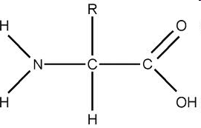
Deamination: removal of amino group from amino acids
Oxygen is required, and along with ammonia, hydrogen peroxide is produced.
Ammonia is highly toxic and very soluble, so as soon as the ammonia is made, it enters the next stage of the process.

Slide 18
keto acids
Respired
Lipids and cholesterol

Slide 19
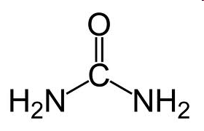
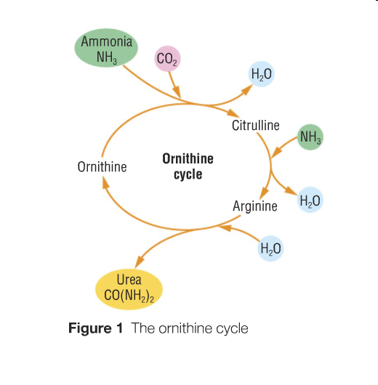
Ornithine Cycle Produces Urea from ammonia
Urea is soluble and can be excreted from the body in the form of urine.
The first stages occur in the mitochondria, the second half of the cycle occurs in the cytoplasm.

Slide 20
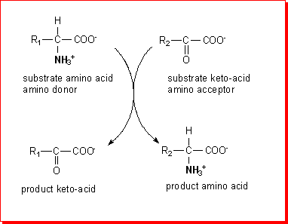
Transamination – transferring an amino group from one molecule to another.
Transaminase is the catalyst

Slide 21
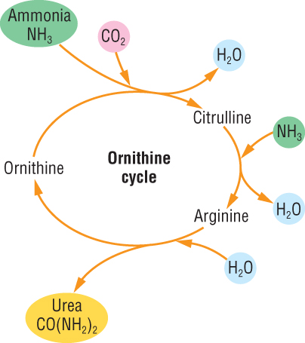
The ornithine cycle: You need to be able to outline the stages
Remember when you synthesise a new molecule you produce water (condensation reaction)
When you break a molecule you add water (hydrolysis reaction)
Task: Look, cover, write, check
Notes:
21

Slide 22
Task: Look, cover, write, check

Slide 23
Task: Look, cover, write, check
Notes:
23

Slide 24
PPQ

Slide 25
Markscheme

Slide 26
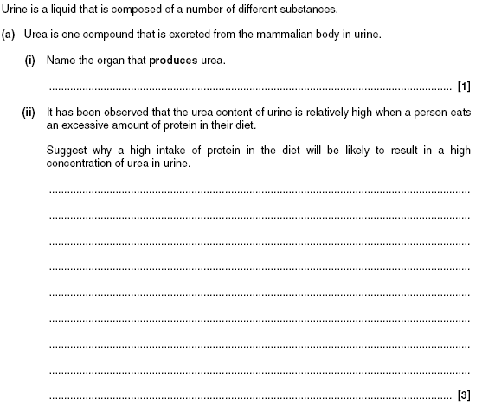

Slide 27
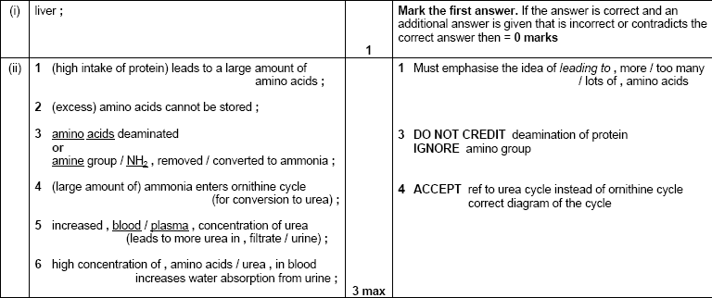
Markscheme

Slide 28
Revision Prompt: Test yourself
Define the term excretion
What are the main 2 substances to be excreted by humans?
Define the term deamination.
What can excess carbon dioxide in the blood cause?
Write down the chemical equation for formation of urea from ammonia?
What is the scientific name for a liver cell.
Name the 2 blood supplies to the liver
What is the function of the Kupfer cell
Name the enzyme that initially breaks down alcohol in the liver
What happens to the acetly co enzyme A that has been produced by the break down of ethanol in the liver?

