Slide 1
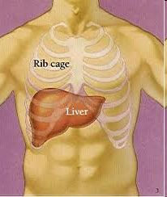
Structure of the Liver
Page 26-27 (P38 – 41 of old book)
Success Criteria
Describe the histology and gross structure of the liver
Task: Complete Worksheet

Slide 2
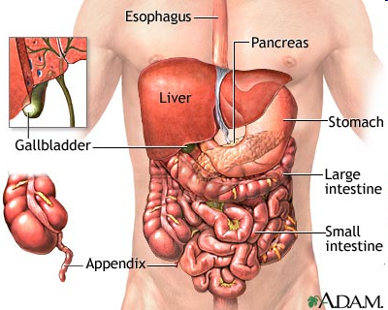

Slide 3
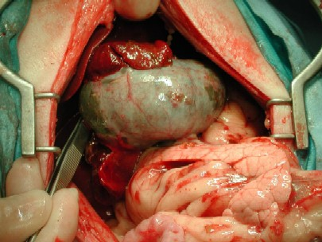
Liver
Gallbladder
Pancreas

