Slide 1
Microorganisms & Food
Module 6.4
Cloning & Biotechnology

Slide 2
Learning Objectives
Understand the use of microorganisms in biotechnological processes.

Slide 3
Success Criteria
Describe the use of microorganisms in the production of dairy products, alcohol and mycoprotein.
State the advantages and disadvantages of using microorganisms to produce food products such as mycoprotein.

Slide 4
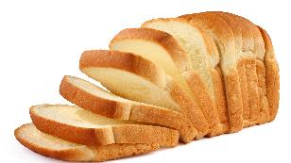
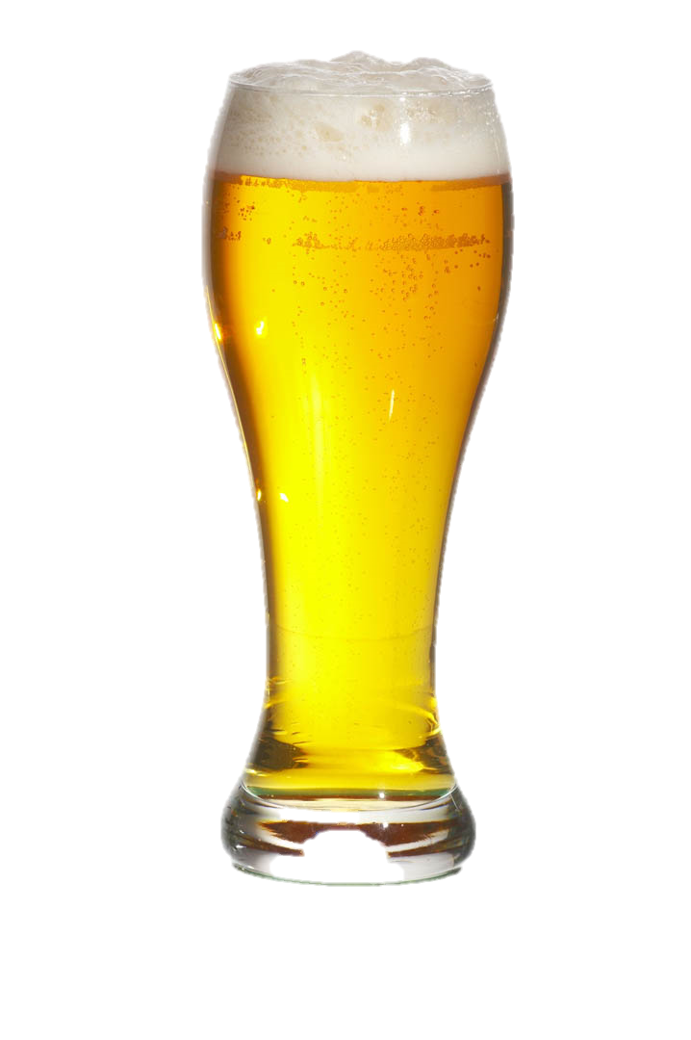
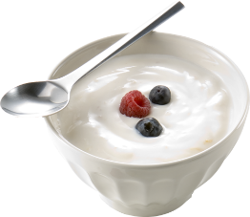
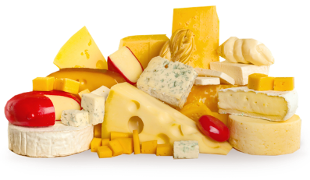
Starter
What foods do you think are made using biotechnological processes?
Most food production incorporates some form of biotechnology, so you should be able to come up with some ideas!

Slide 5
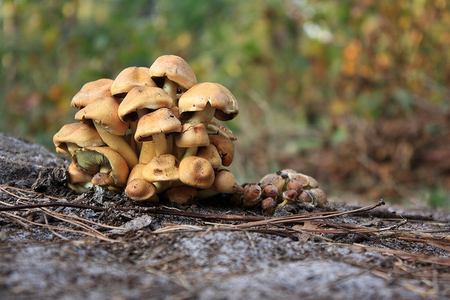
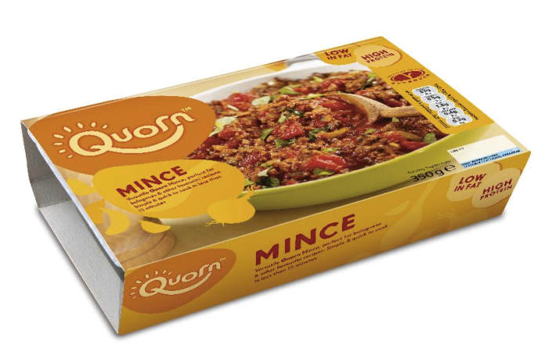
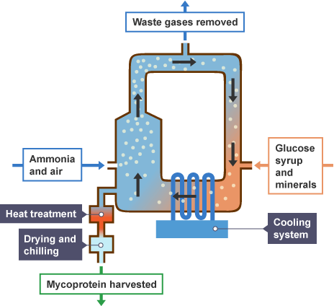
Food Example: Mycoprotein
The fungus Fusarium is cultured.
The fungal mycelium is separated and processed as food.
The fungus can be cultured on a large scale using a fermenter.
The mycoprotein produced is high in protein and fibre, but is also low in fat and contains no cholesterol.

Slide 6
Task
Read the paragraph on single-cell protein (SCP) on page 252.
Answer the following questions after reading the section:
Which fungal species is used to produce mycoprotein/SCP.
What is mycoprotein marketed as?
How is mycoprotein beneficial to health?
What is one of the biggest benefits of using microorganisms to produce mycoprotein?

Slide 7
Advantages/Disadvantages of SCP
Protein production is much faster than in animals.
High protein content (up to 85%)
Production rate can be altered.
No animal fat or cholesterol.
Microorganism can easily be genetically engineered.
SCP production could be combined with waste removal.
Seasonal variations do not affect production.
Not much land required.
Stigma against food produced using waste.
Isolation of the protein can be difficult.
The protein has to be purified to ensure it is decontaminated.
Amino acid profile may be different to animal protein.
Pathogenic organisms also thrive in the same conditions.

Slide 8
Advantages of using Microorganisms
Microorganisms are cheap and easy to grow.
Low fuel/running costs.
Process requires low atmospheric pressures.
Microorganisms can be fed waste products of other processes.
Short life cycles.
Can be genetically modified easily.
Fewer ethical considerations.
Product is easy to harvest.

Slide 9
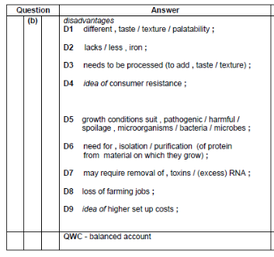
Plenary
Do the exam question on Microorganisms and Food.

Slide 10
Learning Objectives
Understand the use of microorganisms in biotechnological processes.

Slide 11
Success Criteria
Describe the use of microorganisms in the production of dairy products, alcohol and mycoprotein.
State the advantages and disadvantages of using microorganisms to produce food products such as mycoprotein.

