Slide 1
Block 1B – Cell division, cell diversity and cellular organisation 2.1.6
Foundations in Biology
Mitosis PAG 1.1

Slide 2
spec

Slide 3
Mitosis and Cell Cycle
Learning Objectives
Success Criteria
- Collection and presentation of data:
• Produce a root tip squash;
• Use a light microscope to produce annotated drawings of the stages of mitosis.
Review mitosis and the cell cycle
Carry out a qualitative Practical Assessment Practice

Slide 4
INTERPHASE
Period of cell growth; cell prepares cell for cell division (mitosis); genetic material (DNA) is copied and checked for errors – prevents mutations being passed on
No apparent activity
New organelles and proteins are made
Divided into three phases (G1, S, and G2 phase)
G1
S phase
CELL
CYCLE
G2
MITOSIS (M)
Process by which a nucleus divides into two – each with an identical set of chromosomes – the nuclei are genetically identical
Four phases – prophase, metaphase, anaphase, and telophase
Followed by cytokinesis – division of the cell into two genetically identical daughter cells
Mitosis (M)
Two daughter cells – genetically identical

Slide 5
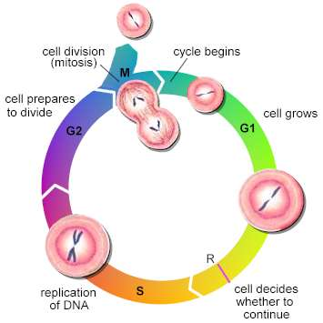
The life cycle of a cell
Interphase can be divided into 3 phases (ITS NOT RESTING!)
G1 – cell growth, duplication of organelles
S – DNA replication and chromosome duplication
G2 – cell growth and preparation for mitosis

Slide 6
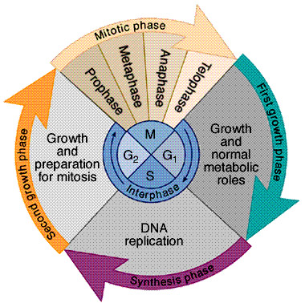
The Cell Cycle
Cytokinesis – cell divides into two
DNA content = 20
G2 - Second growth phase - short
Short gap before mitosis (cell division)
Cell continues to increase in size, energy stores increased.
Cytoskeleton of cell breaks down and the protein microtubule components begin to reassemble into spindle fibres – required for cell division. DNA checked for errors.
DNA content = 40
G1 - First growth phase – longest phase
Protein synthesis – cell “grows”
Organelles replicate
Volume of cytoplasm increases
Cell differentiation (switching on or off of genes)
Length depends on internal and external factors
If cell is not going to divide again it remains in this phase
DNA content = 20 (arbitary)
S - Replication phase DNA replication – this must occur if mitosis is to take place
The cell enters this phase only if cell division is to follow
DNA content = 40
G1 + S + G2 = INTERPHASE
No apparent observable activity

Slide 7
Interphase – S phase
Before mitosis can occur 2 copies of each chromosome are needed.
During interphase the chromosomes which initially consist of a single DNA molecule are duplicated.
The new chromosome is made of two identical structures called chromatids
Each chromatids contains one DNA molecule
Chromatids are held together by a region called the ‘centromere’
DNA is made up of a series of genes

Slide 8
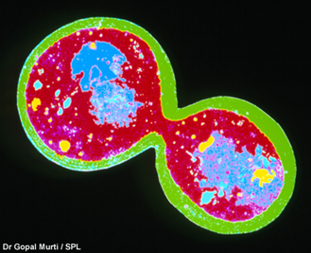
Mitosis
During mitosis, the cell’s DNA is copied into each of the two daughter cells. In multicellular organisms, mitosis provides new cells for growth and tissue repair.
In eukaryotes, it can also be a form of asexual reproduction. This most commonly occurs in single-celled organisms, such as yeast.
Can be split into four stages:
Prophase
Metaphase
Anaphase
Telophase.
Mitosis animation

Slide 9
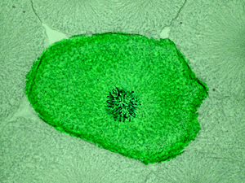
Prophase
The chromosomes shorten and thicken by coiling (supercoiling)
The nuclear membrane breaks down at the end of prophase
The other structures important for mitosis are also forming (i.e. the centrioles or microtubule organising centre MTOC).
Microtubules grow from the MTOC at the poles of the cell to the chromosomes. They form a spindle shape. (Mitotic spindle)

Slide 10
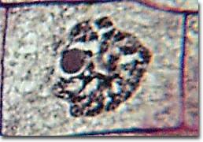
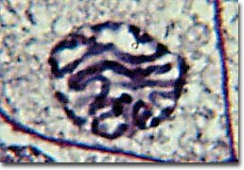
Prophase
(late)
Prophase
(early)

Slide 11
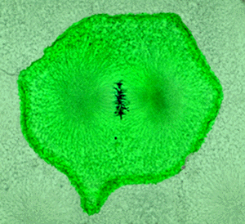
Metaphase
The chromosomes are lined up along the cell's equator .
Spindle microtubules from each pole are attached to each centromere on opposite sides.

Slide 12
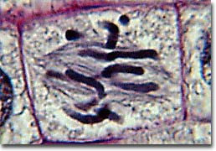
Metaphase

Slide 13
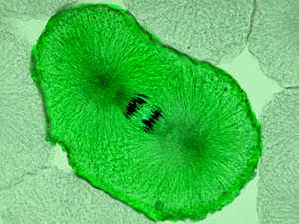
Anaphase
The centromeres divide and the sister chromatids have become chromosomes.
The chromosomes are pulled along the microtubules toward opposite poles of the cell.

Slide 14
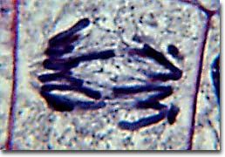
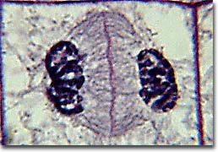
Anaphase
(late)
Anaphase
(early)

Slide 15
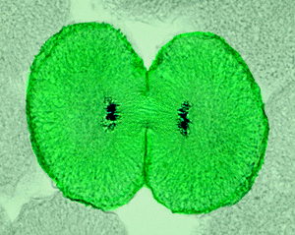
Telophase
The chromosome have migrated to the poles.
The nuclear membrane reforms.
The mitotic structures breakdown.
The chromosomes uncoil.

Slide 16
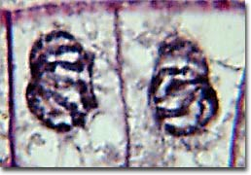
Telophase

Slide 17
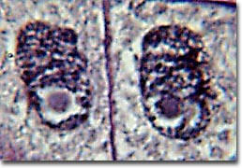
Cytokinesis
The plasma membrane of the cell pinches down along the equator creating two separate cells. At this time, the chromosomes become indistinct (as they are during Interphase).

Slide 18
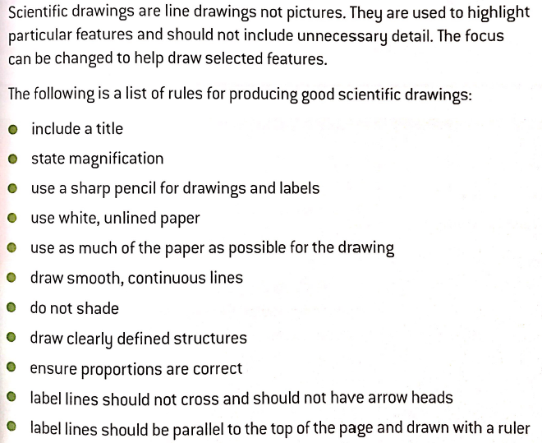
Examining cells under the microscope
Task - Demonstrate use of a light microscope - PAG1

Slide 19
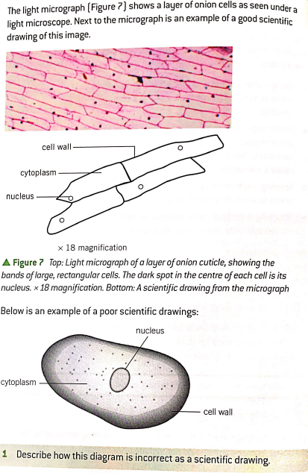
Just before you draw: Check your understanding.
Shading present
Label lines not touching correct place (cell wall)
Label lines not parallel with top of page
No magnification given

Slide 20
PAG 1.1
Place the slide showing the stages of mitosis on the microscope stage.
Without putting your eye to microscope but looking at the slide itself, twist the focusing dial until the microscope stage is up as far as it will go or just touching the slide.
Then use the coarse focusing dial to focus DOWN until you can clearly see the cells in the field of view.
Make sure the cells are in the centre of the field of view (the circle of light you can see when looking down the microscope).
Rotate to the medium power lens and again focus until you can see the cells and the chromosomes in them clearly.
Then rotate to the high power lens and use the fine focusing dial only to bring the chromosomes into distinct view.
Take time to look carefully and identify each stage of mitosis that can be seen.
Make scientific annotated drawings of the stages of mitosis that you have seen and identified. It should be possible from your drawings to know which stage has been drawn.(take note of drawing skills required)
Label your drawing with the magnification used

Slide 21
Part 2 – Measuring 3 chromosomes
A slide is set up at the front of the class room your teacher will assist you when calibrating and using the graticule to measure at least 3 chromosomes.
Make sure these measurements are recorded in your PAG book
Part 3 – Complete extension questions for homework
Stick the practical sheet in your books

Slide 22
Calibration - Using Stage Micrometer
1) Place a stage graticule on the stage
2) The ruler is 1mm long and split into 100 divisions
Each division = 10µm (0.01mm)
1µm is equal to 1 millionth of a metre
Notes:
The mitosis PAG1 sheet in the folder explains this well – they could use the relevant page and measure something on prepared slides, or make cheek cell/onion cell/leaf peel slides.

Slide 23
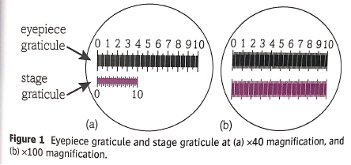
Calibration - Using Stage Micrometer
3) Align the eyepiece graticule with the stage micrometer
4) Find the value of one eyepiece division
In (a) where mag = x40,
The stage graticule is equal to 40 eyepiece divisions.
Each eyepiece division =
1000μm/40 = 25μm
In (b) where mag = x100
The stage graticule is equal to 100 epd
Each epd = 1000μm/100 = 10μm
Remember the stage graticule is 1mm or 1000μm)
Total magnification = mag of eyepiece x mag of objective lens
Notes:
Total magnification = mag of eyepiece x mag of objective lens

