Slide 1
Module 4
Responding to the Environment

Slide 2
Glossary
Tropism
Directional growth response, in response to an external stimuli
Learned behaviour
Response that changes or adapts with experience

Slide 3
Plants need to respond to their environment
Avoid Predation
Thigmonastic response of sensitive plant (close leaves)
Abiotic Stress
Phototropism: grow towards light (photosynthesis)
Geotropism: grow with gravity (gain water and minerals)

Slide 4
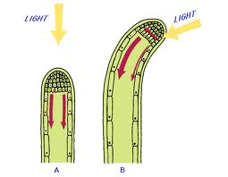
How plants respond to environmental changes: phototropism
Auxins diffuse down shoot tips
Auxins only move down shaded side
Auxins cause cell elongation
Plant bends towards the light

Slide 5
Evaluate experimental evidence
Role of Auxin in apical dominance
Growth of apical tip inhibits growth at lateral buds
When apical bud is removed lateral buds grow
Experiments:
When apical bud is removed auxin levels drop
When apical bud removed and auxin paste applied, lateral buds don’t grow
Evaluation: is it exposure to oxygen causing a hormonal response
Ring of auxin inhibitor applied below apical bud: lateral but grew
Direct causal link disproved when auxin was found to increase in lateral buds and 2 other hormones thought to be involved

Slide 6
Evaluate experimental evidence
Role of Gibberellin in control of stem elongation
Foolish seeding disease in Japan is a fungus that makes plants grow tall: caused by gibberellins
Evaluation just because gibberellins can cause stem elongation, is this how it happens in nature?
Experiments
Compared gibberellin concentrations in dwarf and tall pea plants and found tall pea plants to have more
Used plant with a mutation in the gibberellin formation pathway to show gibberellin is directly the cause of stem elongation

Slide 7
Outline the role of hormones in leaf loss in deciduous trees
Cytokinin levels drop and senescence (turning brown and dying) begins
Senescence causes Auxin levels in leaf tip to drop
Cells in abscission (leaf shedding) zone become more sensitive to ethene
Drop in auxin causes increase in ethene production
Ethene causes production of cellulase which breaks down cell walls in abscission zone

Slide 8
Commercial use of plant hormones
Auxins
Promote flowering
Encouraging cuttings to root
Promote growth of seedless fruit
Kill weeds
Gibberellins
Fruit production
Delay senescence in citrus fruit
Improve apple shape
Grow stalk on grape bunches to make bigger grapes
Brewing: speed up barley germination
Sugar production: make stems elongate so more sugar produced
Cytokinins
Delay yellowing of lettuce
Ethene
Speed up ripening of fruits

Slide 9
Why animals respond to their environment
Stay alive
Coordinate muscles to run away
Control of balance, posture
Temperature control

Slide 10
Organisation of Nervous System
Central
Brain and spinal ocrd
Grey (non myelinated) and white (myelinated) matter
Peripheral
Neurones that carry impulses in and out of CNS
Sensory neurones carry impulses from receptors to CNS
Motor neurones carry impulses from CNS to effectors
Somatic: voluntary (conscious) control
Autonomic: not under voluntary control e.g. to heart, gut

Slide 11
Autonomic Nervous System
Non-myelinated neurones
Connect to the effectors with at least two neurones (which join at a ganglion)
Two Types antagonistic to each other
Sympathetic
Most active in times of stress
Neurotransmitter is noradrenaline
Pre ganglionic neurones are very short as ganglion is near the CNS
Parasympatheric
Most active in sleep and relaxation
Neurotransmitter is acetyl choline
Pre ganglionic neurones are longer as ganglion is within target tissue

Slide 12
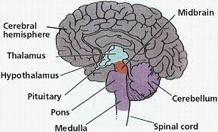
Gross Structure of the Brain

Slide 13
Functions
Cerebrum
Largest part, 2 hemispheres connected by corpus callosum, controls higher brain functions
Conscious thought & emotions
Override some reflexes
Reasoning and judgement
Cerebellum
Coordinates motor responses
Processes sensory information from eye, ear, spindle fibres & joints
Medulla oblongata
Controls non-skeletal muscles (e.g. heart and lung)
Controls autonomic nervous system
Hypothalamus
Controls homeostatic mechanisms e.g. Osmoregulation
Regulates pituitary gland (so controls endocrine function)

Slide 14
Role of brain and nervous system
Coordination of muscle movement
Conscious thought to move in cerebrum
‘auto pilot’ movement from cerebellum
Sends impulses to motor areas

Slide 15
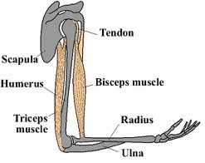
Coordinated movement
Requires action of skeletal movement about joints
E.g. Elbow joint
Biceps and triceps work antagonistically to move forearm at the elbow
Synovial joint
synovial fluid lubricates

Slide 16
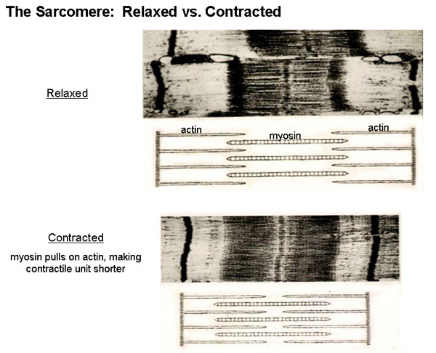
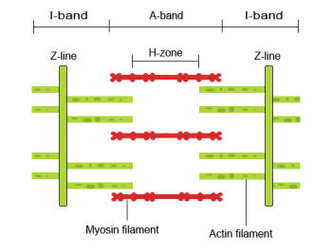
Sliding Filament Model of Muscle Contraction

Slide 17
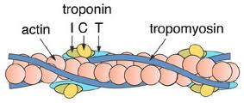
Sliding Filament Model of Muscle Contraction
Two types of protein involved
Thick filament
Bundles of myosin
One tail, two heads
Thin filament
2 strands of actin coiled round each other
Tropomyosin coiled round the actin
Troponin has 3 binding sites: binds to tropomyosin, actin and a free one for calcium ions

Slide 18
Sliding Filament Model of Muscle Contraction
Calcium ions bind to troponin changing its shape so myosin can bind to the actin
Myosin head attaches to actin (forming a cross bridge)
Myosin head bends pulling thin filament along (more overlap)
Uses ATP, so making ADP and inorganic P
Cross bridge broken as ATP binds to myosin head
Head group moves back as ATP is broken down and then forms new crossbridge with actin

Slide 19
Role of ATP in muscle contraction
Energy required to break crossbridge
Supply only sufficient for 1-2 secs contraction
ATP supply maintained by
Aerobic respiration
Anaerobic respiration
Phosphate group from creatnine phosphate used to turn ADP into ATP

Slide 20
Compare & contrast synapses and neuromuscular junctions
Compare | Contrast
Neurotransmitter in vesicles Action potential causes neurotransmitter to be released into cleft Neurotransmitter diffuses across gap and binds to receptors Binding of neurotransmitter results in depolarisation Enzymes degrade neurotransmitter | Synapse | Neuromuscular junction
 | Neurone to neurone Action potential caused in post synaptic neurone Synaptic knob is smooth | Neurone to sarcomere Depolarisation in sarcolemma caused End plate has microvilli

Slide 21
Outline structural and functional differences between voluntary, involuntary and cardiac muscle
Voluntary | Involuntary | Cardiac
Cells form long fibres Contracts and fatigues quickly Under voluntary nervous control Involved in voluntary movements of bones Striated appearance | Short spindle shaped cells Contracts and fatigues slowly Under autonomic nervous control Involved in involuntary movement of tubes e.g gut Un-striated appearance | Cells form branched fibres Contracts quickly and doesn’t fatigue Contraction in myogenic but autonomic controls rate Involved in pumping blood around body Striated appearance

Slide 22
Mammals
Responses to environmental stimuli are coordinated by nervous and endocrine systems

Slide 23
‘Fight or Flight’
Balance between sympathetic and parasympathtic nervous system being changed
Hypothalamus stimulates both nervous system and endocrine system
Nervous system
Activates glands in smooth muscle
Activates adrenal medulla
Releasing both noradrenaline and adrenaline
Endocrine system
Anterior pituitary releases Corticosteroid Releasing Factor
Pituitary gland secretes ACTH
ACTH causes release of many hormones from adrenal cortex

Slide 24
Advantages of Innate behaviour
Innate = response that occurs without learning
Passed on to offspring by reproduction
Rigid
Same behaviour in all of the species

Slide 25
Genetically determined Innate behaviour Examples
Escape reflexes
Avoid predators
Taxes
Directional orientation response
Move away or towards stimulus
Kineses
Rate of movement increases in unfavourable conditions

Slide 26
Learned Behaviour Examples
Habituation
Ignores stimuli when repeated exposure has neither reward or punishment
Imprinting
Young animals associate with another organism, e.g. parent
Classical conditioning
When animal learns to relate a pair of events and responds to the first in anticipation of the second e.g. Pavlov’s dogs
Operant conditioning
Trial and error learning: developing a specific behavioural reaction in response to reward or punishment e.g. Skinner box
Latent learning
Exploring surroundings and retaining information not of immediate use
Insight learning
Highest form of learning
Ability to think or reason to solve problems

Slide 27
Advantage of Social behaviour in Primates
Living in a group
Young learn through observation of and play with other members of the group
Knowledge and protection of food sources shared within the group
Greater ability to detect and deter predators

Slide 28
Links between a range of human behaviours and dopamine receptor DRD 4
Abnormally low levels of dopamine associated with Parkinson’s disease
Treatment by raising dopamine levels linked with schizophrenia and compulsive gambling
Particular variants of DRD4 are more frequently found in ADHD sufferers
Particular variants of DRD4 increase likelihood of addictive behaviours
Research into DRD4 has stimulated research in other areas eg low serotonin levels linked with OCD

