Slide 1
Monosaccharides
Learning objective
To know about monosaccharides
Success Criteria
I can compare alpha and beta glucose molecules
I can describe the ring structure and properties of glucose and ribose
I can compare hexose and pentose sugars
I can explain the formation and breakage of glyosidic bonds

Slide 2
Carbohydrates
Sources in the diet
Sugars e.g. sweets
Starches e.g. bread, potatoes, pasta
Functions
Source of energy
Store of energy
To provide structural support (e.g. cellulose in cell walls)
Notes:
Inform pupils that there are three main groups of carbohydrate:
Monosaccharides, disaccharides and polysaccharides

Slide 3
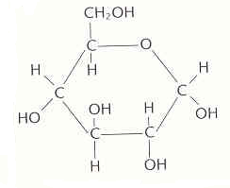
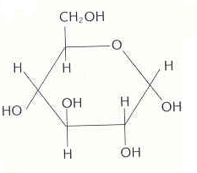
Monosaccharides
Can also be drawn like this…. No ‘C’s written
C₆H₁₂O₆
Alpha-glucose
Notes:
Can anyone name that molecule? Hint: C6H12O6
Have molecule, then animation of C6H12O6, then animation of name, then animation of different view without C molecules

Slide 4
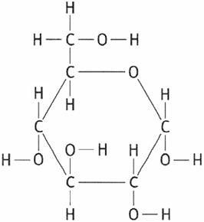
Notes:
Additional diagram of alpha glucose with all bonds shown

Slide 5
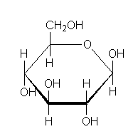
Alpha – below
Beta - above
Beta-glucose
Alpha-glucose
Notes:
How do they differ?
Pnemonic on how to remember which is alpha and which is beta

Slide 6
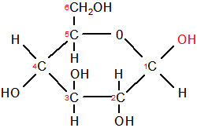
Alpha or Beta?
Notes:
Mini white boards for is it alpha or beta?

Slide 7
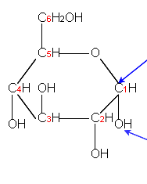
Alpha or Beta?

Slide 8
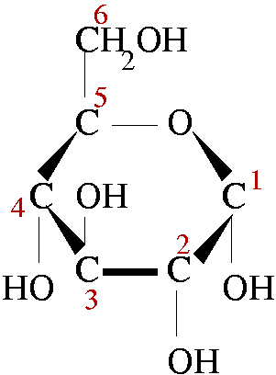
Alpha or Beta?

Slide 9
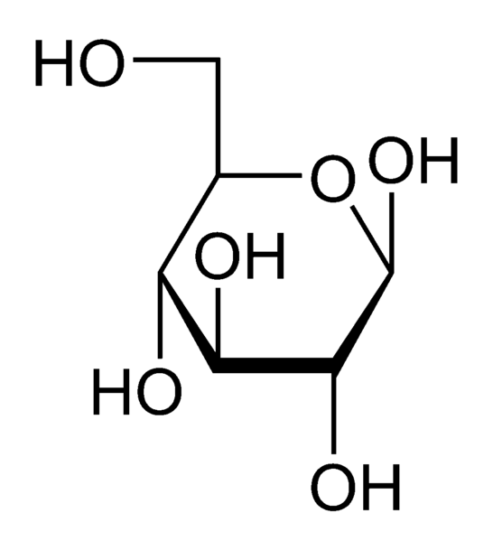
Alpha or Beta?

Slide 10
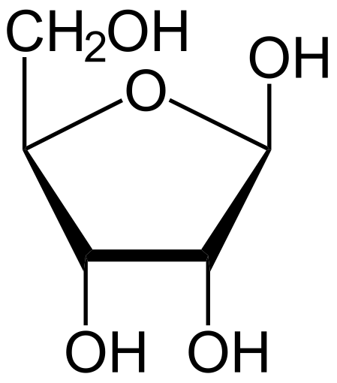
Alpha or Beta?
Neither! It’s ribose – another monosaccharide
Notes:
Animation for box to appear
Here, ask pupils to draw structure of alpha and beta glucose from memory, and hold whiteboards up to check
Get them to circle the difference (for checking)

Slide 11
Describe the difference between a hexose and a pentose sugar (4 marks)
Hexose sugar = 6 carbon atoms
Pentose sugar =
5 carbon atoms
Where have you come across deoxy/ribose before?
Notes:
What are the differences between hexose and pentose sugars? Draw examples of each

Slide 12
Quick Check
Draw alpha and beta glucose, highlighting the difference between the two monosaccharides
Describe the difference between a hexose and a pentose sugar
Draw (and name) an example of a pentose sugar
Notes:
Do if have time

Slide 13
Disaccharides
Two monosaccharides joint together
A glycosidic bond joins them
Examples
α-glucose + α-glucose = maltose
α-glucose + fructose = sucrose
β-galactose + α-glucose = lactose
Notes:
If a monosaccharide is one sugar molecule, what do you think a disaccharide Is?
Talk about condensation
Have examples first and use questioning to point out where the monos are.

Slide 14
Q: What kind of reaction involves the breaking of bonds and production of water?

Slide 15
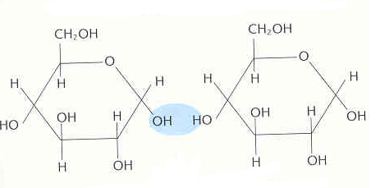
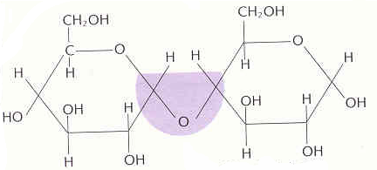
Making a disaccharide
When two monosaccharides join, a reaction occurs forming a glycosidic bond in a condensation reaction
Glucose
Glucose
Condensation
Maltose
H₂O (water)
Glycosidic bond
Notes:
Is this an alpha or beta glucose?
What would we need to break this glycosidic bond?
Chalk and talk this
Condensation windows link

Slide 16
Breaking down a disaccharide
Disaccharides are broken into monosaccharides by a hydrolysis reaction, which requires the addition of water
How could this be broken down into 2 alpha glucose molecules?
Hydrolysis
H₂O (water)
Notes:
ADD ANIMATIONS
Lots of words so maybe simplify it and chalk and talk
Hydrolysis reactions catalysed by enzymes

Slide 17
Homework
What is the difference between monosaccharides and disaccharides? List two examples of each?
What is the difference between a pentose and a hexose sugar?
Draw a ribose molecule, highlighting how this is different from a deoxyribose molecule.
Draw an alpha-glucose and a beta-glucose molecule, highlighting their difference
Describe the formation of maltose. Include structural diagrams in your answer
Describe the breakdown of maltose. Include structural diagrams in your answer
Notes:
Experimental application question to do with the production of water?
In cells,
Think of some form of application questions

Slide 18
Flip Learning
https://www.youtube.com/watch?v=d3u8mWlnN7A

