Slide 1
Nucleotides
Lesson 1

Slide 2
Task: Flip Learning
http://www.youtube.com/watch?v=8kK2zwjRV0M
Watch the video and answer the questions
Notes:
To complete by start of this lesson

Slide 3
Key Term Worksheet IDEAS
This is simply a sheet listing words that students should be able to define and relate to each other when they have studied this module. It can be used in various ways:
Use at the start of the topic for students to assess their initial familiarity or to tick off as work progresses
colour-code or join groups of words judged by students to belong together
categorise the words in a table or mind diagram as molecules, processes, monomers, polymers, organelles, enzymes, bonds, etc.
enclose words related to the same topic or level of organisation within lines of different colours to make a Venn diagram
cut out the words and re-arrange them into groups according to different criteria, eg order of size of molecules or cell structures, order of use of each component in protein synthesis
define the words
use the words to play hangman or a ‘pictionary’ style game
match the words to the syllabus outcomes (a-g)
use at end of topic to write a summary of topic 2.1.3 usi
Notes:
Could also use to assess after flip learning, pick whichever task you want to do

Slide 4
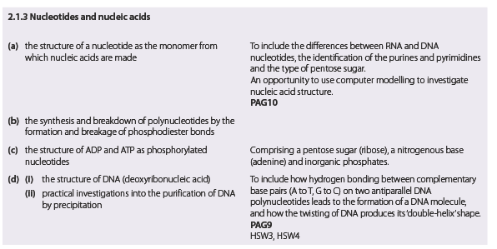

Slide 5
Success Criteria
Learning Objective
Know about nucleotides
Describe the structure of a nucleotide
Explain the synthesis and breakdown of polynucleotides
Compare the structure of ADP and ATP

Slide 6
Which bonds?
Peptide bonds - Proteins
Ester bonds - Lipids
Phosphodiester bonds - nucleic acids
Glycosidic bonds – carbohydrates
All formed by condensation reactions

Slide 7
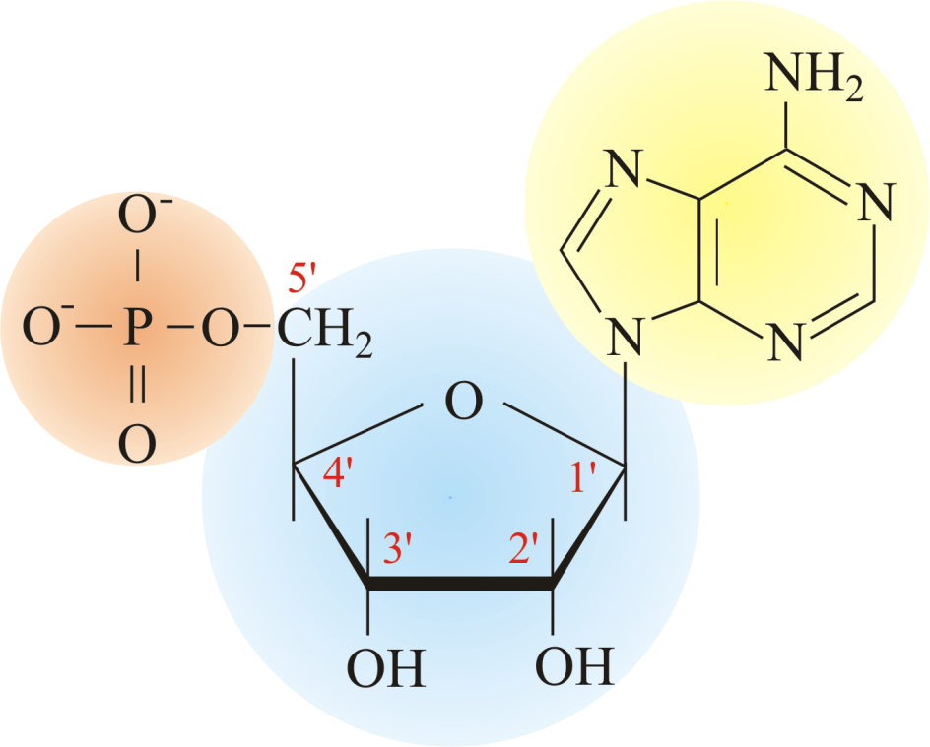
Nucleotides
Describe the structure of a nucleotide
Monomer that makes up
a nucleic acid

Slide 8
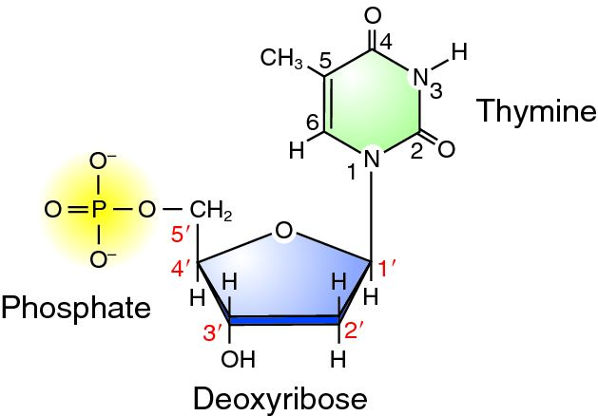
DNA vs RNA nucleotides
Describe the structure of a nucleotide
Task: Compare & Contrast
DNA | RNA
Sugar: deoxyribose | Sugar: ribose
Phosphate group | Phosphate group
Nitrogenous base | Nitrogenous base
Bases: ATCG | Bases: AUCG

Slide 9
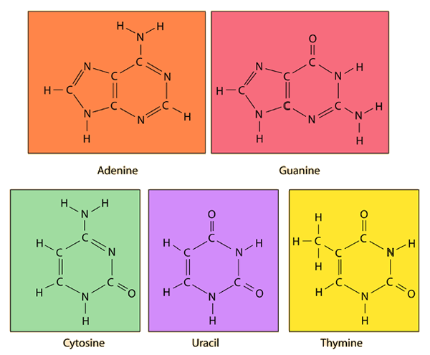
Nitrogenous Bases
Adenine
Thymine
Cytosine
Guanine
Uracil

Slide 10
Pyrimidine & Purine Bases
Describe the structure of a nucleotide
Purine always pairs with a pyrimidine base

Slide 11
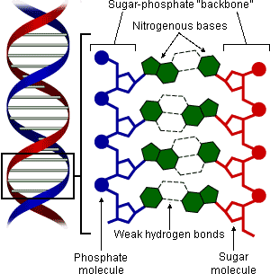
Structure of DNA - Summary
Adenine = Thymine
2 Hydrogen bonds
Cytosine = Guanine
3 Hydrogen bonds
Deoxyribose sugar and phosphate backbone.
Pyrimidines:
Single ring. C and T
Purines:
Double ring. A and G
DNA is a polymer – several repeating units
joined together. It is a polynucleotide.

Slide 12
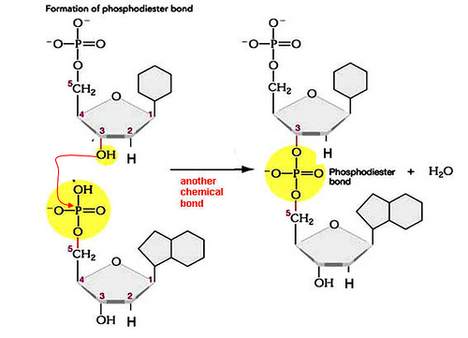

Slide 13
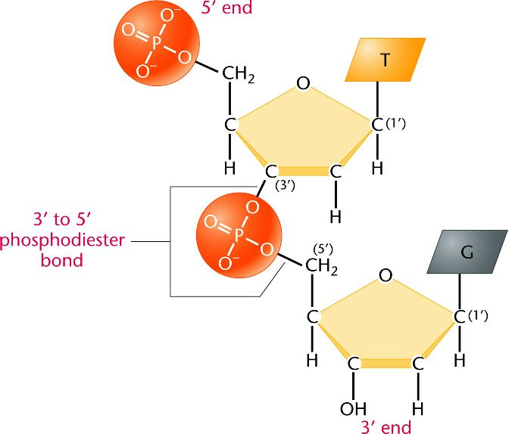
Polynucleotide formation
Phosphate
base
sugar
base
Phosphate
sugar

Slide 14
Phosphodiester Bond
Explain the synthesis and breakdown of polynucleotides
Ester bond forms between the 5th carbon on the pentose sugar and the phosphate group.
This is the same as a normal ester bond but with the P in the phosphate group rather than a C.
A second ester bond forms between the phosphate and the 3rd carbon of the pentose sugar the other side, hence ‘diester’

Slide 15
Formation of a Polynucleotide
Explain the synthesis and breakdown of polynucleotides
Breakage of a polynucleotide is the opposite, with a hydrolysis reaction

Slide 16
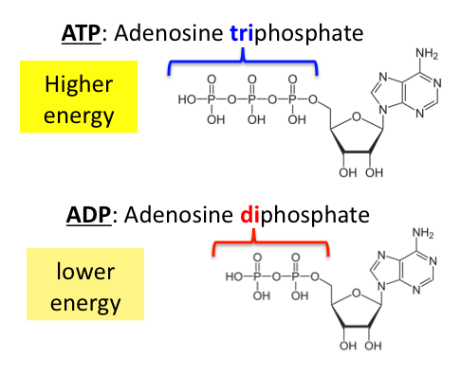
Phosphorylated Nucleotides
Compare the structure of ADP and ATP
The third type of nucleotide. Do not form polynucleotides.

Slide 17
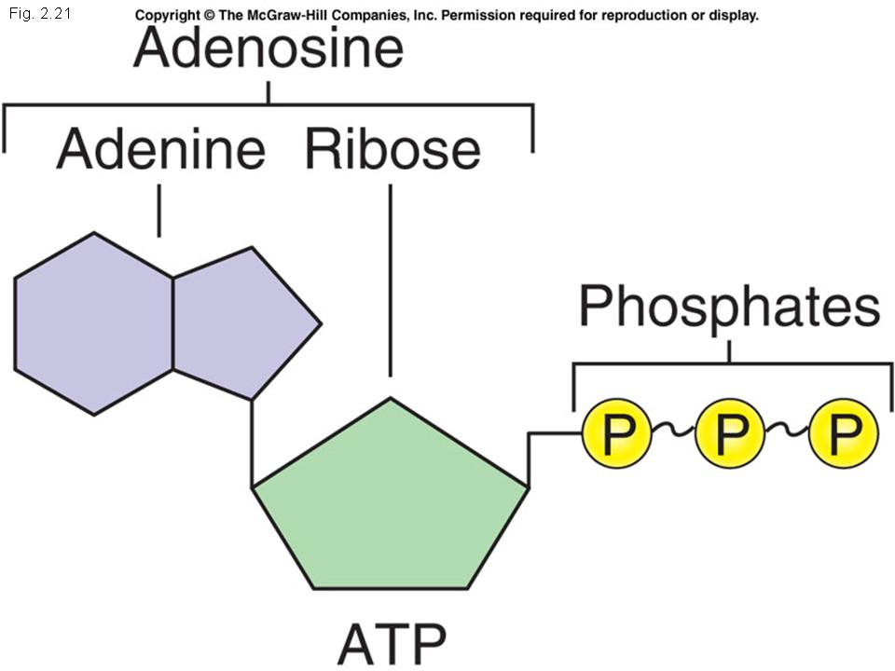
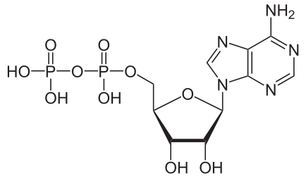
Phosphorylated Nucleotides
Compare the structure of ADP and ATP
ADP ATP
Pentose sugar: ribose
Nitrogenous base: adenine
Inorganic Phosphate

Slide 18
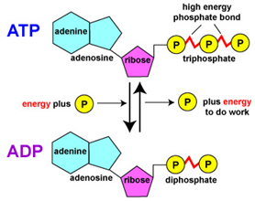
Phosphorylated Nucleotides
Compare the structure of ADP and ATP
& ATP
Breaking off a phosphate group provides small packets of energy
Universal energy currency

Slide 19
Plenary
DNA Quiz Powerpoint

